Slide 1
How to Produce Approval-Ready Applications and Reduce Turnaround Time
Notes:
Welcome! Thanks for attending this presentation that I hope will help you to submit applications that are correctly completed, along with acceptable and correctly printed documentation. As everyone is aware, the turnaround time for reviewing applications is a constant issue, but when applications and documentation are correctly submitted, the turnaround time decreases dramatically. I will be showing you how to help the process move more quickly.

Slide 2
Pathway to Review and Approval
Mail is opened and transmittal is date-stamped.
Finance accounts for checks.
Registrar enters basic application and contact info in database and issue ACN#s.
Genealogy pre-checks, logs in apps, and adds apps/docs to file cabinet to await review. Apps are then reviewed in the order received.
Genealogy reviews applications.
Upon approval, applications are handed over to and processed by the Registrar, issued national numbers, and certificates, etc., are printed. Certificates, record copies (one for the state secretary/one for the member), a welcome letter, etc., are mailed to the state secretary for distribution.

Slide 3
Pre-Check of Applications
When applications arrive in the mail, the Admin Coordinator opens them and looks for the following:
Checks that fees and dues received are for the correct amounts
All signatures are applied
New-member apps must have five signatures
Applicant, state registrar, state secretary, and two sponsors.
Supplemental apps must have two signatures
Member and state registrar
Applications are printed correctly, legal-sized, on back and front of one sheet of watermarked paper, facing the same direction.
Applications that do not comply with the above will be held up or returned to the state secretary and will not be entered in the database until the issues are resolved. They will not appear on the status report until then.

Slide 4
Next Steps
From the Admin Coordinator, applications, along with the documentation, are handed over to Finance, where the funds are accounted for.
From Finance, they go to the Registrar’s office, where apps are entered in the database, date-stamped on the back, and ACN #s are assigned. At this time, attention is once again directed to ensuring needed signatures are there and apps are correctly printed.
From the Registrar, apps are brought to the Genealogy Department. Genealogy is now doing a limited pre-check of apps and certain documents before being placed in the cabinet of apps awaiting review to look for a few issues that can be resolved before they come up for review, for example, to ensure that:
BCs state gender.
DAR applications are correctly printed and complete.
C.A.R. transfers contain Certificate of Good Standing and C.A.R. record copy.
Preliminary check of applications didn’t miss any issues.

Slide 5
Most Common Reasons Applications Are Pended …and how to avoid them.
Missing birth certificate for applicant, or it does not indicate gender. It should also include names of both parents, including mother’s maiden name (particularly if the line goes through her).
Incorrectly printed DAR applications, including ones printed legal-size on standard-size paper.
Incorrect date format in the lineage section . All dates must be entered as follows:
01 Jan 2023
No slashes between numbers, just one space.
Only enter the first three letters of each month.
Never enter dates as 01/01/2023.
Only DAR record copies are considered; chapter copies are not. Record copies are purchased from the DAR website; chapter copies are printed by a DAR chapter registrar, which DAR forbids. Record copies redact the first page that contains members’ contact info, and you will see the words “chapter copy” are part of the footer at the bottom of each page of a chapter copy.
Incorrectly printed DAR record copies. They must be printed in their entirety. Pages cannot be cut off because of printing legal-sized on standard-sized paper and must contain all four pages. [The first page that precedes all DAR record copies should not be submitted.]
Not providing adequate proofs for parent-to-child connections, including resolution of naming conflicts.
Not providing proofs for the patriot’s generation that proves that the patriot was alive at the time of service, was of the right age to have performed the service being claimed, and whose residency aligns with the service claimed.
REMINDER: When an application is pended, all communications to and from the Genealogy
staff must only be with the state point of contact/registrar, not individual chapter
members or individual applicants.
Notes:
Exception to date format: slashes between data if more than one date is proven, such as when neither is from a primary source.

Slide 6
Common Reasons For Application Review Slow-Downs
Superfluous documentation
Lengthy or incorrectly prepared proof arguments.
Lineage data entered but not supported by documentation.
Incorrectly entered (or missing) data on applications, based on the documentation submitted.
Incorrectly printed or unreadable documentation that we must research and reprint. All images/pages must be printed in their entirety and be legible.

Slide 7
Prepare Applications Properly for Review at National
First and foremost, ALWAYS complete an application from the documentation! Advise all applicants not to type an application and then add documents.
Remind everyone completing an application to only include data that is supported by documentation.
When possible, do not ask inexperienced applicants to complete their own applications. You can advise them to use a worksheet to begin their applications. If applications are completed before the chapter or state registrar receives them, check to make sure all data is entered correctly before printing the final copy and obtaining signatures.
Remember, if applications and documentation are completed correctly, reviews at National can be completed in as little as 30 minutes.
Also, bear in mind that submitting a deficient application may result in the loss of fees paid by your applicant. Application fees are non-refundable. Applications that have irresolvable issues may be replaced with another application on an alternate line/patriot. New-member applications are allowed two chances to resolve with replacement applications. Supplemental applications may only be replaced once. After three years in pended status, those applications will be withdrawn. Again, bear in mind that if you submit an application that has not been thoroughly vetted, you are risking your applicant’s fee, which is currently $100.

Slide 8
ENTERING LINEAGE DATA CORRECTLY ON APPLICATIONS
NAMES:
Enter full names when provided by documentation. Do not omit or abbreviate middle names when the full names are proven. Do not include titles, ranks, or professional designations.
Place nicknames in quotation marks, i.e. Mary “Polly” Smith -- do not put nicknames in parentheses.
Use a forward slash to separate different spellings of the same name, i.e. “Mary/Maria Browne/Brown” and “Johann/John Smith/Smythe.” Do not put alternate spellings in parentheses. A slash represents the word “or.”
State a previously married woman’s name as “Mrs. First Middle Maiden (then her) Former Married Surname,” i.e. “Mrs. Mary Ann Smith Jones.” Her name should be stated to reflect her name at the time of her marriage to the husband in that generation. NOTE: Do NOT include a subsequent married surname if the wife remarries AFTER the death of, or divorce from, her husband in the lineage. It may be necessary, however, to prove with documentation that she is the same woman on, for instance, her death certificate that shows her with that subsequent married surname.
DATES:
Dates should be entered as “day month year,” i.e. “08 Sep 2001.” Enter only the first three letters of each month (with no periods). Do not use dashes or slashes. Allow one space between the day and the month and the year. If only a year is known, simply type the year without slashes before it. Note: a slash can be used between two dates or months or years to indicate “or,” such as when two different dates are provided by secondary sources, when no primary source is available. Example: 20 Mar 1922/23.
LOCATIONS:
For state names, enter ONLY the standard two-letter, uppercase abbreviations with no periods; do not spell out state names.
To indicate a county name, use “Co.” after the name of the county or you can follow the format stated on the application form (city/county/state).
If you are only entering a county and state, but no city, enter “/county/state.” Example: /Jefferson/KY
If you are entering a city and state, but no county, that location should be listed as “city/ /state.” Example: Louisville/ /KY
If entering only a state, simply enter the standard two-letter abbreviation in that field (no slashes are needed).NOTE: If both a city (or town) AND a county are stated on documentation, enter BOTH, not just one or the other. Example: Louisville/Jefferson/KY
MISCELLANEOUS TIPS:
Leave all unknown or non-applicable fields completely BLANK.
Do not enter “living” in the death date field for those who are not deceased.
Do not enter “N/A,” “unknown” or “unk” or “??” in any unknown fields.
Do not enter any data in the lineage section within parentheses.
Cite all sources in the Reference Section for each generation. There is no need to explain what proof or connections the documentation provides. Feel free to use abbreviations, such as BC (birth certificate), DC (death certificate), MC (marriage certificate). When referring to an SAR or DAR application for proof, cite the national number AND patriot name.
Proof all applications for accuracy -- compare side-by-side with supporting documentation.
Remember, documentation should be included for all data entered in the lineage section. Do not enter lineage data
that is not supported by documentation.

Slide 9
Examples of Correctly vs Incorrectly Printed Documentation
Download images to computer, then crop, and adjust brightness, etc. Do not use the print command on your web browser to print images.
Census pages (examples follow)
Wills (examples follow) Print wills one page at a time. Note: Transcriptions of wills, etc., must be accompanied by originals.
Indexes (use print command from the website rather than from your web browser).
Full pages of text from books, must include title page that includes publication date.
Tombstone photos must include place of burial (cemetery name and location)
Tombstones must be period-appropriate.

Slide 10
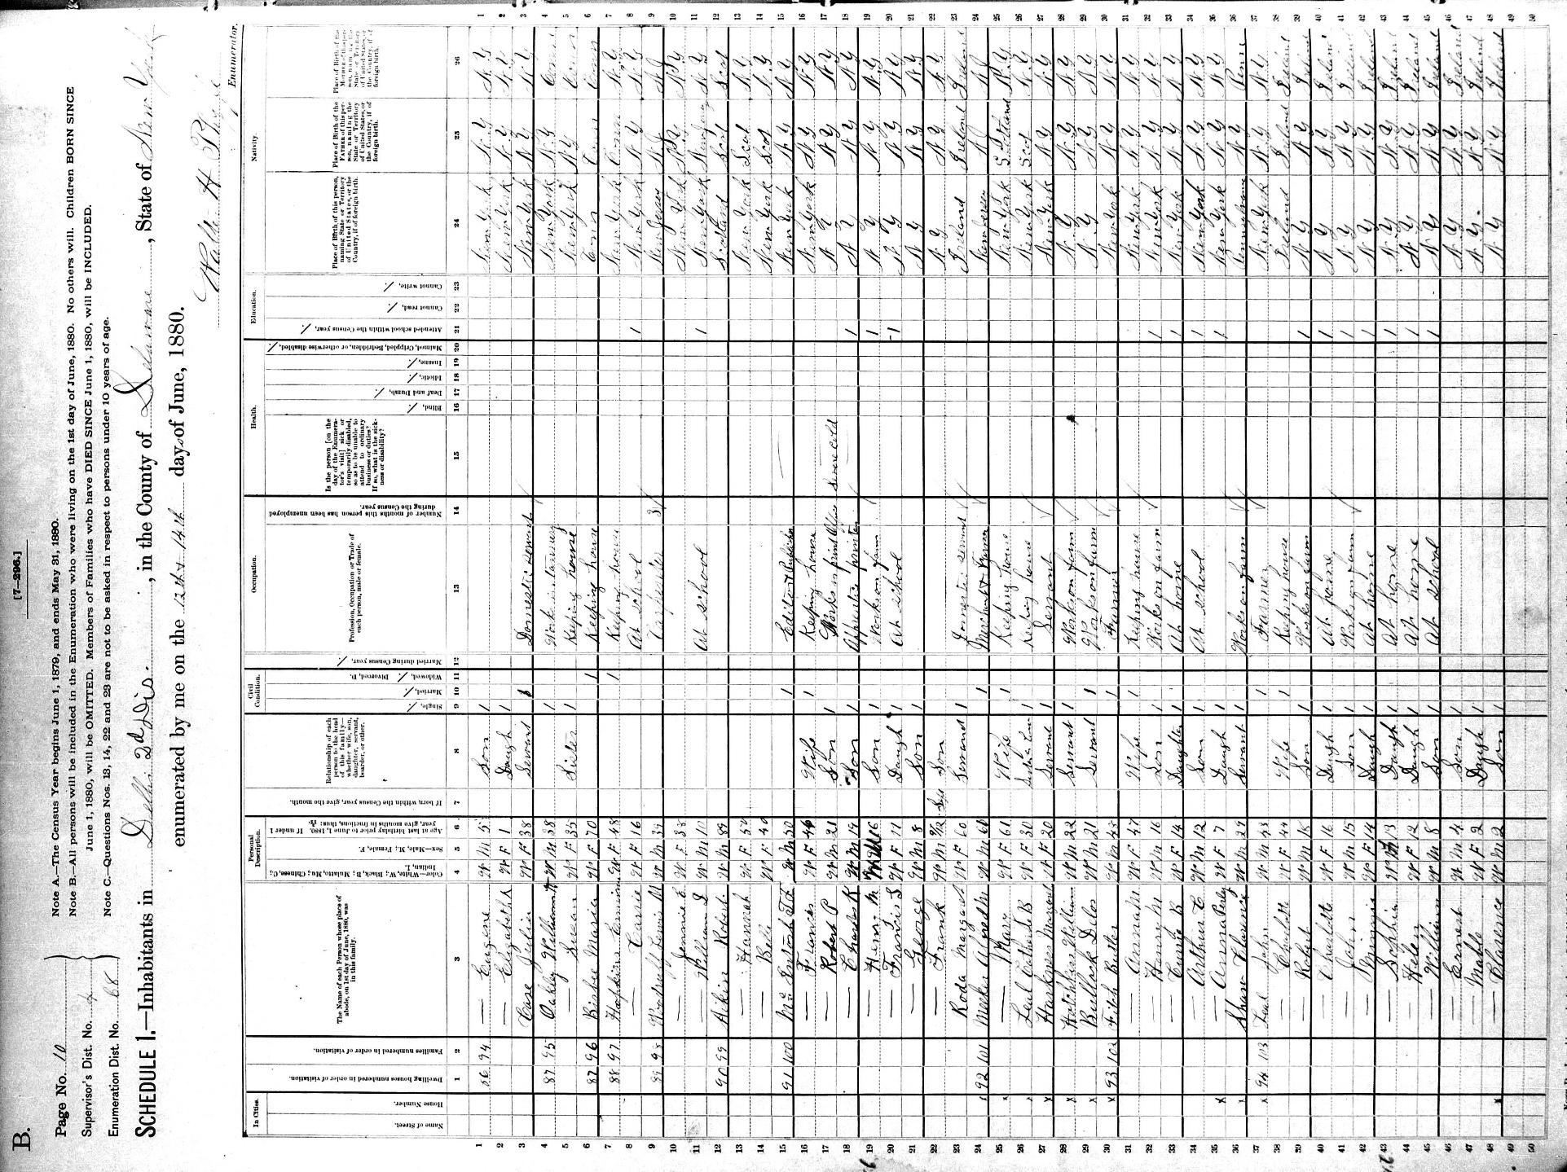
1850 to 1880 Federal Censuses should be printed in portrait orientation.

Slide 11
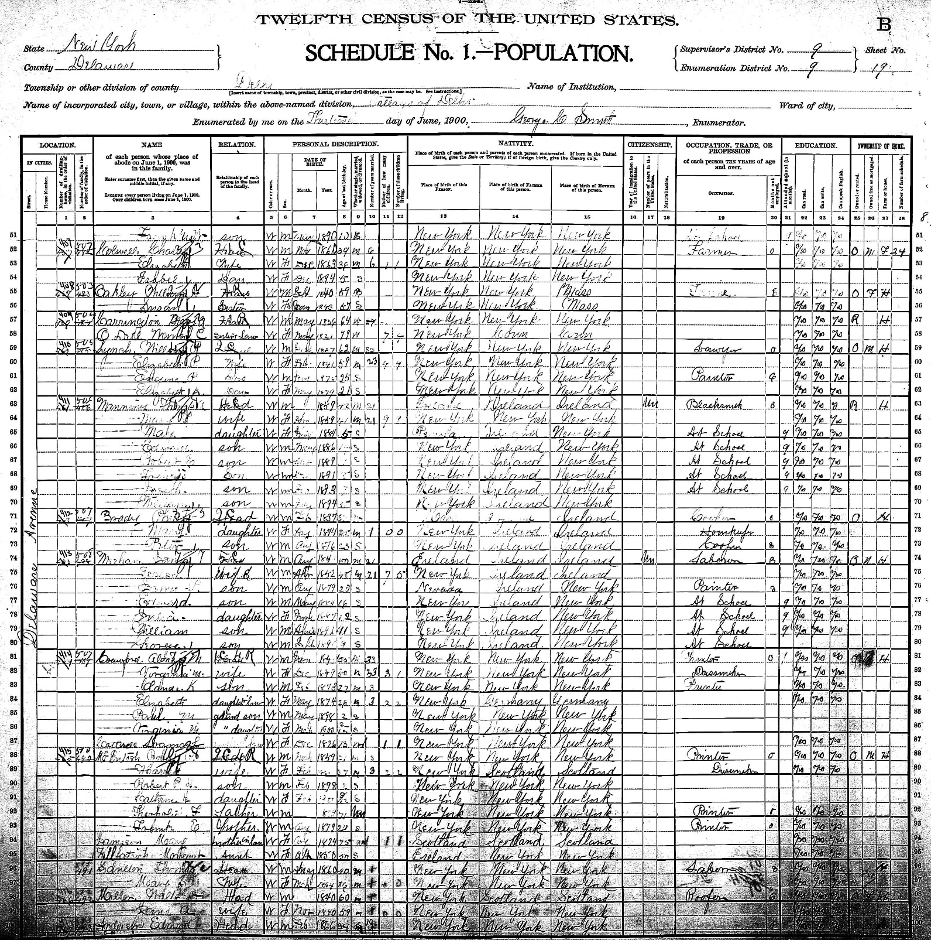
1900 Federal Census is virtually square.

Slide 12
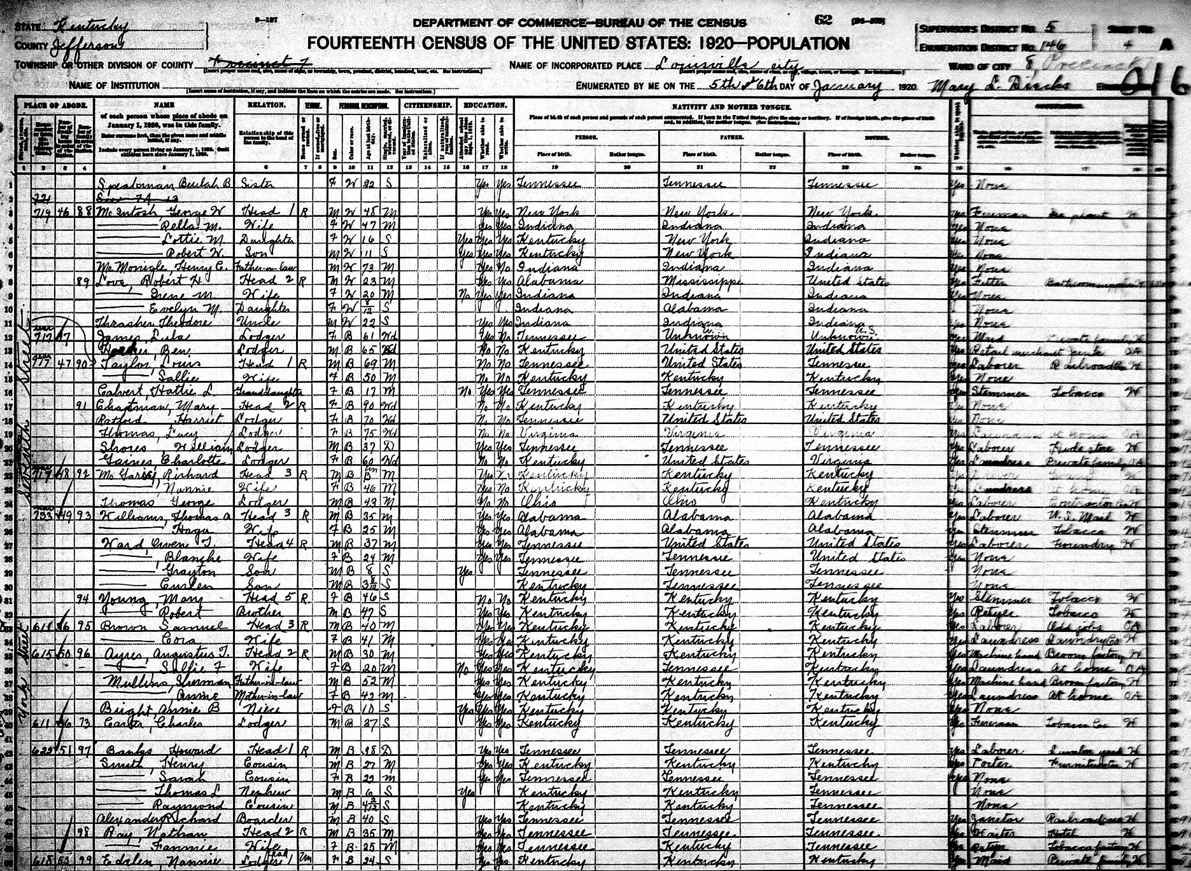
1910 to 1940 censuses should be printed in landscape orientation.

Slide 13
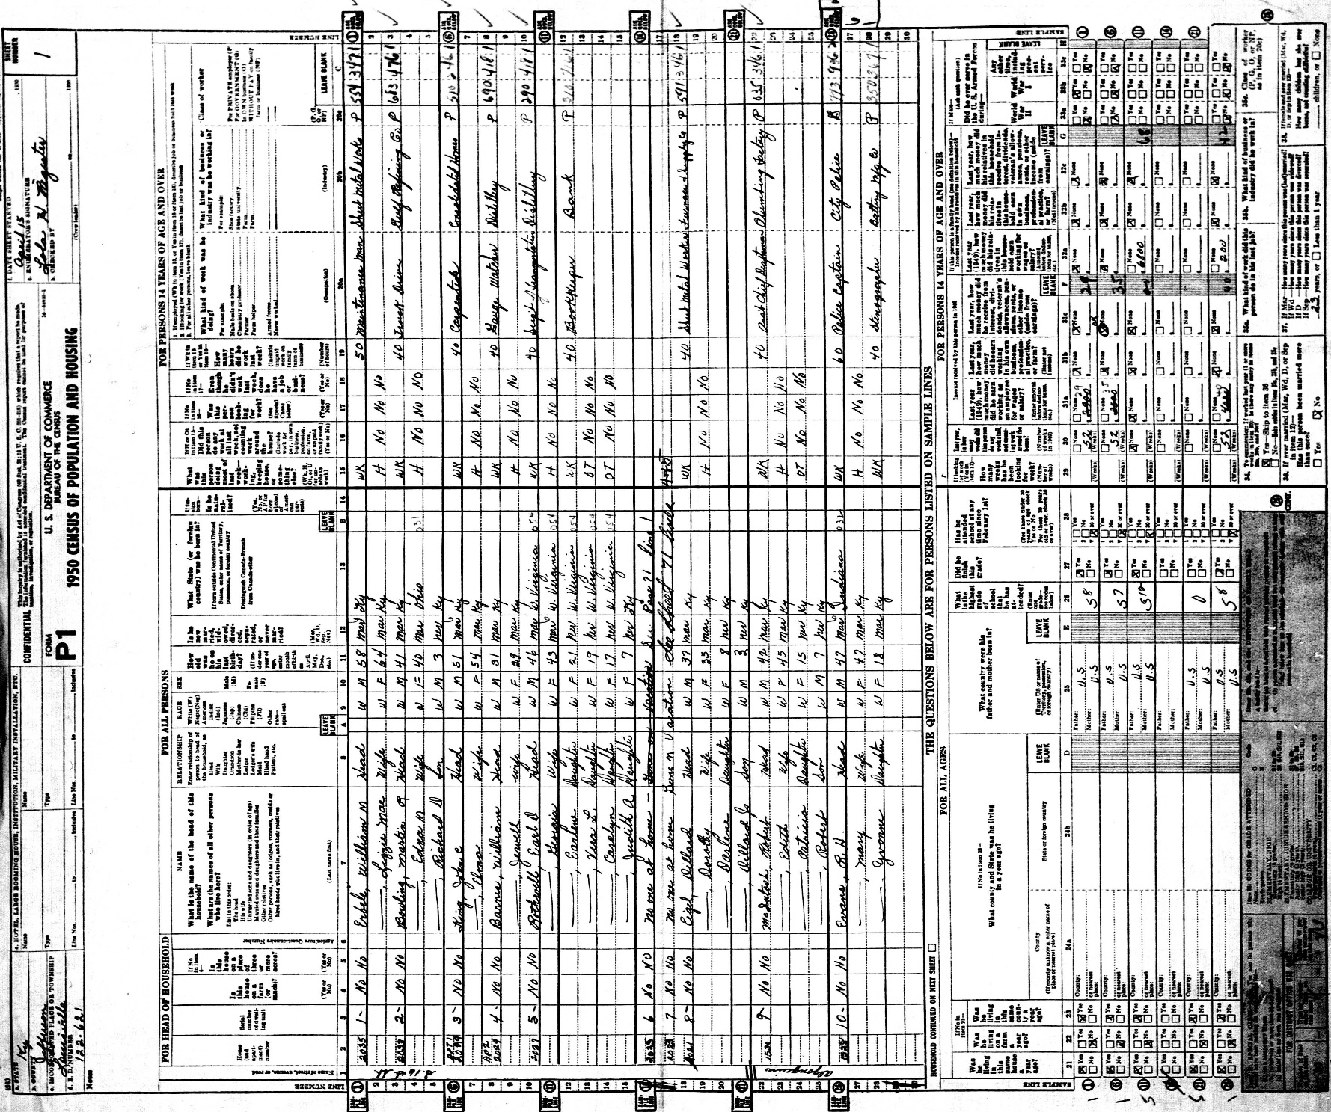
1950 census should be printed in portrait orientation.

Slide 14
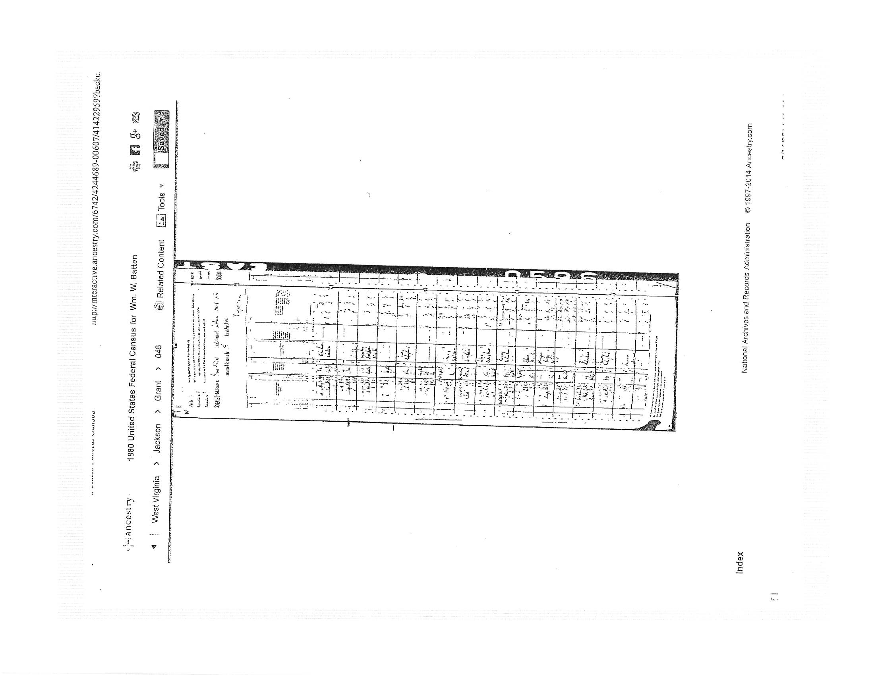

Slide 15
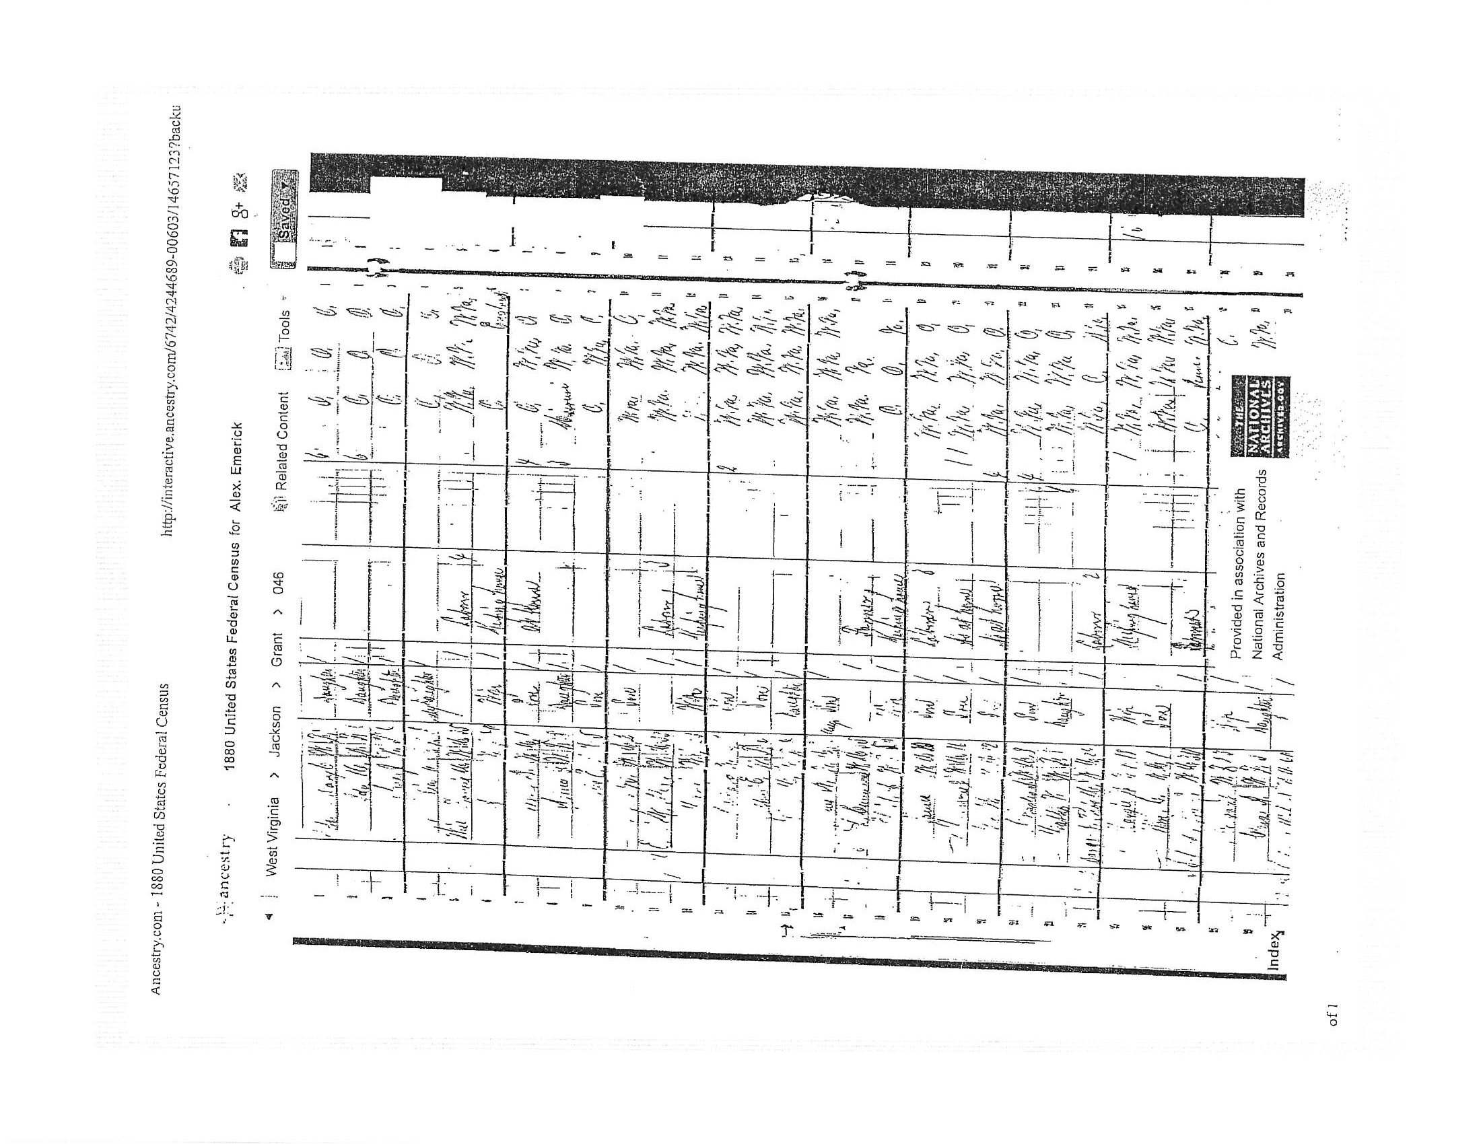

Slide 16
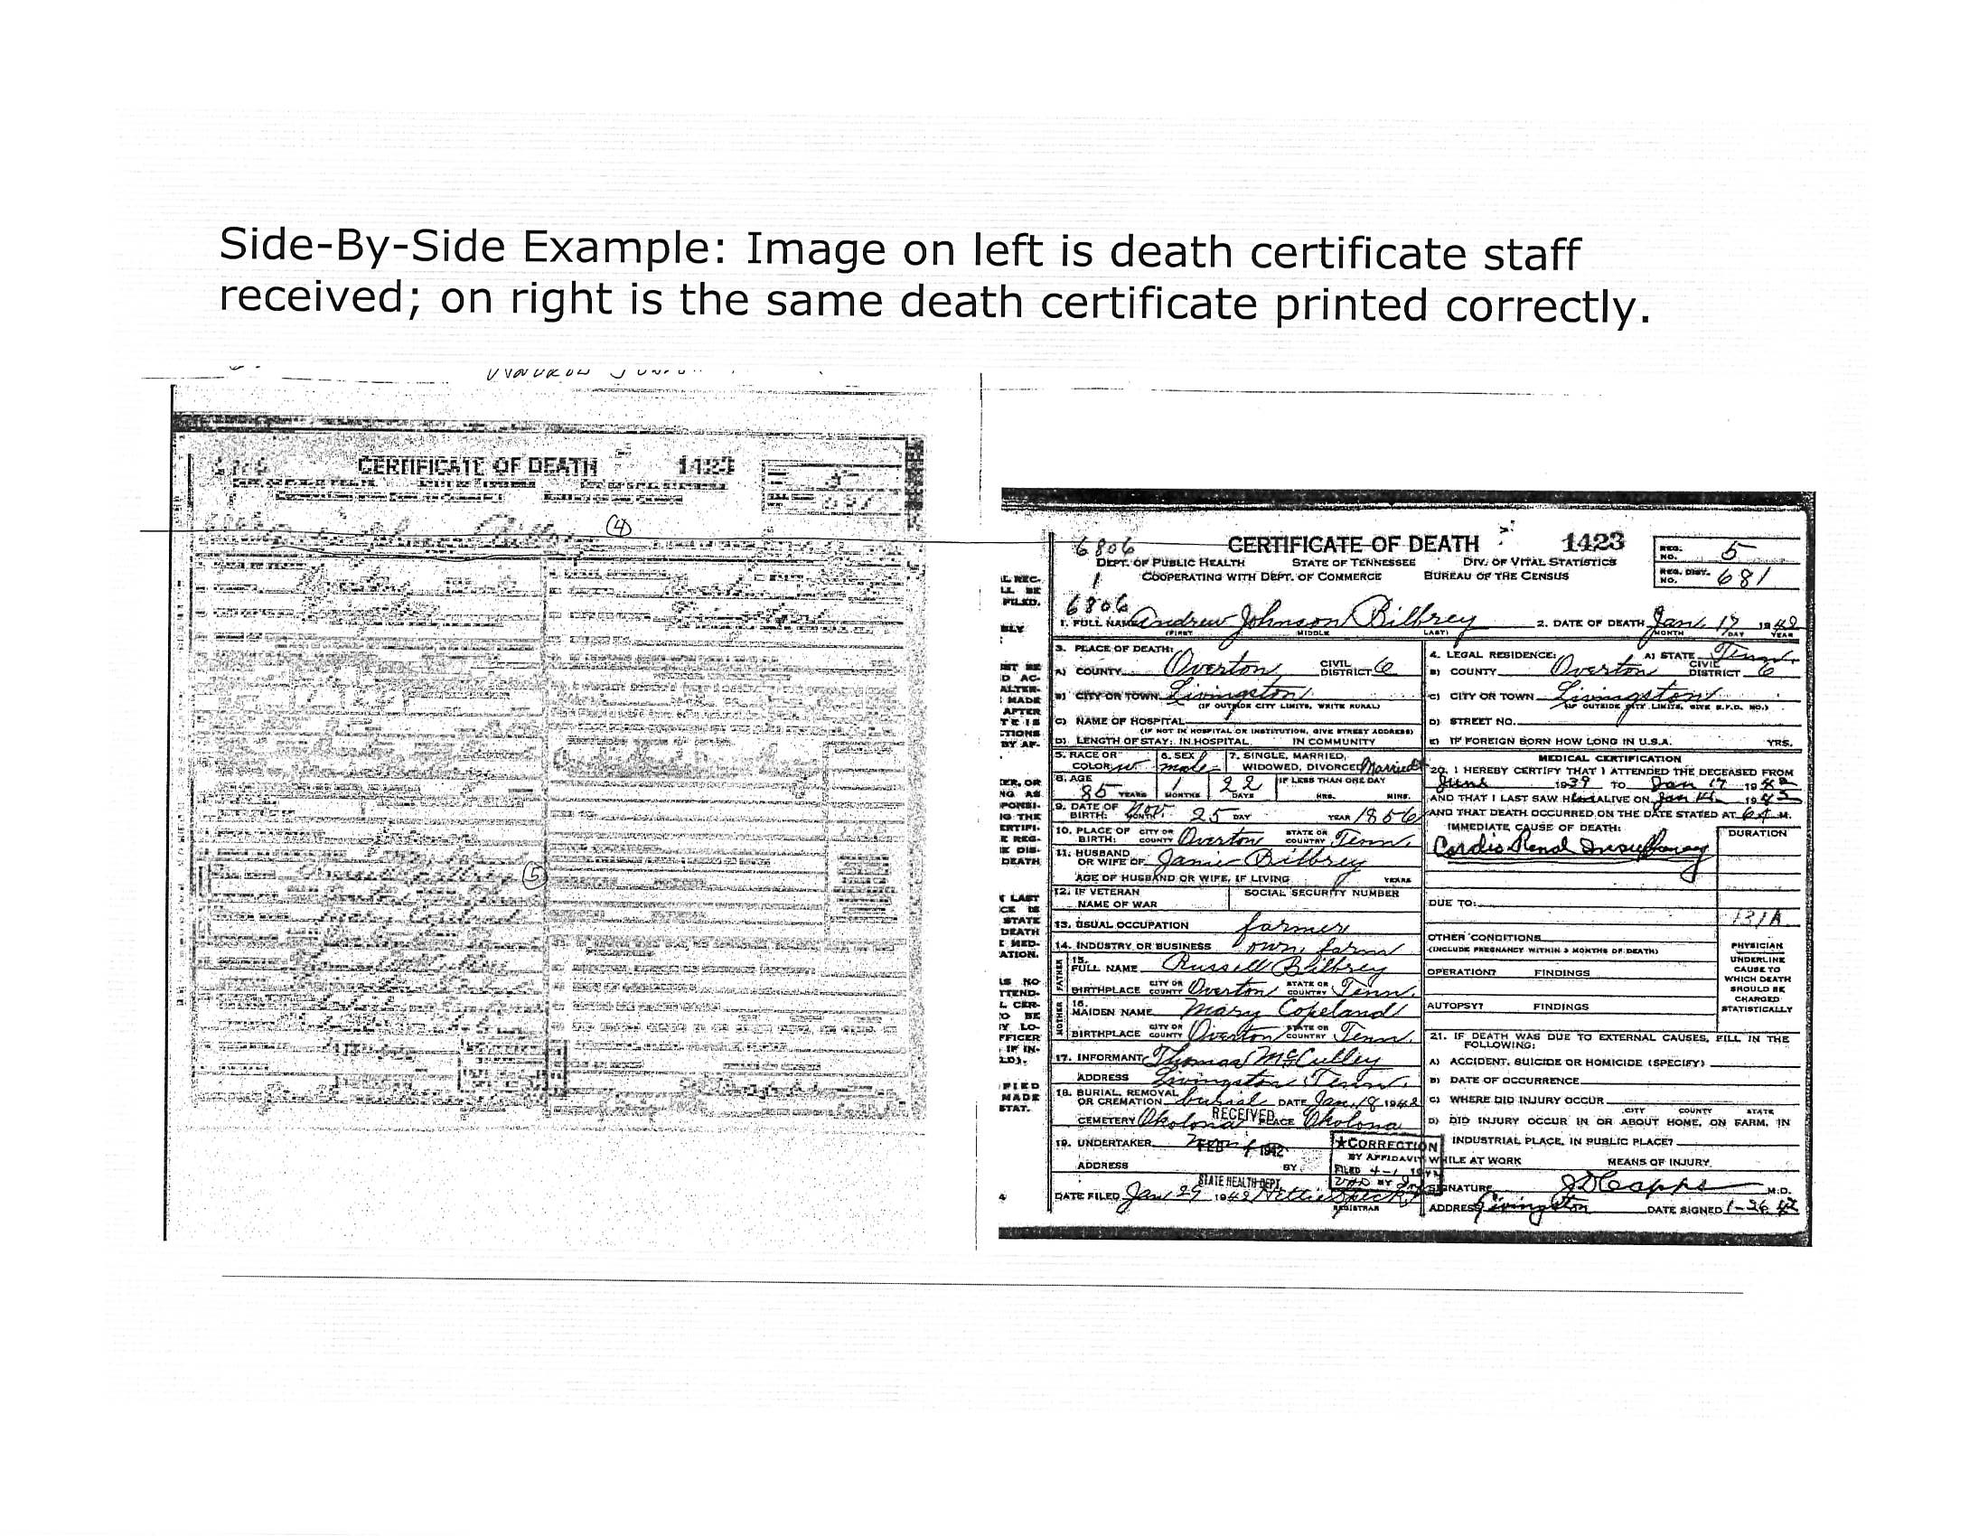

Slide 17
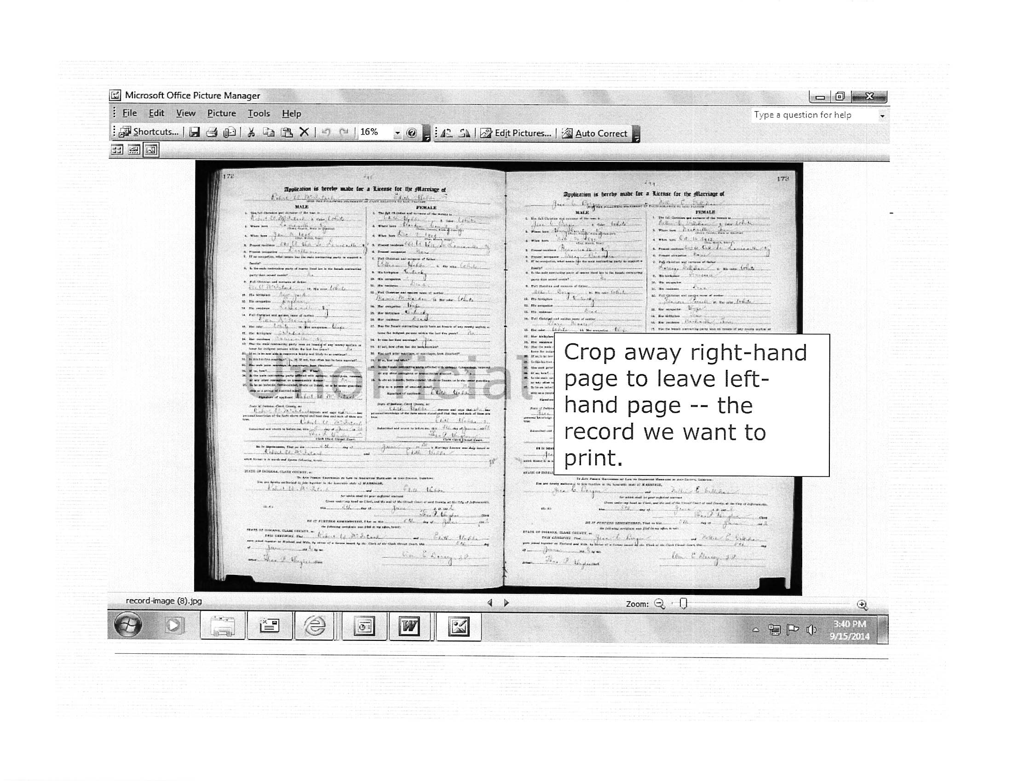

Slide 18
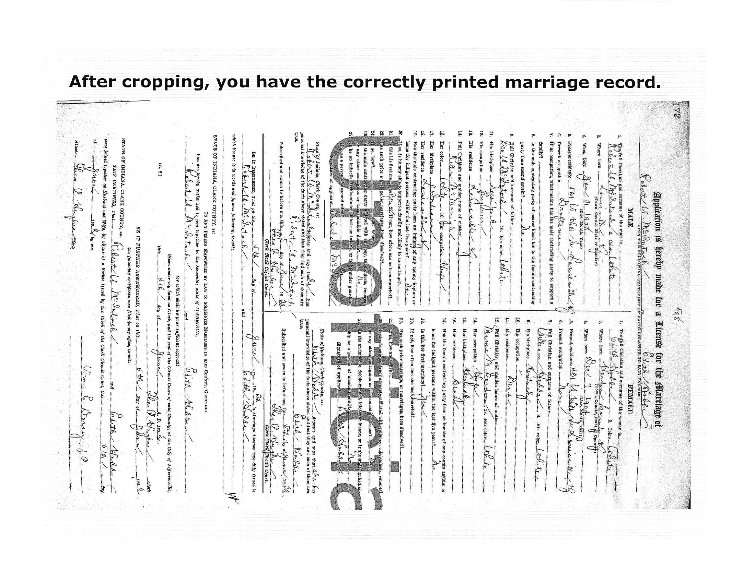

Slide 19
How to Review Applications Like the Pros!
Make a plain paper copy of the application that you can mark on. Do not mark on the original printed app.
Place documents beside it.
Flip through each individual document and place a check mark over each individual piece of datum on the app that is verified by each document.
When a parent-to-child connection is proven by documentation, place a vertical mark between the two generations to show that connection was made. Important: DO THIS AS YOU GO, BEFORE MOVING TO THE NEXT GENERATION!
Remember, when switching to the female line, her maiden name must be proven before connecting her to her parents!
During your review, omit data not proven by documents, and make changes to incorrectly entered data.
When using a previously approved SAR or DAR application as proof, ensure that the data ticked as verified on those applications is correctly entered on the SAR application being reviewed. Any data that was bracketed (placed in parentheses by a reviewing genealogist) or lined through should be omitted on the new SAR application. Any amended data should be incorporated, as well.
Verify that the patriot’s data is entered correctly and is consistent with proving service.
Ensure that the Description of Service at the top of the app is correctly entered. Use the DAR’s description of service as a guide.
Ensure that the References proving service are entered correctly and are not simply entered as a DAR or SAR number. If proof of service is from a DAR application, cite the proof of service as, for example, “DAR # 178395 cites PA Archives, Ser 5, Vol. 3, p. 36.” Cite the same way if using an approved SAR application that cited a DAR service proof. If a service reference was proven by a previous SAR application, simply cite the same proof of service as cited on that earlier application, unless it simply was cited as an SAR #. In that case, you will need to discover the actual proof of service, and it would be beneficial to go ahead and include that document.

Slide 20
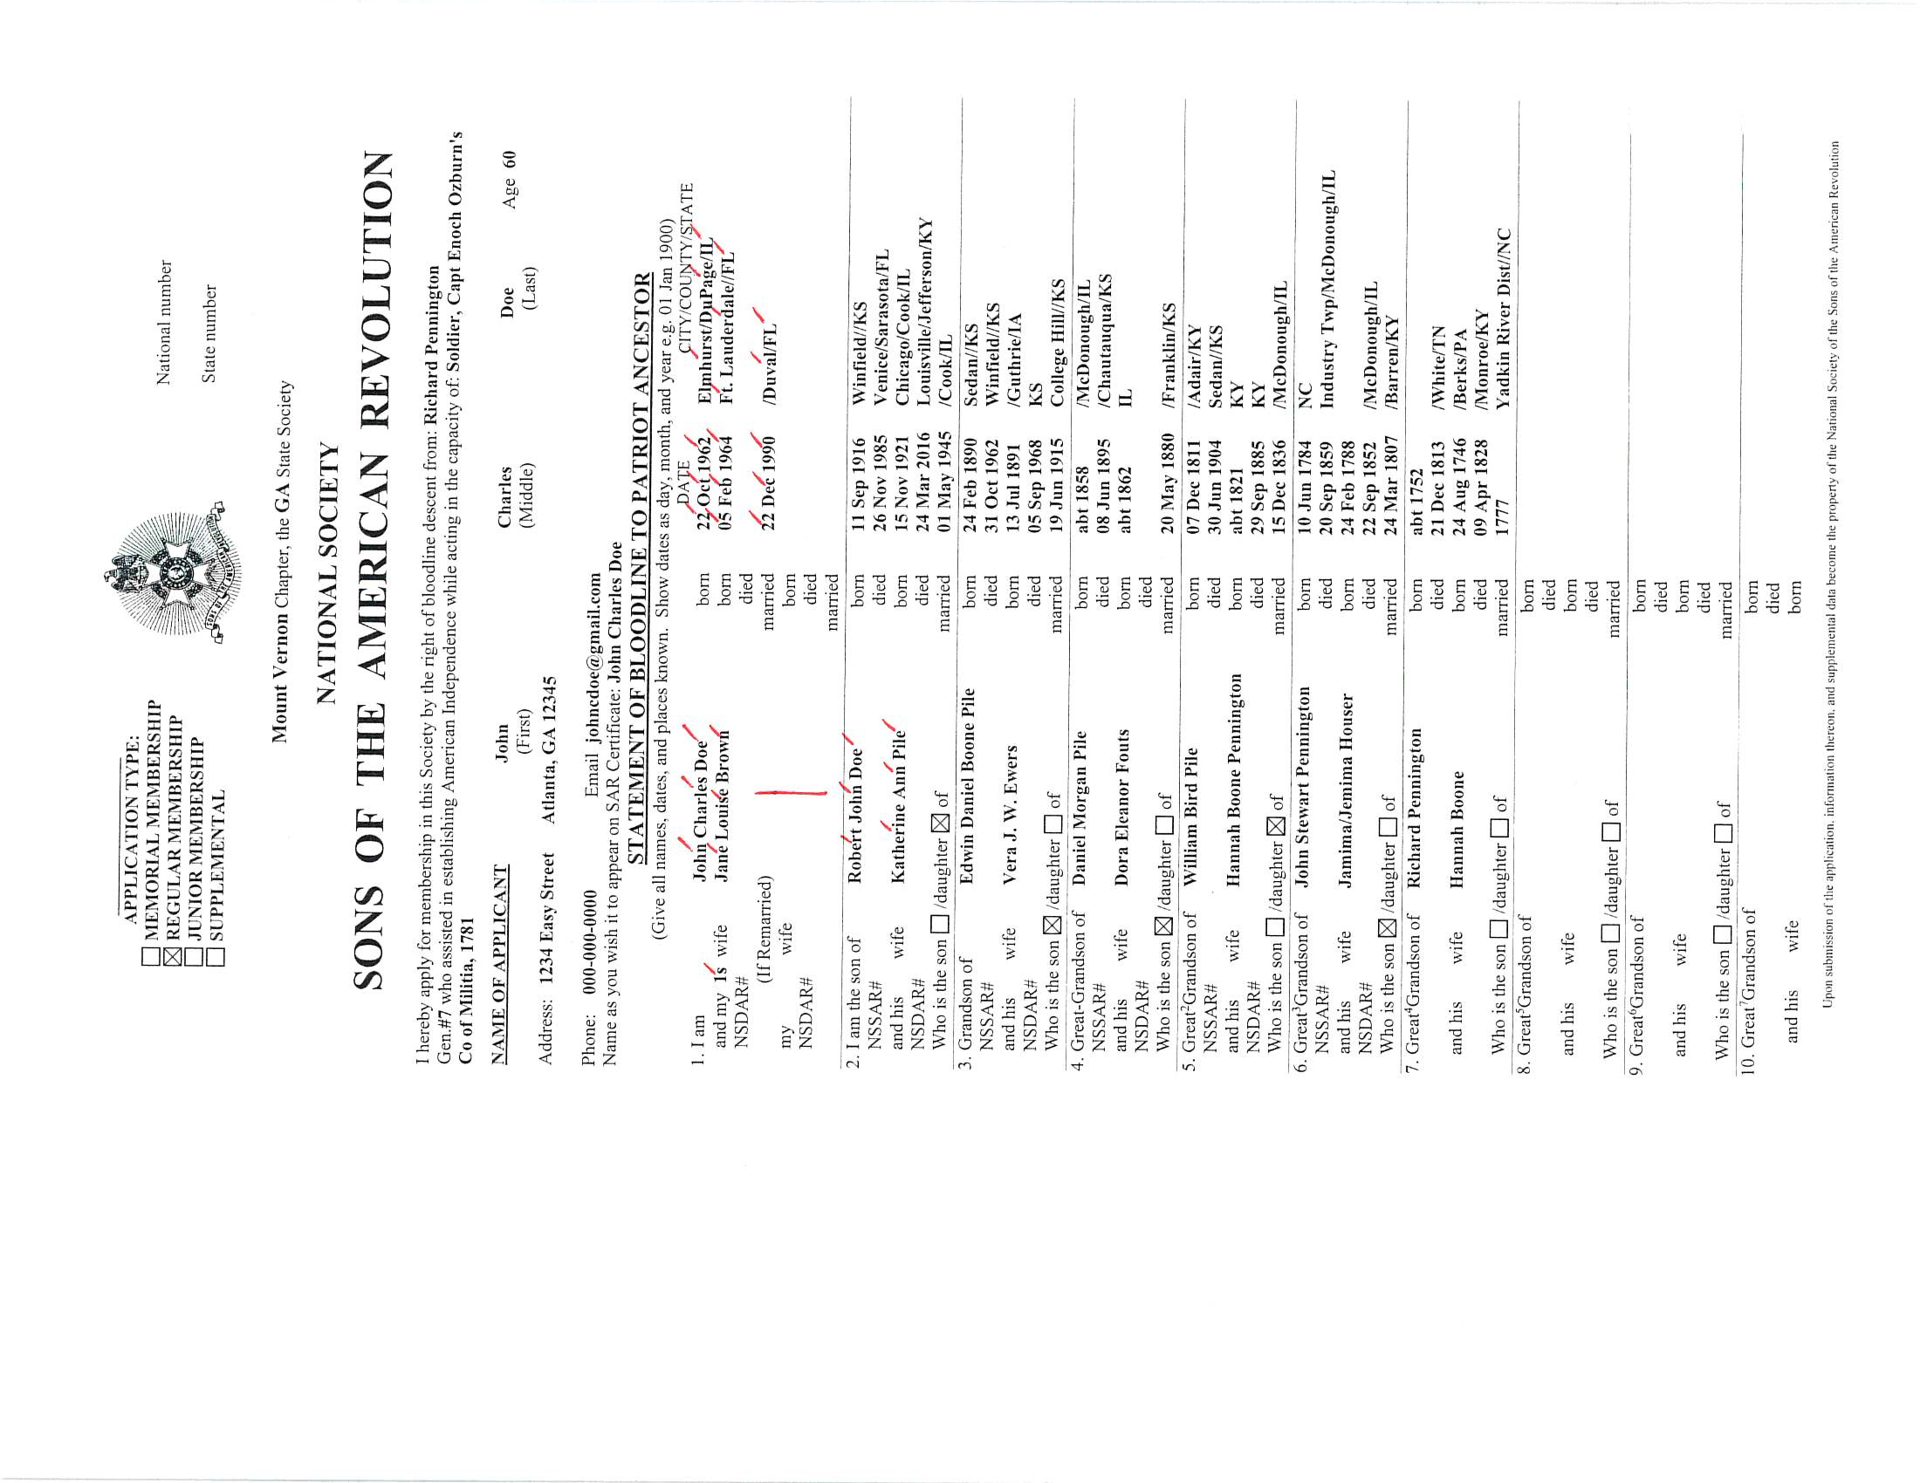

Slide 21
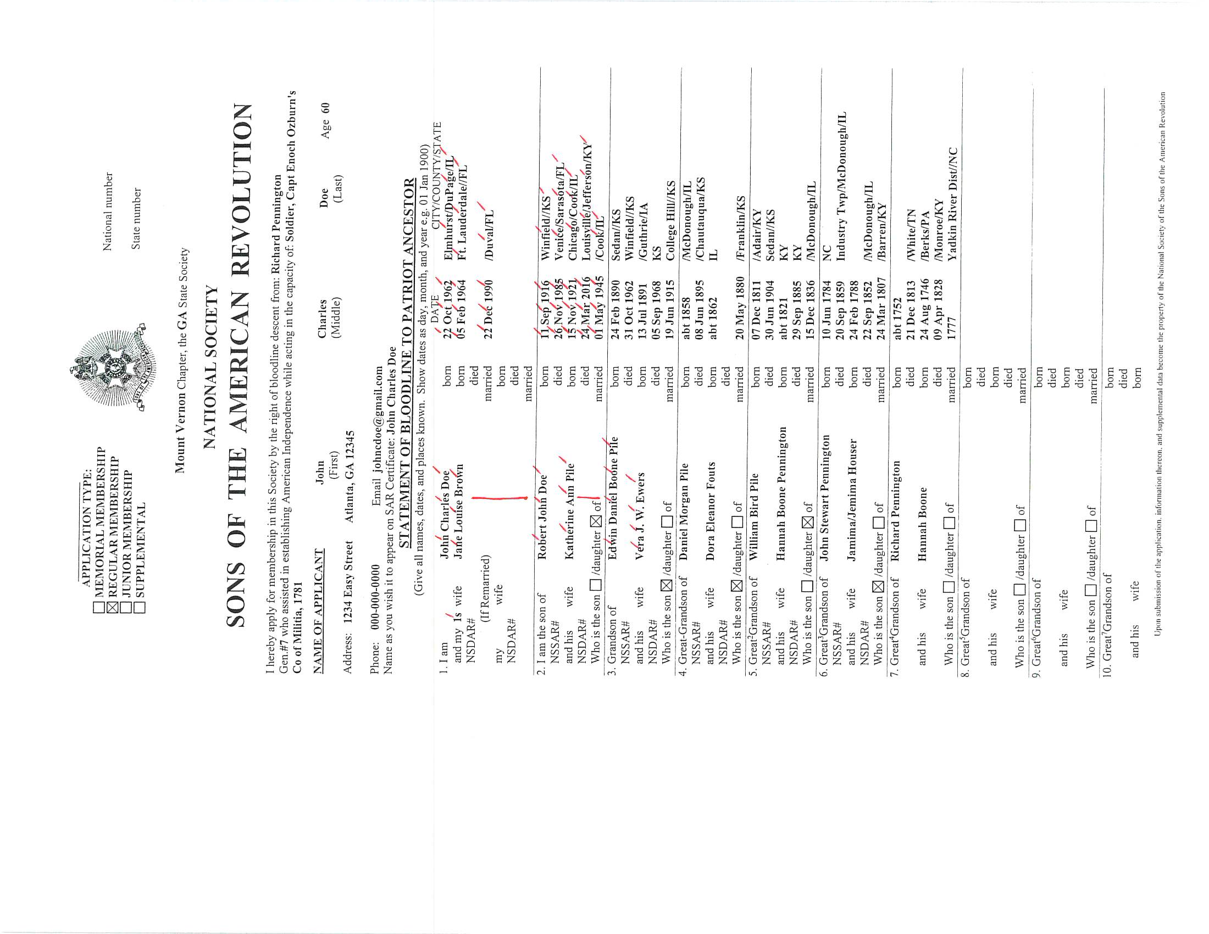

Slide 22
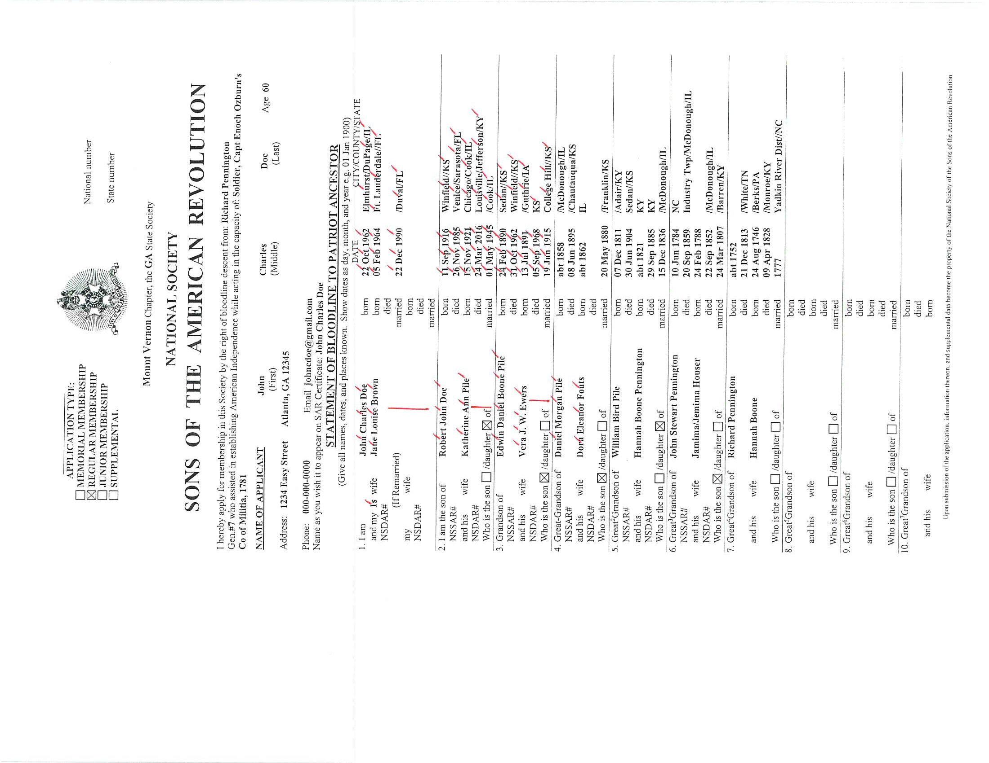

Slide 23
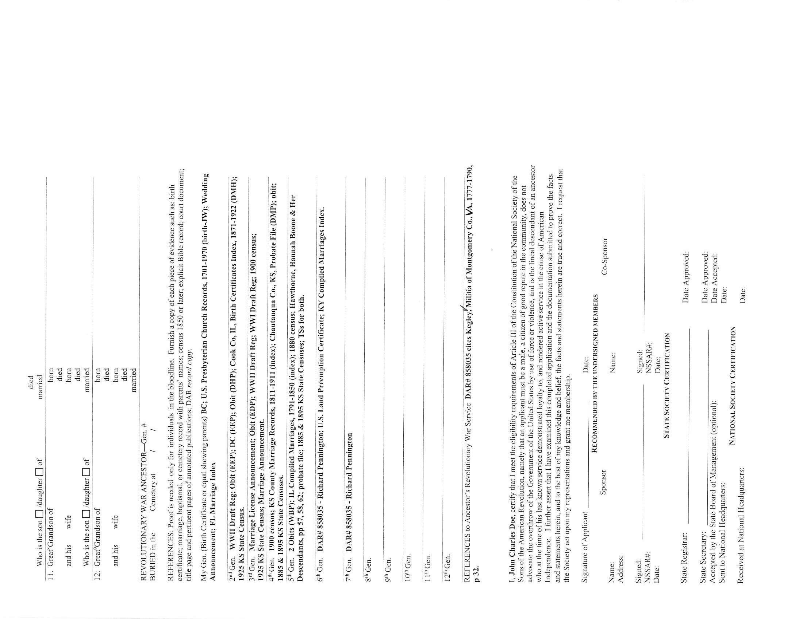

Slide 24
Training Resources at www.sar.org
Also, read the Genealogy Policy Manual and Application Preparation Guide.

