Slide 1
NSSAR Chapter Registrar & Genealogist Training
Seminar 1
Correctly Filling Out an Application
Dennis VanWormer – paworm@me.com

Slide 2
Introduction
For purposes of this training, NSSAR chapter registrars and genealogists are considered to have the same roles and responsibilities.
Chapters have different rules for these offices, and some chapters combine them.
SAR chapter registrars and genealogists DO NOT have the same privileges in the NSSAR “blue” membership database. Chapter genealogists need to be submitted as assistant or co-registrars with NSSAR* to receive the same privileges. They will be officially set up as a DataAdmin. (*or your state secretary)
My philosophy is that the completed application & documentation should be “a work of art” – accurate, as complete as possible with known proofs, and a document both the preparer and the applicant will be proud to show to others. Anything less is a disservice to the patriot ancestor and his or her descendants.

Slide 3
Correctly Filling Out an Application
Basic Membership Requirements
Purpose of the Application
Application Preparation Manual & Genealogy Committee Policies
Acceptable Options for Applications
Using the Online Application Process
Applicant information
Lineage information
Patriot information
System quirks & tips
Questions & Answers

Slide 4
Basic Membership Requirements (NSSAR Constitution, Article III)
Any male shall be eligible for membership in the Society being a citizen of good repute in the community, is the lineal descendant of an ancestor who was at all times unfailing in loyalty to, and rendered active service in the cause of American Independence either as an officer, soldier, seaman, marine, militiaman or minuteman, in the armed forces of the Continental Congress of any one of the several Colonies or States, as a signer of the Declaration of Independence, as a member of a Committee of Safety or Correspondence, as a member of any Continental, Provincial, or Colonial Congress or Legislature, as a foreign national of, but not limited to, France, Germany, Poland, Spain, Sweden or Switzerland who rendered service in the cause of American Independence or as a recognized patriot who performed actual service by overt acts of resistance to the authority of Great Britain, provided, however, that no person advocating the overthrow of the Government of the United States by use of force or violence shall be eligible for membership in the Society.

Slide 5
Purpose of the Application (APM, 23 Feb 2021, p 2) (GCP, 25 Jul 2022, 3.5001 & 5.2002)
The Sons of the American Revolution is a heritage society. It is not a genealogical society that requires proof of every name, place and event listed on the application, but it does require sound proof of the bloodline to a patriot ancestor and of the service rendered by that ancestor. By “sound proof” we mean adequate documentation of each parent/child link in the line, and differentiation of people with similar names living near one another at the same time. (In other words, it is a “proof document” – not a family history.)
SAR requests and encourages but does not require proof of data concerning non-bloodline spouses. (5.2002) It does require only information for which proof is given be listed on the application. (3.5001) (Yes, this is a contradiction. However, 3.5001 is more restrictive than 5.2002, so it is the controlling policy.)

Slide 6
Purpose (of the APM) (APM, 23 Feb 2021, p 1)
One of the primary objectives of SAR in general, and of its State and Chapter Registrars in particular, is growing its numbers. Key factors in that process are the preparation, review, and approval of membership applications. The intent of this Manual is to help Registrars understand their responsibilities as Registrar and understand the elements of a successful application by discussing in general terms policies adopted by the NSSAR Genealogy Committee, and by providing examples both of best practices and common pitfalls. For detailed text of current policies, see the Genealogy Committee Policies Manual.

Slide 7
Responsibilities of Registrars (APM, 23 Feb 2021, p 2)
By signing an application, the State Registrar verifies that in his opinion it contains sufficient proof of every fact claimed to meet the requirements for membership of the National Society.
Applications he deems insufficient to meet those standards should be returned to the Chapter Registrar or applicant to resolve any concerns. State Registrars may make hand-printed corrections to signed applications in black ink to add information or references to documentation, prior to submission. Only those considered acceptable should be forwarded to the National Office for processing by the NSSAR Genealogy Staff. If in doubt the State Genealogist, if one has been appointed or elected, should be consulted.
Chapter Registrars also need to be aware of the documentation standards and requirements so they do not burden the State Registrar with inadequate applications that will have to be returned, modified and/or researched further.

Slide 8
APM & GCP (& GG Emails)
Application Preparation Manual (23 Feb 2021 is latest version) provides “most” of what is needed to prepare an application.
Genealogy Committee Policies (25 Jul 2022 is latest version) contains the official rules (mostly!) and is very detailed relative to acceptable patriot service.
Genealogist General e-mails contain latest news, issues, and occasionally changes to GCP that will be in next version of GCP.
NSSAR staff genealogists may occasionally “interpolate” from or “extrapolate” from official rules and guidelines.

Slide 9
Acceptable Options for Applications (From NSSAR Website)
OPTION #1 – NSSAR ONLINE APPLICATION This option allows for your data to be captured for future supplemental patriot ancestor applications and allows the SAR application helper to electronically access your application for real time guidance and assistance. This is the recommended method for future SAR membership applications and will be the focus of these classes. The SAR has initiated an assessment of the updates of the application.
OPTION #2 – ADOBE PDF APPLICATION* This option is recommended for those with limited Internet access who don’t mind meeting with their helper in person for assistance in completing their application. Please make sure you download this to your local PC for data entry or ALL data entry and/or changes will be lost.
OPTION #3 – MICROSOFT WORD APPLICATION* This option is recommended for those with limited Internet access who don’t mind meeting with their helper in person for assistance in completing their application. This application requires Microsoft Word or its equivalent.
OPTION #4 – INEXPENSIVE SOFTWARE PACKAGE BY COX SOFTWARE This is an option for those who don’t mind paying for extra features. SARApAid has been licensed by the National Society of the Sons of the American Revolution as an approved NSSAR Application form software package. It is a stand-alone program.
*NOTE: PDF and MS Word forms MUST be dated 2017 or later to be acceptable.

Slide 10
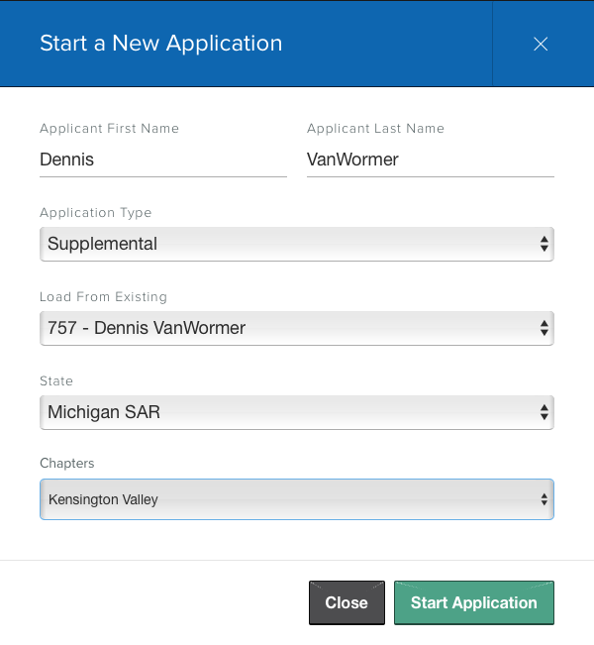
Using the Online Application Process
Starting a New Application:

Slide 11
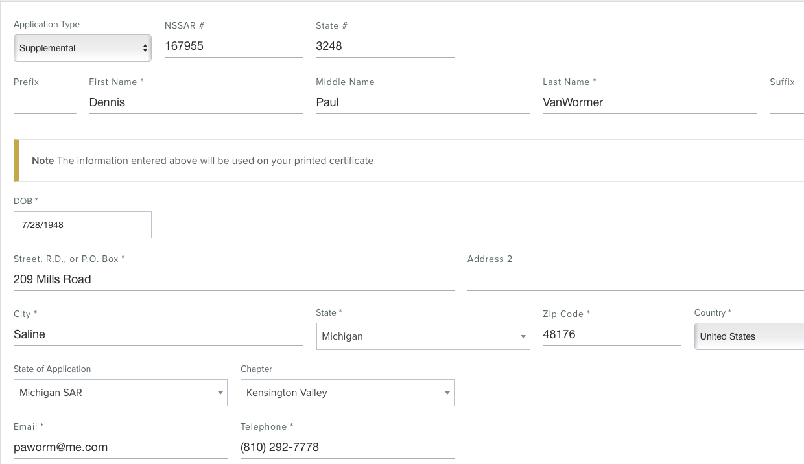
Using the Online Application Process
Applicant Information (“Basic Info” section):

Slide 12
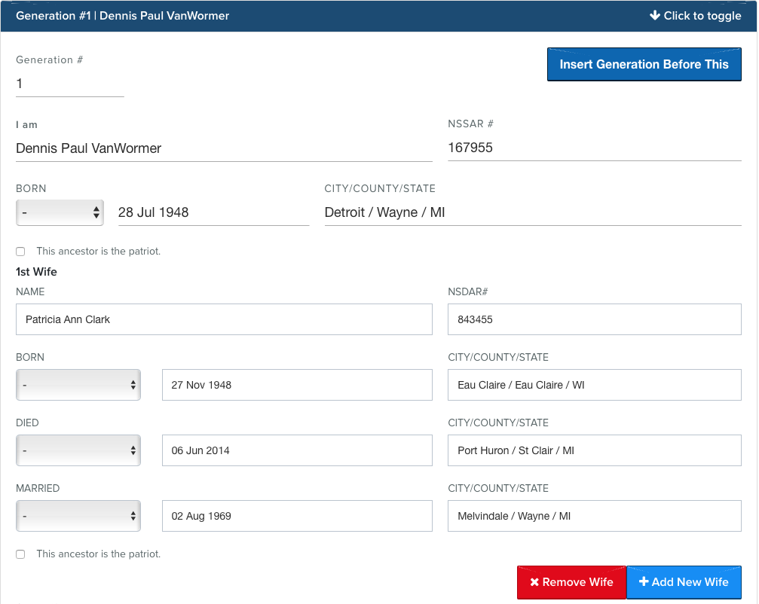
Using the Online Application Process
Lineage Information (“Generations” section):

Slide 13
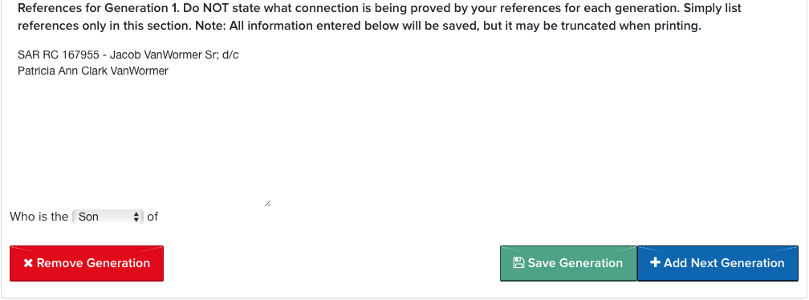
Using the Online Application Process
Lineage Information (“Generations” sections):

Slide 14
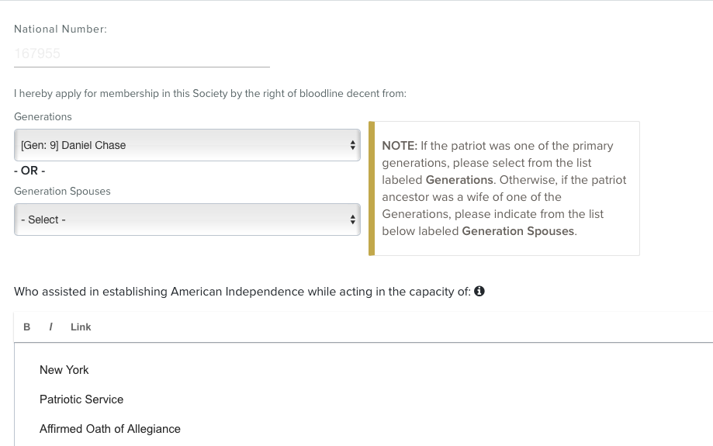
Using the Online Application Process
Patriot Information (“Finalize” section):

Slide 15
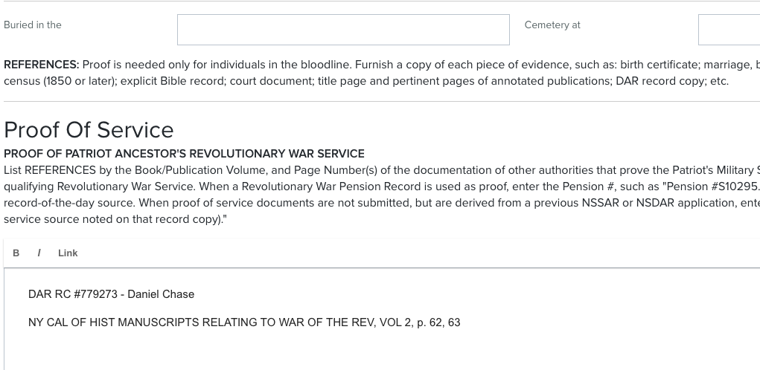
Using the Online Application Process
Patriot Information (“Finalize” section):

Slide 16
Using the Online Application Process
Signatures (“Finalize” section):
NEVER type in Applicant’s name – inserted automatically by program
On NEW applications, type in Sponsor’s and Co-sponsor’s names and NSSAR numbers (if known). Address info and chapter registrar info will not appear on printed application.
On Supplemental applications, sponsor and co-sponsor will NOT appear because not required (and no credit given to sponsor/preparer)
DO NOT type in State Registrar’s or State Secretary’s name on any application. Space provided is for the officer’s signature.
Notes:
Be sure to click on the “Save Draft and View” green box at the bottom right of the screen or your entries on this screen will be lost!

Slide 17
Using the Online Application Process
System Quirks & Tips (& Common Issues)
“Save Generation” does NOT always save everything. (Especially applicant birth location) Always double-check after saving!
If you add or remove generations, you will have to ”Save generations” and possibly close out application and open it back up to get generation numbers corrected.
Some changes (such as removing a wife) may not work. In that case you will need to remove the entire generation and re-enter it.
Enter all citations in “References” sections WITHOUT hitting Enter or Return key. Program will automatically wrap text when the printed version is created.
Supplemental application quirk? Some have reported (not me) that if “Supplemental” is noted as the application type on the Basic Info page, then nothing will save on the Finalize page. Work-around is to set application type to “Regular,” fill in and save info on the Finalize page, and then reset application type to “Supplemental.”

Slide 18
Questions?

