Slide 1
NSSAR Chapter Registrar & Genealogist Training
Seminar 3
Application Printing, Review, and Submission
Dennis VanWormer – paworm@me.com / (810) 292-7778

Slide 2
Application Printing, Review, and Submission
Printing & Signing the Official Application
Preparing Proofs for Submission
  Certified copies NOT required!
  SAR, DAR, and C.A.R. record copies
  How to properly copy documentation for an SAR proof
  How to properly annotate an SAR proof
  Tips for preparing proofs
Application Mark-up Review Process
Submitting the Application Package to the State Registrar
Questions & Answers

Slide 3
Printing the Official Application
(APM, 23 Feb 2021, p 10) (GCP, 25 Jul 2022, Section 6.1001)
Applications must be printed using the legal-size print option on both sides of official, SAR legal-size watermarked, bond paper. If a third page is needed, it must also be on SAR legal-size watermarked, bond paper. If a fourth page is required, it must be on the back of the sheet with page 3. (Don’t print the back side upside down from the front side!)
Applications must be typed or computer-printed with black print and must be neat and not smudged or produced with loose toner but may contain no more than five very minor neat corrections in ink.
For the on-line SAR Application, set the scale on the print setup in the range of 90 to 110. A scale smaller than 90 will increase the margins and shrink the font size on the printout making it very difficult to read. For the on-line system, trying different scale sizes between 90 and 110 can fix the page break between page 1 and page 2 of the application so the break falls properly between generations. (Quirk of the on-line system.)

Slide 4
Signing the Official Application
(APM, 23 Feb 2021, p 11) (GCP, 25 Jul 2022, Section 6.1002)
Adults (18 and over) who apply for membership must sign their application, unless they are incapacitated. Exceptions may be approved by the Genealogist General. Junior Members (under age 18) may sign their application, or an adult family member (parent or legal guardian) may sign on their behalf. (No surprise gifts!)
The new member application must include the signatures of the applicant, two sponsors who are members in good standing, the State Registrar, and the State Secretary. A Supplemental application only requires the signatures of the applicant and the State Registrar.
A memorial application must be signed by an adult SAR member.

Slide 5
Preparing Proofs for Submission
(APM, 23 Feb 2021, pp 10-13)(GCP, 25 Jul 2022)
Documentation of applicant’s lineage is required; other information and documentation is requested and encouraged. List on the application only information for which a proof is given. (GCP 5.2002 & 3.5001)
A copy of the applicant’s birth certificate identifying him, his date and place of birth, and his natural parents’ names, and his gender as male is required unless one cannot be obtained from any source. (APM) (GCP 5.4001)
Photocopies of vital records, not certified copies, are preferred.
Each piece of documentation must contain the entire image of the document. If a pertinent section is difficult to read, a partial blow-up of that section may be printed on the reverse of the page. All documents should be oriented properly (portrait or landscape) to maximize readability.

Slide 6
Preparing Proofs for Submission
(APM, 23 Feb 2021, pp 13-14)
All documentation must be readable (legible). If the record is difficult to read, try blowing up the section of relevance and printing the blown-up section on the reverse (the obverse must include the complete documentation page so no part is missing). If the document is too light to easily read, try to darken it prior to submission.
Do not put enlargements or superimposed images on the same page. Enlargements or superimposed images of pertinent information that are put on top of the complete image obscure other parts of the page. Enlargements may be put on the reverse side of the document if needed for readability.
All pages of documentation should be submitted on standard 8 ½ by 11 paper if possible. Legal sized documents such as DAR Record Copies should be reduced to that size. (8 ½ by 14 paper is acceptable, but not preferred.)
Smaller documents should be scanned to fit on an 8 ½ by 11” page.

Slide 7
Preparing Proofs for Submission
(APM, 23 Feb 2021, pp 14-15)
Do not submit duplicate pages of a documentation source. Only one copy of a document is needed, no matter how many generations are accounted for on that document. The generation numbers that the document pertains to should be marked in red fine-tip pen at the top of the first page of that document and the document should be referenced in each corresponding line in the documentation proofs on the Application form.
Do not supply redundant information when the package already contains adequate proof. If a vital record is submitted, do not provide an index for that record. Do not supply census summary pages, just a copy of the actual census page.
Obituaries are an exception; the Genealogy Staff welcomes obituaries, even though a death record may have been submitted because the obituary may give more information on the family which may help prove the relationship between the deceased and another family member that was not listed on the death record.

Slide 8
Preparing Proofs for Submission
(APM, 23 Feb 2021, p 15)
When needed, include a narrative describing how multiple documents provide indirect proof of a conclusion. Without this, staff must analyze the documents and arrive at its own conclusions. Make sure the narrative resolves any conflicting evidence, and in the case of multiple persons of the same name in the same area, that all ambiguity is eliminated. (Proof Summary or Proof Argument)(Session 5)
All published sources submitted as proof must include both the page(s) of interest and the title page providing the title, author, and date of publication.
Published full transcriptions of documents are preferable to abstracts. Either must contain source information, including state, county, volume/book, and page number.

Slide 9
Preparing Proofs for Submission
(APM, 23 Feb 2021, pp 15-16) (GCP, 25 Jul 2022, Section 3.6001b)
Proof of the Maternal Bloodline
  If the bloodline goes through the maternal side, there must be acceptable evidence of the connection between the woman and her parents, as well as between the woman and her child. A will or Bible record explicitly describing the relationship is of course preferred. By themselves census records usually will not suffice, unless one shows the father and/or mother living in the married daughter’s household, but other indirect evidence may establish the linkage. If a will, deed, or court record is used to show her maiden name but doesn’t indicate her married name (“ to my daughter Mary”), more proof is required to show the marriage and establish both her married and maiden names.
Death Certificates of Remarried Wives
  If her death certificate is under the surname of a second spouse, proof of the name change from that of the bloodline spouse to that of the second spouse is needed.
Proof of Service of Patriot Ancestor
  If the applicant is not citing a previously approved NSSAR or NSDAR application, the proof of service using acceptable sources must be provided. If the source used for proof of service on an SAR or DAR approved application does not meet current standards, a copy of an acceptable proof of service is required.

Slide 10
Preparing Proofs for Submission
(APM, 23 Feb 2021, p 17)
Census records
  The entire census page must be shown so the data can be evaluated in context.
  If the data must be enlarged to read, include an enlargement of the section on the reverse side.
  Transcriptions or printed summaries on “printer-friendly/source pages” are not acceptable.
  The census images should be printed in the correct orientation for that census year (usually portrait for 1850-1880 and landscape for the later census years) so the image can be optimally read.

Slide 11
Preparing Proofs for Submission
(APM, 23 Feb 2021, pp 18)
Bible records and Other Original Documents
  If possible, a photo or scanned image of all the pages showing the family information must be submitted, and in the case of a Bible, a photo of the Bible’s title page, giving an indication of the Bible's age and the genealogy presented, is required.
  Evaluation will not only consider the apparent age of the document, but also the handwriting and ink used, and evidence that the events were recorded soon after they occurred. If the writer can be identified through the handwriting (through old letters, etc.), proof of the identification should be included.
  Bible entries apparently entered long after the event will reduce their usefulness.

Slide 12
Preparing Proofs for Submission
(APM, 23 Feb 2021, pp 18-19)
Find-A-Grave Memorial Pages
  Memorial pages found on www.findagrave.com are not acceptable unless they include a readable photograph of the actual tombstone and the information on the memorial page stating where the subject is buried (name of cemetery, city/county/state). Only the text on the tombstone is accepted as evidence. Acceptable tombstone photographs are those that appear to be of the contemporary to the death.
  Newer stones containing information about events that occurred years ago are not recognized.
  Vital records posted with the memorial page will be accepted and attached obituaries may also be considered if they provide the newspaper name, place published, and date of publication).
  User entered information added to the memorial page is not accepted as proof. This would include names, dates, and relationships listed or any other personal data entered that is not on the tombstone.

Slide 13
Preparing Proofs for Submission
(APM, 23 Feb 2021, pp 18-19)
Other proof types
  Records in Foreign Languages (foreign language document must be accompanied by an accurate English translation)
  Birth certificates (Short-form birth certificates that do not identify the parents are insufficient)
  Tombstone records (Tombstones used as supporting evidence must be contemporaneous to the time of the subject’s death and include a readable photograph of the marker. New stones containing information about events that occurred years ago are not recognized)
  Newspaper Articles (Copies of newspaper articles such as an obituary or wedding announcements must include identifying publication names, locations, and dates of publication) (Newspapers.com!)
  Published family and local histories (These records may be acceptable, especially when properly annotated with the source of the information. Consideration may also be given to un-annotated histories, when the author can be shown to have been in a position to have first-hand knowledge of the person or event in question)
  Initials or use of middle names instead of first names (Documents containing initials rather than a full given name can be problematic, and normally require additional supporting evidence that the subject is the correct person)

Slide 14
  SAR, DAR, and C.A.R. Record Copies
  (APM, 23 Feb 2021, pp 16-17)
Unless new applications qualify under the “Grandfather Policy”, they must cite either Record Copies of well documented SAR, DAR, or C.A.R. applications, or include their own documentation.
Do not include the first page of downloaded DAR Record Copies that begin with “What has changed”. Pages 2-5 of downloaded DAR Record Copies may be printed double-sided to save paper, postage, and space.
While DAR record copies must be “official,” SAR and C.A.R. record copies are essentially just photocopies of the approved application (with ”Record Copy” stamped on SAR record copies).
May be reduced to 8-1/2 x 11 when copying as a proof.

Slide 15
Annotations
(APM, 23 Feb 2021, p 14) (GCP, 25 Jul 2022, Section 3.9004)
Do not make any annotations to documents submitted since documents must be taken at face value as written. Only a reference to identify the generation by number should appear in the margins and the pertinent text underlined in red fine-tip pen or pencil. Extraneous annotations by others on records are not generally acceptable. This includes such things as annotations listing the family with a photo or transcription of a tombstone record. (i.e., Find-A-Grave)
Do not use highlighters or markers on documentation to indicate important text. Underline pertinent text with a fine-line pen or pencil (red is preferred). Felt-tip pens or highlighters can obliterate the text they cover or touch when copied or scanned.
Do underline relevant passages in the document that support the proof and write the generation number of the generation for which the passage applies in the margin beside the underlined passage(s) using a red fine-tip pen or pencil in the documents submitted. Mark all of the generation numbers to which the document applies in red fine-tip pen or pencil at the top of the document.

Slide 16
Copying Proofs
(APM, 23 Feb 2021, p 11) (GCP, 29 Nov 2021, Section 6.1003)
All pages of documentation should be submitted on standard 8 ½ by 11 white paper if possible. Legal sized documents such as DAR Record Copies should be reduced to that size.
Smaller documents should be scanned to fit on an 8 ½ by 11” page.
Do not submit duplicate pages of a documentation source. Only one copy of a document is needed, no matter how many generations are accounted for on that document.
Do NOT put different proof documents on opposite sides of same sheet of paper.

Slide 17
Application Mark-up Review Process
I developed this procedure in 2019 due to high level of errors and poor quality in Michigan Society applications.
IF FOLLOWED CORRECTLY, this procedure can (almost) eliminate information in the lineage section and on the patriot ancestor that is not properly cited and/or proven.
Results of use of this process were a slow but noticeable improvement in the quality of applications submitted to the state registrar (me).
It does have a learning curve, and it does not respond well to taking shortcuts.
Quality of some application submissions has DECREASED as some chapter genealogists discontinued using this process.

Slide 18
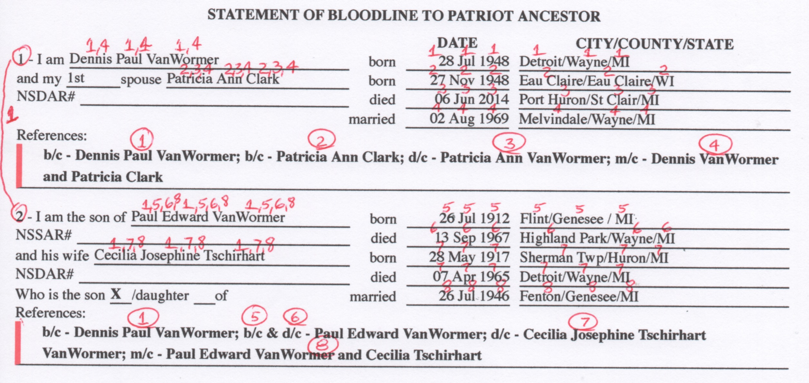
Application Mark-up Review Process

Slide 19
Submitting the Application Package
(APM, 23 Feb 2021, pp 10, 12, 14) (GCP, 25 Jul 2022, Section 6.1001)
Applicants must submit the original application form containing all necessary signatures. Photocopies of applications will not be accepted.
Do not use staples or paperclips within the documentation package. Only a single suitably-sized binder clip should be used to hold the complete package together. Do not use Post-it or similar notes or flags stuck to pages. Do not use divider pages to separate the generations (the generation numbers should be identified on the page only).
Sort and organize in same order (generational) as cited on application. Applicant’s birth certificate is always first.
Include:
  Applicant check(s)
  Additional clean plain-paper copy of application for state registrar’s use per state process
  DAR Finder Form if appropriate
  GG Requirements List or Requirements Checklist per state decision

Slide 20
Questions?

