Slide 1
New Member Orientation
Presentation

Slide 2
Presentation Overview
(Remove this Page Before Making Presentation)
This presentation has been written to be used with the New Member Orientation Workbook. It provides an overview of the National Society, State Society and Chapter organizations and introduces several of the programs but, in a little different order than the Workbook. It does require customization to add state and chapter information and to meet the presenters style.
To customize the presentation, review each slide carefully and make modifications as needed especially to information in blue font. Blue font covers state and chapter information unique to each state or chapter. Be sure to change color of font back to black when done.
Presenters have different presentation styles. Some like few bullets and talk on the points. If so make a second copy and drop all or most of the sub-bullets in the second copy. Keep the original as reference notes. Others presenters like to basically read the slide and cover only what is on the page. Beware, it took me 40 minutes at a fair pace to read the information on all the slides. So you may need to cut the presentation down some in order to keep it short.
Remember the most important part of the presentation is the last half, slides 18 through 32, and leaving 10 minutes of time for the members to fill out the My Part – Participation Summary Sheets at the end of the Workbook.
NOTE: Many current members might benefit from the presentation at a chapter meeting. Break up into two presentations. One could cover National and State Societies and the second Chapter and programs.

Slide 3
WELCOME TO THE SAR
WE WANT YOU TO BE AT HOME IN SAR
MENTOR IS YOUR PRIMARY GO TO PERSON. HE HAS GOOD KNOWLEDGE OF CHAPTER AND ITS PROGRAMS
WORKBOOK PROVIDES AN OVERVIEW OF THE ORGANIZATION AND
WE WANT YOUR INVOLVEMENT

Slide 4
ABOUT THE SAR
History
  Outgrowth of Centennial Celebrations 1870’s-1880’s
  Nationally Organized April 30, 1889 (131 Years Ago)
  Incorporated Washington DC 1906 by Act of Congress
    Compatriot Theodore Roosevelt (a Member) Signed Into Law
Objectives
  Patriotic
  Historical
  Educational
Not For Profit Organization-501 (c) (3)
  National Society is Umbrella 501 (c) (3)
  States and Chapters Under National 501 (c) (3)
  All State Societies and Chapters File 990 Tax Return
  Our State Society is Registered in State as Charitable Organization
  Our Chapter is Registered in the State as a Charitable Organization

Slide 5
Handbooks and Regulations
National SAR Handbook-8 Volumes
  Governing Documents
  Organization
  Membership Compliance and Policies
  Insignia, Protocol, Ceremonies & Rituals
  Individual Medals & Awards
  Youth Programs, State Society & Chapters
  Summary History of SAR
  Historic Roster of SAR General Officers
Find the SAR Handbook at www.sar.org
  Set up password
  Handbook in Members Tab
Find the StateName Society Regulations at www.statewebsite.org
  Password is - Password
  Find Regulatios in Members Only Tab
Find the ChapterName.org Chapter Regulations at www.chapter.org (or where if not there)
  Password is – Password
  Find Regulations in Members Tab
This Presentation is an Overview– Orientation Workbook and Handbooks Provide More Detail

Slide 6
National Organization
Overview of Organization
  President General (PG) Chief Executive Officer
    Supported by 17 Vice President Generals
    Supported by 11 Executive Officers
    Supported by Standing Committees
    Supported by Headquarters Staff
  Board of Trustees
    Custody of Property
    Manage Business Policy and Affairs
  All Executive Officers and Trustees Elected at National Congress
  Serve Without Compensation
  See Listing of National Officers in Workbook Appendix A
National Headquarters-Louisville, KY-Home 1st Congress
  Executive Director Manages Headquarters
  Departments/Functions
    Administrative Support
    Finance
    Library
    Museum
    Genealogy (Application Approval)
    Education
    Store
  National Headquarters Staff Paid
Meetings
  National Congress-Different Locations-Annually in July
  2 Leadership Meetings-Louisville KY-September/February
    All Compatriots Can Participate In Leadership/Committees
Lets Look at Organizational Chart

Slide 7
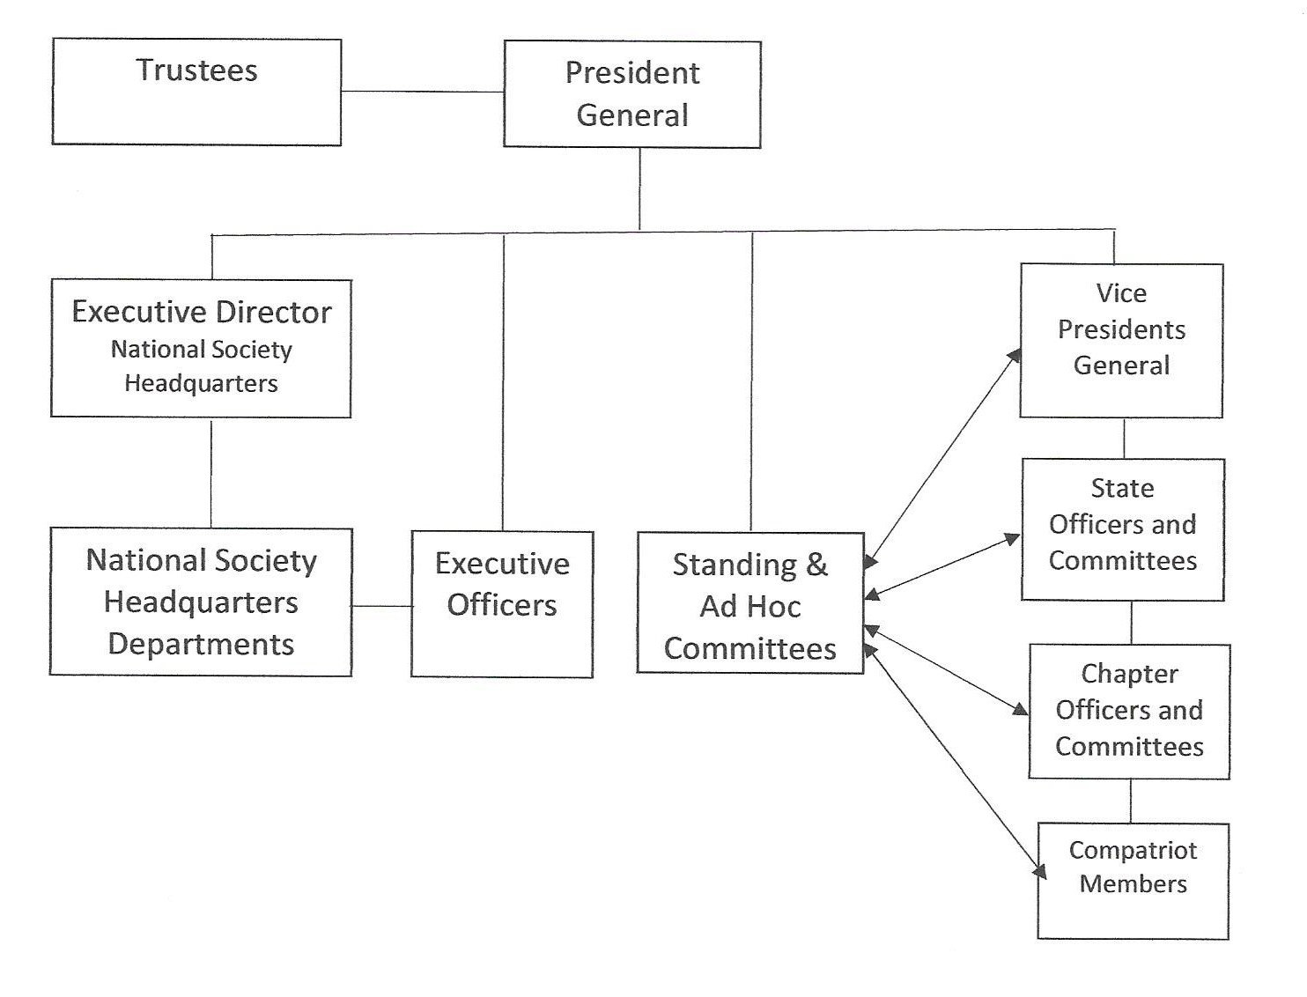
ORGANIZATION STRUCTURE

Slide 8



SAR SEAL, INSIGNIA, RECOGNITION PIN
SAR Seal
SAR Insignia and Badge
SAR Recognition Emblem-Rosette
SAR Standard

Slide 9
StateName Society and ChapterName Chapter
Flags and Seals
(Place State and Chapter Flags and Seals on this page)

Slide 10
National Committees
(You Can Participate)
National Committees are the working groups within the Society who work to generate, refine, document and implement policy, programs and procedures.
There are over 75 National Committees
  Administrative (Executive, Audit, Finance)
  Programs (Youth, Partners in Patriotism, Americanism)
  Functional (Merchandise, Genealogy)
Meet at Leadership Meetings and Congress
“Any Member can Attend and Provide Input”
Voting Members Appointed by PG
What Committees Do
Determine Need or Receive Requests for Change
  From Executive Officers/Trustees/Other Committees
  From National Headquarters
  From Members/Chapters/State Societies
Document and Present for Approval Proposals to Change Policies or Programs
  To Executive Officers
  To Executive Committee and Trustees
  To Other Committees Involved
After Approval Implement Changes
  Write/Rewrite Forms, Changes to Manuals, Procedures
  Design and Request Implementation of Pins or Medals
  Distribute Notices of Changes to Societies and Chapters
  Monitor Implementation

Slide 11
PLEDGE AND RECESSIONAL
Pledge
  “We descendants of the heroes of the American Revolution who, by their sacrifices, established the United States of America, reaffirm our faith in the principals of liberty and our Constitutional Republic and solemnly pledge ourselves to defend them against every foe.”
Recessional
  “Until we meet again. Let us remember our obligations to our forefathers, who gave us our Constitution, the Bill of Rights, an independent Supreme Court, and a Nation of Free Men.”
Protocol
  Recited at Opening and Closing of All Meetings
  Many new members read. Hold copy in right hand
  NO Hand over Heart
  Pledge is to Liberty and Constitution (not to organization)
  Anyone Present May Recite

Slide 12
DUES AND LIFE MEMBERSHIPS
Dues Collected Fall of Each Year by our Chapter OfficerTitle OfficerName
  $35 National
  $XX State
  $XX Chapter
  $XX Junior
Dues Due to Chapter by December 31 of Each Year
  Non Payment of Dues – Member Dropped
  Reinstatement Upon Payment of Dues
  Charges for Reinstatement
    State $XX
    Chapter $XX
National Life Program
  Covers only National Dues
  See National Website for Details
StateName Society Offers Life Program
  Covers National and State Dues Only
  See www.statewebsite.org for details
ChapterName Chapter Offers Life Program
  Covers Chapter, State and National Dues
  See www.chapgerwebsite.org for details

Slide 13
AWARDS
MEDALS, PINS, CERTIFICATES
Awards are a Testament to Personal Achievement of the SAR Objectives – Ware Them Proudly
Opportunity of Rewards for Service
  Typically Worn to SAR, DAR, C.A.R. Meetings
Medals, Pins and Certificates Awarded
  For Participation/Support in Chapter, State and National Organizations
  For Achieving Specific Program Goals
  For Community Service – Member and Non-Member
  For Donations made to Fundraising Programs
Medals and Pins are Worn
  On Blazer
  On Formal Attire
Neck Ribbons
  Worn by Current and Past Presidents, National Officers, Trustees
  Past President Pins and Supplemental Patriot Stars can be Worn on Ribbon.
Protocols for Wearing Listed In National Handbook
See Workbook Appendix B for Beginning Medals

Slide 14
Fundraising
  National Society,StateName Society and ChapterName Chapter offer Worthwhile Fundraising Programs Benefiting Patriotic, Educational and Historical Programs
  National Fundraising (A few are)
SAR Education Center and Museum Supports the Completion of an Education Center and Museum-Includes Interactive Educational Galleries
George Washington Endowment Fund Provides Funding of Principal to an Endowment, Income Only Supports Worthy SAR Objectives Projects
Friends of the Library 60% of Donation Untouchable Endowment, 40% Plus Endowment Interest Used for Special Programs and Operating Expenses
Council on Youth Awards Donations to any of the Youth Contests supports program expenses and contest awards for that contest
StateName Society Fundraising
Place One or Two Key State Society Fundraising Projects Here
ChapterName Chapter Fundraising
Place A Key Chapter Fundraising Project Here

Slide 15
Color Guard
The Color Guard brings color and bearing to our celebrations, both public and private
  Attracts the attention of the general public to our activities
  Used for ceremonies and to open and close meetings
  Participate in parades, memorial services and grave markings.
  They bring favorable publicity with
    Colorful flags
    Attractive uniforms
    Colonial style music.
    Demonstrations and Displays
    Education in Schools
Need Uniform or Militia Clothing to Participate
Chapter Color Guard – Participates in Local Events
State Color Guard - Participates in State Events
  State Color GuardMade up of Chapter Color Guard Members
National Color Guard – Participates in National Events
  National Color Guard Made of Chapter Color Guard Members

Slide 16
Associated Organizations
DAR-Daughters of American Revolution
  Our Partners with the Same Objectives
C.A.R. - Children of the American Revolution
  Our Youth Partners with Same Objectives
  DAR Does not have Junior Program
  Focus on Youth with Senior Advisor Members
Ladies Aux-Wives, Daughters, Female Relatives of Compatriots
  Organized at National, State and Chapter Levels
  Supports Programs of SAR

Slide 17
VPG’s and the
DistrictName District
Vice Presidents General (VPG)
  Report to President General (PG)
  Nominated by State – Elected at National Congress
  Represent Three or Four States
  17 VPG’S in US
  2 International VPG’s
StateName Society is Part of DistrictName District
  States in District are:
    State 1
    State 2
    State 3
    State 4
  VPG Election is Rotated Annually Between States
One District Meeting is held each year.

Slide 18
StateName SOCIETY
History
  Chartered (date)
  Notable Members
Organization Overview
  President (Elected)
    Supported by 1st and 2nd Vice President (Elected)
    Supported by Secretary (Elected)
    Supported by Treasurer (Elected)
  All Above Make up Executive Committee
  Board of Management (BOM)
    Include XX Other Officers (Elected)
    Include XX Chapter Presidents & Secretaries (Elected by Chapters)
    Include XX District Chairmen (Appointed)
    Previous State Presidents
  Standing Committees (Appointed)
    X Program Committee Chairmen (Appointed)
  StateName Society is Member of Central District
Registered Business Not-For Profit 501 (c) 3
Registered StateName Charitable Organization
Meetings
  X Board of Management Meetings Annually
  1 Annual Meeting (Held with BOM-1st Week End May
Memorial Event Held Annually, Name of Event

Slide 19
ChapterName Chapter
Welcome New Member
Chapter History
Constitution and By-Laws found where
Incorporated in State of StateName
Registered Not For Profit Charitable Organization
Your Officers and What They Do
  President, Name, Manager of Chapter
  1st Vice President, name, Substitutes for President
  2nd Vice President, name, Meeting Programs
  Secretary, name, Minutes/Correspondance
  Treasurer, name, Financial Bookeeping/Reports
  Historian, name, Chapter Historical Files
  Registrar, name, Applications, Member Records
  Genealogist, name, Genealogical Support
  Chaplain, name, Spiritual Wellbeing
Meetings and Event Overview
  See listing of Meetings and Events in Workbook Appendix C/Website
Chapter Committees

Slide 20
SAR PROGRAMS
Following Slides Present Several of the SAR Programs
We request your participation

Slide 21
Member Sponsorship
Your help in Sponsoring New Members is Needed
New Members are the Life Blood of the Organization
Being Sponsor Involves Helping Potential Member
  Fill out a Pedigree Chart
  Research Family History
  Working with Chapter Registrar/Genealogist
Go To Page 17 of Workbook
Please Answer These Questions in the Workbook
  Do you have compute skills and often access the genealogy websites?
  Do you enjoy helping others research their family history?
  Would you be willing to work on sponsoring others to be members?
Sponsoring 10 New Members Leads to Receiving Liberty Medal

Slide 22
Youth Awards Program
Your help in Sponsoring Youth Awards is Needed
Helping with Youth Awards Involves:
  Working with Youth Awards Chairman
  Contacting School Administrators
  Sending out Press Release on Program
  Taking Flyers to Local Community Centers (Library)
  Follow Up with Teachers to Make Sure Students Meet Deadlines
  Presenting Awards
Youth Awards are listed on page 17:
      Grades 3-5 Poster Contest
      Grades 6-8 Brochure Contest
      Grades 9-12 Oration Contest
      Grades 9-12 Essay Contest
      JROTC Award Outstanding High School JROTC Cadet
      C.A.R. Award Outstanding Support of C.A.R. Goals
      Eagle Scout Award Exemplary Participation in Scouting
      American History Teacher Award-Outstanding Teacher in Revolutionary War History
Go To Page 17 of Workbook
Please Answer These Questions in the Workbook
  Do you have school age children, grandchildren, nieces, nephews?
  Were you a teacher, or do you know a secondary education teacher?
  Were you a Boy Scout, or are you interested in a the scouting program?
  Are you willing to help with the administration of a Youth Program?

Slide 23
American Flag Award
Help Honor Individuals/Organizations in Your Community Who Fly the American Flag
Being Sponsor Involves Helping Flag Committee Chairman
  Find Worthy Recipient
  Have Flag Committee Chairman Complete Certificate
  Contacting Individual/Organization to Schedule Presentation
  Participate with Chapter in the Presentation Ceremony at Flag Location
Go To Page 18 of Workbook
Please Answer These Questions in the Workbook
  Do you know individuals or organizations who fly the American flag?
  Are you willing to find an individual, family, or organization who does?
  Are you willing to attend the ceremony at the recipient’s location?
  Are you willing to help by reading a flag poem or leading Pledge of Allegiance?
  Are you willing to help by participating in the Flag Program?

Slide 24
Color Guard
Help the Color Guard Display the Colors
Being In Color Guard Involves:
  Buying or making a uniform or period militia clothing
  Volunteering to be a member
Go To Page 18 of Workbook
Please Answer These Questions in the Workbook
  Are you interested in wearing a period uniform or militia clothing?
  Do you want to help make the SAR visible in your community?
  Do you get a sense of pride when marching in a parade?
  Would you like to become a member of your chapter Color Guard?
Participation leads to Chapter, State Society and National Medals

Slide 25
Grave Markings
Help Honor the Memory of Patriots
Participation Involves Working with a committee and Doing One or More of Following:
  Help Locate Patriot Graves
  Visit Cemetery to find and Survey Condition of Stone
  Assist in Repairing Stone or Getting a New Stone
  Research the Patriot and Prepare a Brief Biography
  Help with Press Release or Contacting Decedents
  Participate in the Ceremony
Go To Page 18 of Workbook
Please Answer These Questions in the Workbook
  Do you enjoy walking through a cemetery searching for a grave?
  Do you enjoy researching and writing stories and biographies?
  Do you enjoy refurbishing things like old tombstones?
  Would you like to support the chapters Grave Marking program?
Participation leads to a Grave Marking Medal

Slide 26
Veteran Service and Support
Receive Acknowledgement for Being a Veteran and/or Help Support Veterans
Participation Involves :
  Filling out a Form to Receive Recognition for Your Military Service
  Participate in or Support Local Veterans Service Programs
  Visit Veterans who are in the Hospital
Go To Page 19 of Workbook
Please Answer These Questions in the Workbook
  Were you a veteran in the United States Military?
  Have you been involved in veteran’s organizations and events?
  Would you like to support the chapters Veterans Program?
Completion of Service as Veteran Gives you Opportunity to Purchase a Veteran Medal
Completion of Work with Veterans Give you Opportunity to Purchase a Veteran Service Medal

Slide 27
Speaker Bureau
Be a speaker and help to spread the history of the revolutionary period
Participation Involves :
  Writing talks on Revolutionary Period or SAR
  Present talks to Chapter, Local Organizations, Schools
Go To Page 19 of Workbook
Please Answer These Questions in the Workbook
  Do you enjoy researching and putting together talks?
  Do you enjoy presenting but not preparing speeches?
  Would you be willing to develop and/or present Revolutionary Period talks?

Slide 28
Patriot Research System (PRS)
Help Build the New Patriot Research System
System will Provide On-Line Access to Patriot Records
  Biographies
  SAR Applications
  Source Information
  Link to DAR to GRS System
  Link to Find A Grave to Grave Data/Stone
Participation Involves :
  Volunteering to Enter Data
  Knowledge of Computer Word Processing and Data Entry
  Knowledge of Navigating Web Sites
Go To Page 19 of Workbook
Please Answer These Questions in the Workbook
  Do you like using computer skills and enjoy navigating websites?
  Are you interested in entering data on patriots into a database?
  Are you interested in researching biographical information on patriots?
  Would you be willing to help build the Patriot Research Database?
Participation of 40 hours entry work leads to earning the Lafayette Medal.

Slide 29

250th Anniversary Celebration
1776-2076
SAR Anniversary Logo
National, State Organizing Committees are Working on Anniversary Celebration. You can help too.
Participation Involves:
  Working with Chapter Committee to plan
  events for the Celebration
  Help contact other local organizations to partner in events.
  Participation in Events
Go To Page 19 of Workbook
  Do you have an interest in anniversary of our country?
  Are you a member of other organizations that are planning events?
  Would you be willing to help the chapter organize and hold events for 250th Celebration?
Be a Part of the Celebration
Medal for Participation is Available

Slide 30
Wreaths Across America
A Partners in Patriotism Program
Wreaths Across America is a National Veterans Remembrance Event held every Second Saturday in December and often led by local SAR and DAR organizations.
Participation Involves :
  Work with Chapter to organize or support another organization to organize the event.
  Help sell wreaths to be placed on veteran graves.
  Participate in the event.
  If a veteran put on that uniform (oh boy) and represent your branch of service.
Go To Page 20 of Workbook
Please Answer These Questions in the Workbook
  Do you have an interest in honoring the Nations Veterans?
  Are you willing to contact people or businesses and sell wreaths?
  Are you ready to put in a few hours preparing the cemetery and placing wreaths?
  Would you be willing to help the chapter organize and hold this event?

Slide 31
Attendance at State Society and National Meetings
Being a member of the SAR gives you the opportunity to actively participate at all levels of the organization helping it to meet its objectives.
Ways to Participate are:
  Taking and active roll in some of the programs presented.
  Being willing to hold a committee chair or officer position.
  Attend State Society events and meetings.
  Be willing to participate on State Society committees.
  Attend and participate in National Leadership meetings.
  Attend and be a delegate to the National Congress.
Go To Page 20 of Workbook
Please Answer These Questions in the Workbook
  Are you interested in defining or coordinating programs?
  Do you enjoy working with a group?
  Are you interested in meeting new compatriots from other states?
  Would you like to attend a Leadership Conference?

Slide 32
Wrap Up
Again We Welcome You to the ChapterName Chapter
Thank You for Listening and Participation
Take 10 Minutes Right Now and Answer Questions on My Part Participation Summary Sheet
  Summary Sheet Last Page of Workbook
  Please Turn in Summary Sheet
Our Next Chapter Meeting Is
  Date
  Time
  Location
  Occasion (Patriots Day, Vet Day, Presidents Day, Picnic)
Are There Any Questions???

