Slide 1
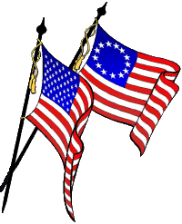
Honoring the United States Flag
(United States Code Title 4 Chapter 1 — The Flag)
Jim Alexander
Alabama Society

Slide 2
Honoring the United States Flag
History of Our Flag
The Meaning of the Flag Colors
Saluting the Flag
The Pledge of Allegiance and National Anthem
Displaying the Flag
Flag Etiquette
Disposing of Worn Flags

Slide 3
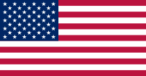
Honoring the United States Flag
History of Our Flag

Slide 4
Honoring the United States Flag
Question: Did our flag always look like it does today?
No, it has changed many times.
When we first declared our independence
from England we didn’t have a flag.
Question: How did our flag get started?
Many people think and believed that Betsy Ross did it.
Let talk a little about Betsy Ross

Slide 5
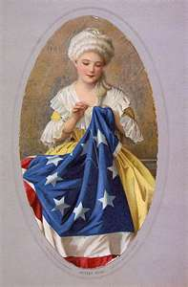
Honoring the United States Flag
She was a Philadelphia seamstress married to John Ross.
John owned and operated a upholstery shop.
He was killed in an munitions explosion in 1776.
Betsy kept the shop and earned her living as a seamstress
She did many seamstress duties for
George Washington.
According to her grandson, William J. Canby , Betsy made the first flag.

Slide 6
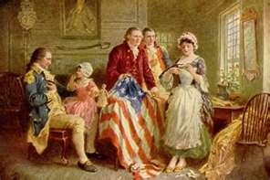
Honoring the United States Flag
At a 1870 meeting of the Historical Society of Pennsylvania Canby said:
In June, 1776 George Washington and 2
congressmen came to Betsy’s
home.
The Congressmen were Colonel Ross and
Robert Morris.
They ask that she make a flag according
to a rough draft they had with them.
At Betsy’s recommendation, Washington redrew the flag using 5 point stars instead of 6 points.
She made the flag, however, her version of the flag wasn’t used until 6 years later.

Slide 7
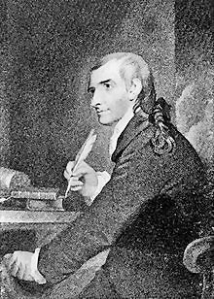
Honoring the United States Flag
Many people have investigated who made the 1st flag.
But, no one is absolutely sure who designed it, or who made it.
Many think it was most probably Congressman
Francis Hopkinson.
Now lets look at the development of the flag
In June, 1777 Congress said:
That the flag be made of :
- thirteen stripes, alternate red and white;
- that the union be thirteen stars, white in a blue field, representing a new Constellation.

Slide 8
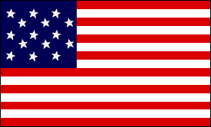
Honoring the United States Flag
This flag looked like this
13 stripes and 13 stars.
Then in 1795 when Kentucky and Vermont were admitted to the union –
Congress said:
After May, 1795. The flag should have 15 stripes and 15 stars
This flag looked like this:

Slide 9
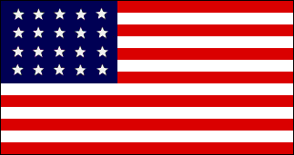
Honoring the United States Flag
Our flag had 15 stripes until 1818 -
- When congress said it was to have 13 stripes.
- and one star for each state.
By this time Tennessee, Mississippi, Ohio, Indiana and Louisiana had joined the union making 20 states.
The flag of 1818 had 20 stars and looked like this:
After this, the star for each new state was to be
added to the flag on the 4th of July following the admission of
each new state.

Slide 10
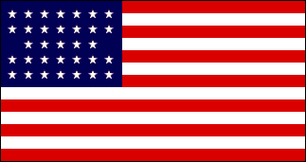
Honoring the United States Flag
Up until now, the government hadn’t said anything about the order
of the stars, nor the proportions of
the flag.
Also, design of the stars and the flag
proportions , were left up to the
flag maker.
Flag with 33 stars

Slide 11
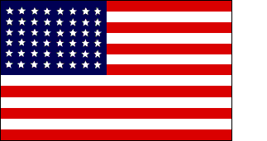
Honoring the United States Flag
June 24, 1912 – The government said:
The flag is to have the stars in
six horizontal rows –
With eight stars in each row
Flag with 48 stars
And a single point of each star is to be pointed
upward.

Slide 12
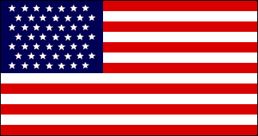
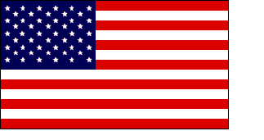
Honoring the United States Flag
In 1959 Alaska became a state so we had 49
Stars.
Flag with 49 stars
And, in 1960 Hawaii became a state and our stars increased to 50.
And that’s where we are today.
Flag with 50 stars

Slide 13
Honoring the United States Flag
Meaning of the Flag Colors

Slide 14
Honoring the United States Flag
Meaning of the Flag Colors
What does the colors red, white, and blue stand
for in the American Flag?
Writers and speakers often attribute a meaning to the colors of the flag.
But, in truth, the Continental Congress never
spoke about what the colors represented.

Slide 15
Honoring the United States Flag
Meaning of the Flag Colors
The red, white, and blue colors did appear in 1782 in the
Great Seal of the United States, and were
said to represent the ideals and beliefs
of our Founding Fathers.
The color significance was explained by Charles Thompson, Secretary of the Continental Congress, and included in the book "Our Flag," published in 1989:

Slide 16
Honoring the United States Flag
Meaning of the Flag Colors
White represents purity and innocence;
Red represents hardiness and valor;
and blue represents vigilance, perseverance, and justice.
In the beginning, only 2 parts of the flag had a meaning :
The 13 stripes represented the 13 original colonies that rebelled against Great Britain.
The stars on the blue background represented the states in the union. In the flag , there is one star for each state.

Slide 17
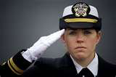
Honoring the United States Flag
Saluting the Flag
The Flag Salute

Slide 18
Honoring the United States Flag
Saluting the Flag
The Flag Salute
Face the flag , remain silent, and stand at attention.
Place your right hand over your heart.
Men and boys who are wearing a hat or cap remove it with their right hands and hold it at their left
shoulders, so that their right hands are over their hearts.
Women and girls do not need to remove their hats or caps.
People in uniform (soldiers, policemen, firemen, scouts,
security people ) should give the hand salute.
Citizens of other countries should stand at attention, and men remove their hats.

Slide 19
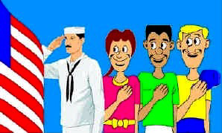
Honoring the United States Flag
Saluting the Flag
The Flag Salute should be given on these occasions:
When the flag is passing in a parade or review.
If it’s in a moving column, the salute should
be given at the moment the flag passes.
During the ceremony of raising or lowering the flag.
When the National Anthem is played.
During the Pledge of Allegiance.

Slide 20
Honoring the United States Flag
Saluting the Flag
Again, to do the Flag Salute:
- All persons come to attention.
- Citizens not in uniform salute by placing their right hand over the heart.
- Men and boys with hats or caps should remove them and hold them to their left shoulders, with their right hands over the heart.
- Women and girls do not need to remove their hats or caps.
- Those in uniform give the appropriate salute.
- Veterans may give the hand salute if they choose.
- People in a formation, such as a scout group or military unit, are to salute upon command of the person in charge.

Slide 21
Honoring the United States Flag
The Pledge of Allegiance and National Anthem

Slide 22
Honoring the United States Flag
The Pledge of Allegiance and National Anthem
When the National Anthem is played and the flag is displayed:
You face toward the flag and do the Flag Salute.

Slide 23
Honoring the United States Flag
The Pledge of Allegiance and National Anthem
When the National Anthem is played and the flag is not displayed:
You face the source of the music and do the Flag Salute.

Slide 24
Honoring the United States Flag
Displaying the Flag

Slide 25
Honoring the United States Flag
Displaying the Flag
There are many ways to display a flag. We’ll only talk about a few of them.
Also, flags are displayed at many places:
- Who can tell me where the American flag is displayed?
Here’s a few:
Businesses
Schools
Post Office and other government buildings
Churches
Homes
Parades

Slide 26
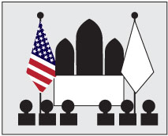
Honoring the United States Flag
Displaying the Flag
When displayed on a pole in a church or public auditorium -
- The flag of the United States of America should hold the position of superior prominence.
- It should be placed at the preacher’s or speaker's right as he faces the audience.
- Any other flag on display should be placed on the left of the speaker .

Slide 27
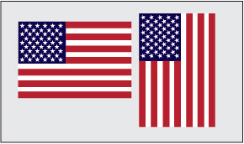
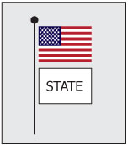
Honoring the United States Flag
Displaying the Flag
When the flag is displayed vertically and
horizontally -
When horizontal – the blue field should be
in the upper left corner when facing
the flag.
Likewise, when hanging the flag in the vertical position the blue field should be in the upper left corner when facing the flag.
When the flag is flown with a state, city or local flag -
- When flown from the same pole the United States flag is positioned above the other flag.

Slide 28
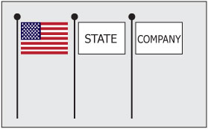
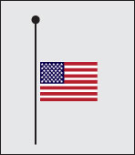
Honoring the United States Flag
Displaying the Flag
When the flag is displayed with state, city or local
flag or flags and each has a pole -
- The U. S. flag should be positioned on the left looking from the audience.
- The flag of the United States should be hoisted first and lowered last.
When the flag is flown at half staff –
- In raising the flag - it should be first raised to the top of the pole for an instant and then lowered to the half-staff position.
- When taking the flag down - the flag should, again, be raised to the top of the pole before it is lowered.

Slide 29
Honoring the United States Flag
Flag Etiquette

Slide 30
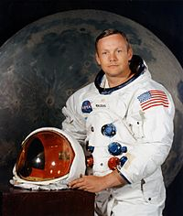
Honoring the United States Flag
Flag Etiquette
The flag should never be dipped to any person or thing.
It is flown upside down only as a distress signal.
The flag should not be used as a drapery, or for covering a
speakers desk, draping a platform, or for any
decoration in general.
Who can tell me the one exception?
The flag should never be used for any advertising purpose.
The flag should not be used as part of a costume or athletic uniform, except that a flag patch may be used on the uniform of military personnel, fireman, policeman and members of patriotic organizations.

Slide 31
Honoring the United States Flag
Flag Etiquette
The flag should never be worn as clothing.
The flag should never have placed on it, or attached to it, any mark, insignia, letter, word, number, figure, or drawing of any kind.
The flag should never be used as a receptacle for receiving, holding, carrying, or delivering anything.
When the flag is lowered, no part of it should touch the ground or any other object; it should be received by waiting hands and arms, and folded properly

Slide 32
Honoring the United States Flag
Flag Etiquette
To stow the flag it should be folded neatly and ceremoniously.
The flag should be cleaned and mended when
necessary.
When a flag is so worn that it is no longer fit to serve as a symbol of our nation, it should be destroyed appropriately.

Slide 33
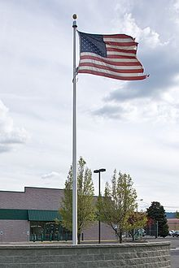
Honoring the United States Flag
Disposing of Worn Flags

Slide 34
Honoring the United States Flag
Disposing of Worn Flags
It should be destroyed privately and in a dignified manner.
- This must be done with honor.
- The best method to destroy a flag is to burn it. Burning represents cleansing and rebirth.
- The flag should not be cut in pieces prior to burning
- If you don’t feel comfortable disposing of the worn
flag yourself, there are patriotic organizations
that will do it for you.
- Organizations such as Girls Scouts of America, Boy Scouts of America, American Legion Post, or Veterans of Foreign Wars and many Sons of the American Revolution Chapters.

Slide 35
Honoring the United States Flag
Questions ????
Thanks for having us!

Slide 36
Honoring the United States Flag
Sons of the American Revolution
Booklet on the American Flag

