Slide 1
A Proposal to Spotlight Special United States Military History Key Events
National Society
Veterans Committee

Slide 2
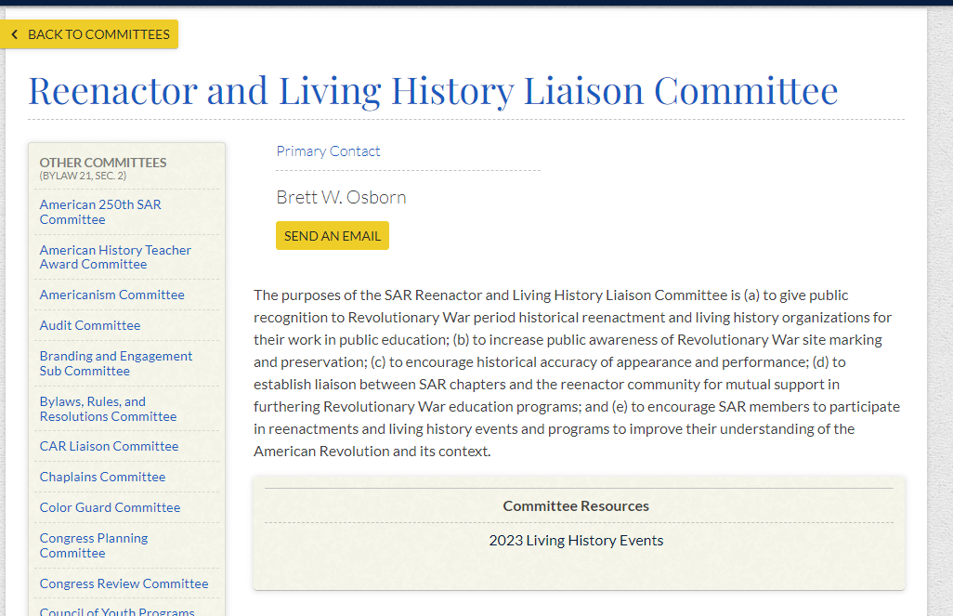
How to…
Expand the scope of the Vietnam War Commemoration sub-committee.
One idea is to have a website updated annually posting a list of the upcoming commemorations with a brief description of the various anniversaries similar to the Re-Enactors Liaison webpage.

Slide 3
Recurring Event with Annual Highlights
The National Guard of the United States was founded as State Militias and is the oldest component of the Armed Forces. Today, it is a joint activity of the United States Department of Defense consisting of the Army and the Air National Guard.
The United States Army was founded on 14 June 1775 when the Continental Congress authorized enlistment of riflemen to serve for one year.
The United States Marine Corps was founded to serve aboard naval vessels and was responsible for the security of the ship and its crew by conducting offensive and defensive combat during boarding actions and defending the ship’s officers from mutiny.
The United States Coast Guard was founded on 4 August 1790 when President George Washington signed the Tariff Act that authorized the construction of ten vessels, referred to as “cutters,” to enforce federal tariff and trade laws and to prevent smuggling.
The United States Air Force was Initially part of the United States Army and authorized as a separate branch of the military on 18 September 1947 under the National Security Act of 1947.
The United States Space Force is the first new armed service since 1947 established 1 September 1982 with responsibility for space warfare operations.
June 14, 1775 – Army Birthday
August 4, 1790 – Coast Guard Birthday
September 18, 1947 – Air Force Birthday
October 13, 1775 – Navy Birthday
November 10, 1775 – Marine Corps Birthday
December 13, 1636 – National Guard Birthday (The Militia)
December 20, 2019 – Space Force birthday
Focus on the celebration of each service birthday to show pride and respect for military members and what they represent!

Slide 4
Significant Event Anniversaries
2023:
20th Anniversary of the beginning of OIF
50th Anniversary of the end of the Vietnam War
50th Anniversary of the All-Volunteer Army
70th Anniversary of the Korean Armistice
240th Anniversary of the end of the Revolutionary War
250th Anniversary of the Boston Tea Party
2022:
160th Anniversary of the Congressional Medal of Honor.
30th Anniversary of Desert Storm and Desert Shield

Slide 5
Significant Military Months Examples
April – Month of the Military Child
May – National Military Appreciation Month
May – Month of the Military Caregiver
November – Military Family Month, Warrior Care Month

Slide 6
Events the SAR Already Highlights
May 30 – Memorial Day A solemn occasion to honor those who died while serving in the military.
June 14 – Flag Day – A day to celebrate the adoption of the U.S. flag.
July 4 – Independence Day
Nov. 11 – Veterans Day – This is the anniversary of the signing of the armistice treaty, which ended World War I and is also a day to thank military Veterans for their service.
Dec. 17 – National Wreaths Across America Day

Slide 7
A Partial List we can Select From
Feb. 3 – Four Chaplains Day – A day to remember the four U.S. Army chaplains who made the ultimate sacrifice when the USAT Dorchester sank during World War II.
Feb. 19 – Coast Guard Reserve Birthday
March 3 – Navy Reserve Birthday
March 13, K-9 Veterans Day – The date is the official birthday of the United States K9 Corps and a day to honor their service.
March 25, Medal of Honor Day – A holiday to honor the heroism and sacrifice of Medal of Honor recipients for the United States.
March 29 – Vietnam Veterans Day – A national holiday to recognize and honor Veterans who served in the military during the Vietnam War. Learn more about Vietnam Veterans Day here.
April 5 – Gold Star Spouses Day – A day dedicated to those whose spouses gave their lives while serving in the U.S. military or as a result of service-connected injuries or illness.
April 14 – Air Force Reserve Birthday
April 23 – Army Reserve Birthday

Slide 8
A Partial List we can Select FromCont.
May 1 – Silver Star Banner Day – Per Congressional resolution, it is an “Official Day to honor wounded, ill, and injured Veterans”.
May 6 – Military Spouse Appreciation Day – This date recognizes the service and sacrifices of military spouses.
May 13 – Children of Fallen Patriots Day – A day to honor the children left behind by the brave men and women who gave their lives while defending our freedom.
May 21 – Armed Forces Day Observed on the third Saturday every May, this is a day dedicated to paying tribute to men and women currently serving in the U.S. Armed Forces.
June 6 – Anniversary of the World War II Allied invasion in Normandy, France, now known as D-Day.
June 23 – Coast Guard Auxiliary Birthday
June 27 – National PTSD Awareness Day – A day to bring awareness about issues related to PTSD. Find resources for PTSD here.
July 27 – Korean War Veterans Armistice Day

Slide 9
A Partial List we can Select FromCont.
Aug. 7 – Purple Heart Day – A time for Americans to pause to remember and honor the brave men and women who were either wounded on the battlefield or paid the ultimate sacrifice. Learn more about the Purple Heart.
Aug. 29 – Marine Forces Reserve Birthday
Sept. 11 – Patriot Day – An annual observance to remember and honor those who were injured or killed during the Sept. 11, 2001, terrorist attacks.
Sept. 16 – POW/MIA Recognition Day
Sept. 25 – Gold Star Mother’s and Family’s Day – A day to honor the families of fallen Servicemembers.
Oct. 26 – National Day of the Deployed
Dec. 7 – Pearl Harbor Remembrance Day – The anniversary of the day Japan attacked Pearl Harbor, Hawaii, signaling the United States’ entrance into World War II. Learn more about Pearl Harbor Day.

