Slide 1
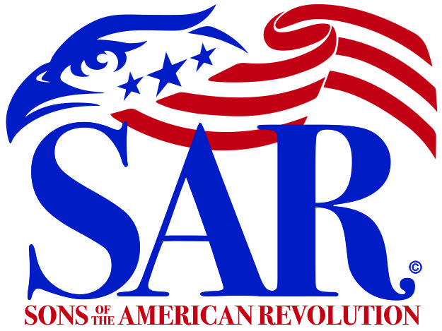
BRAND Concepts The Mission Statement, Logo & Engagement
Prepared by the Communications and Marketing Committee

Slide 2
Contents
This presentation provides a brief overview of the Brand and Engagement Guide generated to work toward the stated goals.
Where do I find it?
Log in to National Website: SAR.org
Click on Members
Click on Forms & Manuals
Scroll down to:
Brand and Engagement Guide

Slide 3
Purpose
The purpose of the new guides is to provide for:
Cohesion of messaging
Continuity
Adherence to standards established
In so doing, SAR will be in better position to achieve the goals of the mission statement, as well as:
Increase membership and retention
Increase awareness of SAR, the offerings, and the value
Increase engagement with the target audiences

Slide 4
Brand and Engagement Guide – Overall Goals
This guide will provide steps for creating engagement with the target audience through certain media avenues utilized by National, Chapter, State and District SAR organizations.
This guide is divided into three main parts:
Brand Identity
Proper Usage of Branding Elements
Engagement

Slide 5
SAR Brand Pyramid
The following visually displays the framework at the heart of every brand. Each level helps shape the “who”, “how”, and “why” of our brand in its own way.
Purpose – Mission Statement
Positioning – Elevator Pitch
Personality - Brand
Perception – Touch Points
Promotion - Marketing

Slide 6
Brand and Engagement Guide - Brand Identity
Essentially brand identity is the personality of the organization and the process of impression shaping, and it’s comprised of:
what your brand says,
what your values are,
how you communicate your value, and
what you want people to feel when they interact with the organization and its content.
Purpose - Mission Statement
Positioning - Elevator Pitch
Personality – Brand
Perception - Touch Points
Promotion - Marketing

Slide 7
SAR Mission Statement
The Sons of the American Revolution honors our Revolutionary War patriot ancestors by
promoting patriotism,
serving our communities,
and educating and inspiring future generations about the founding principles of our country.

Slide 8
Discussion - What is promoting patriotism?

Slide 9
Promoting Patriotism
Our eagle logo represents our goal to inspire patriotism
We work to carry out the promises enshrined in the preamble to the Constitution:
“We the People of the United States, in Order to form a more perfect Union, establish Justice, insure domestic Tranquility, provide for the common defense, promote the general Welfare, and secure the Blessings of Liberty to ourselves and our Posterity, do ordain and establish this Constitution for the United States of America."

Slide 10
Promoting Patriotism
We work to inspire our community
Color Guard Participation in patriotic events
Leadership presence at civic and patriotic events
Extend the institutions of American Freedom by focusing public attention on the teaching of US History.
SAR Congress passes resolutions to stimulate personal and national actions based on these principles
We strive to maintain and extend institutions of American freedom.
Focus public attention on issues on the teaching of history

Slide 11
Promoting Patriotism
Public Service Recognition of those who exemplify our best civic traditions
Law Enforcement
Public safety officers
First responders who exemplify our best civic traditions
Honor, respect, and support our military and our Veterans, especially those in residential and hospital facilities of the Veterans Administration

Slide 12
Discussion What does serving our communities mean?

Slide 13
Serving our communities means…
“Community service is work done without pay to help people in a community…”
“Community service is a non-paying job performed by one person or a group of people for the benefit of their community or its institutions.”
“Community service is work done by a person or group of people that benefits others. It is often done near the area where you live, so your own community reaps the benefits of your work.”
(Source: The Britannica Dictionary, https://www.britannica.com)
(Source: Wikipedia; "Community Service". Merriam-Webster. Merriam-Webster, Incorporated. Retrieved 1 August 2020.)
Christine Sarikas, Michigan State University with degrees in Environmental Biology and Geography and received her Master's from Duke University. See: Definition: What Is Community Service? (prepscholar.com)

Slide 14
Serving Our Communities
Nonprofits are where Americans come together to solve problems
Nonprofits are promoters of civic engagement
Nonprofits are building blocks of democracy
Nonprofits are laboratories where people learn leadership
Nonprofits are economic engines
(Source: National Council of Nonprofits, “Nonprofit Impact Matters: How America’s Charitable Nonprofits Strengthen Communities and Improve Lives”., www.nonprofitimpactmetters.org)

Slide 15
Serving our Community another look …
Serving our Community is volunteer work we do to help people in near where we live.
Serving our Community is volunteer work done for the benefit of the community or its institutions.
Serving our Community can be done individually or as part of a larger group, both of which can bring benefits to those being helped, as well as those helping.

Slide 16
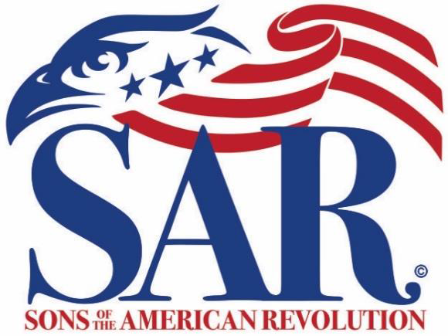
Does the SAR provide service to the community?

Slide 17
Different Types of Service
SERVICE
External:
Benefits the Community
Internal:
Benefits the Organization

Slide 18
Which of these constitutes service? Which serves externally? Internally? Our Community?
Visiting a VA Hospital?
Giving a classroom presentation?
Participating in Wreaths across America?
Recognizing public service?
Sponsoring/organizing youth contests?
Helping someone with their lineage?
Marking grave sites?

Slide 19
Discussion - How do we educate and inspire future generations about the founding principles of our country?

Slide 20
Educating and inspiring future generations about our founding principles
Sponsorship of youth award programs
Essay and Oration contests
Elementary and Middle school programs
Patriot Chest lessons
SAR Education Center and Museum
SAR Outreach Education program
Inform the community about the ideals of the Revolution
Help people locate and evaluate genealogical sources at the local, state, and national level

Slide 21
Brand and Engagement Guide – Branding Elements (Let’s Focus on the Logo)
To establish consistent usage of logos, colors, and naming protocols, this document details the proper uses of the various branding elements in sections pertaining to:
SAR Eagle Logo Usage Guidelines
SAR Eagle Logo Specifications
SAR Eagle Logo Brand Uniform Naming Conventions
SAR Insignia Usage Guidelines (Restrictions Apply)
SAR Information Technology URL Protocols
SAR Organization Designation Protocols

Slide 22
SAR Eagle Logo Usage Guidelines
The SAR eagle logo brand of red and blue on a white background to be used consistently on
all National, District, State and Chapter websites,
business cards, stationary, correspondence,
press releases, social media, banners, merchandise,
and anything else that will be seen by the public to continually reinforce our brand and its image.

Slide 23
Brand and Engagement Guide – Logo Usage
Logo usage guidelines pertain to the SAR principal “Eagle” logo.

Slide 24
Discussion – Logo Standardization
What is the problem with all the state and
chapter logos?
Why is logo standardization necessary?
How does it help with Brand Recognition?
Is it necessary for Professionalism?
Does it provide credibility to SAR?
Will it create clarity and ease of use?
What does cross-platform consistency provide?

Slide 25
SAR Eagle Logo Specifications
Brand Colors
The SAR Eagle Logo is comprised of two colors. There are to be no deviations from these colors on the SAR Eagle logo.
The color codes are as follows:
Logo Font
The official font for the SAR Eagle logo is Bodoni 72 oldstyle. There are to be no deviations from this font on the SAR Eagle logo.
Primary Color | PMS
Blue | PMS 287C
Red | PMS 193C

Slide 26
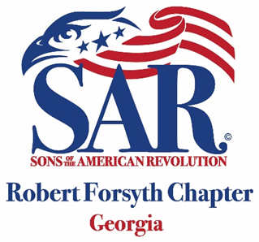
SAR Eagle Brand Uniform Naming Conventions
District Logo
Uniform Naming Conventions for all Districts
State Logo
Uniform Naming Conventions for all States
Chapter Logo
Uniform Naming Conventions for all Chapters
NOTE: Contact Drew Hight at National if assistance is needed to create your uniform logo.

Slide 27
Brand and Engagement Guide Logo Usage Exceptions
Exceptions to SAR Eagle Principal Logo approved by the Executive Committee remain in effect for the life of the program or materials. At present, the following are exempted from these usage guidelines:
The America 250 SAR logo
The Revolutionary War Rarities logo
Medals and other awards approved by the Medals & Awards and Executive Committees
Insignia of the National Society
Annual Congress memorabilia
Grave markers

Slide 28
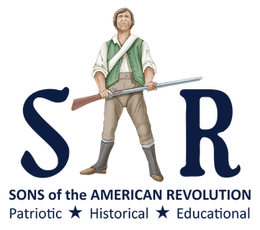
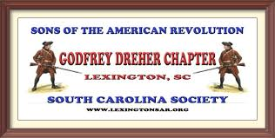
State/Chapter Logos vs National Logo
What is the
best answer for
Brand Awareness?
Use only National Logo
State or Chapter underneath

Slide 29
Brand and Engagement Guide – Engagement
This guide also details the various elements of engagement to be implemented:
Know your audience
Changing public perception of your brand
Maintaining the human touch
Remain consistent
Get creative with content posts
Tell stories
Track analytics
Post consistently
Use taglines

Slide 30
SAR Elevator Pitch
The Sons of the American Revolution
promotes patriotism,
serves the community, and
inspires and educates the public
about the history of the American Revolution.

Slide 31
NEXT STEPS
Read the Mission Statement at the beginning of business meetings: National, State, Chapter
Have the mission statement or elevator pitch on the back of Compatriot business cards
Update all brochures with the mission statement
Have elevator pitch contests at state conventions during youth luncheons when filler is needed during oratory contests
Include the mission statement in all proclamations

