Slide 1
Postcard Project
Purpose, Target Audience (Internal)
Postcards are being created that help commemorate the 250th anniversary of significant events during the Decade of the Revolution. These postcards might become keepsakes.
The postcards are intended to be mailed to Compatriots as a dues payment reminder or a reactivation request.
Organization
This PowerPoint is divided into three sections.
Section 1 – talks about the Why and the What.
Section 2 – discusses How a postcard is made.
Section 3 – has .jpeg images of both the front side of the postcard, as well as the back side of the postcard.
Section 3 also has images for: The Boston Tea Party, Carpenter’s Hall, and Lexington & Concord. More images will be added in the future.

Slide 2
Postcard Project – Section 1
Purpose, Target Audience (Internal)
Postcards are being created that help commemorate the 250th anniversary of significant events during the Decade of the Revolution. These postcards might become keepsakes.
The postcards are intended to be mailed to Compatriots as a dues payment reminder or a reactivation request. Using this approach “reactivate” means “reinstate.”
The Chapter might also use the “reactivate” message to send to members who haven’t been to a meeting recently. Reactivate was chosen over “reinstate” to permit this concept. Personal space usage is encouraged.
Design Concept
Front Side
The design of this project is to develop postcards of each of the ten primary signature events of the Decade of the Revolution as developed by the SAR America 250th Committee.
There are multiple different images offered. They either utilize SAR commissioned artwork or an image believed to be public domain images. The images are meant to be evocative of the American Revolution.
Occasionally there may be different options with each image.
Design Concept
Obverse Side
The message content is generally SAR contact information, the mission statement, and a brief image comment. The back side may explain a quote on the front and should be used.
There are two back side choices.
  One has the mission statement and a request to reactivate their membership with a place for mailing information.
  One has the mission statement removed and a small amount of space for a personal message.
  Note: The Concept is to have a QR code to take you to a landing page to make it easier to pay your dues. When that is developed each of the postcards will be updated with a QR code.

Slide 3
Postcard Project – Section 2
How to make a Postcard
There are two basic steps to creating your postcard.
The first is you pick the reproduction medium.
The second is you select the front page and also the back side.
Reproduction Medium
You could use a vendor you can find online such as Vista Print. The other way is to print them yourself using a product such as Avery matte white postcards, 4” by 6”. Cost varies by quantity ordered and vendor selected. Time of delivery is also a consideration. Compatriots willing to help are listed on the Project Plan with their email addresses.
Selection of the Front and Back sides
Obviously, you select the image and the message for your target audience.
The images on this power point are jpegs. You must capture these and then upload to the vendor or copy and paste into the template space if you choose a product such as Avery.

Slide 4
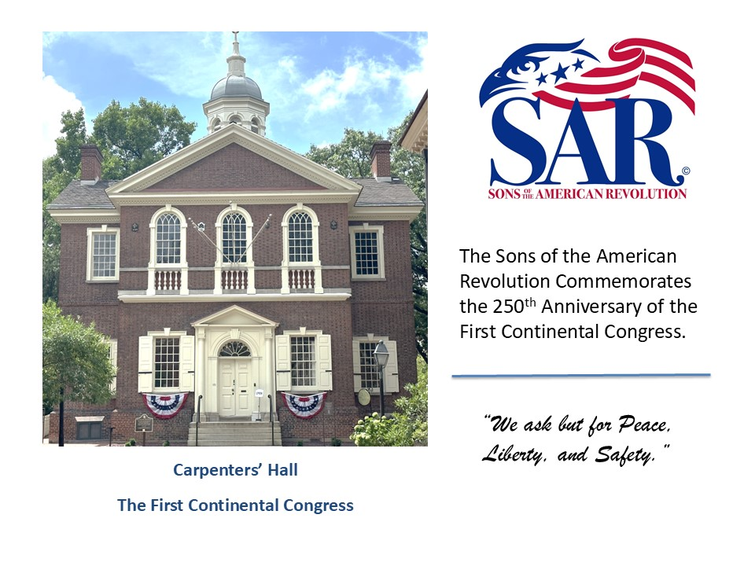
Postcard Project – Section 2
Sample Front Side
Right click on the image to save as a .jpeg to your computer. Using a filename that usefully matches the image.
This applies to any of the .jpeg images in Section 3.

Slide 5
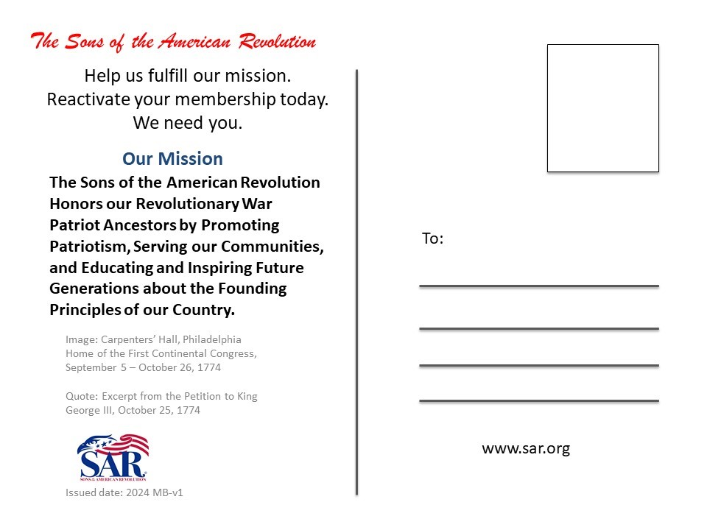
Postcard Project – Section 2
Sample Back Side
Right click on the image to save as a .jpeg to your computer. Using a filename that usefully matches the image.
This applies to any of the .jpeg images in Section 3.

Slide 6
Postcard Project – Section 3
Carpenters’ Hall
First Continental Congress
(There are 4 different fronts you may choose between.)

Slide 8
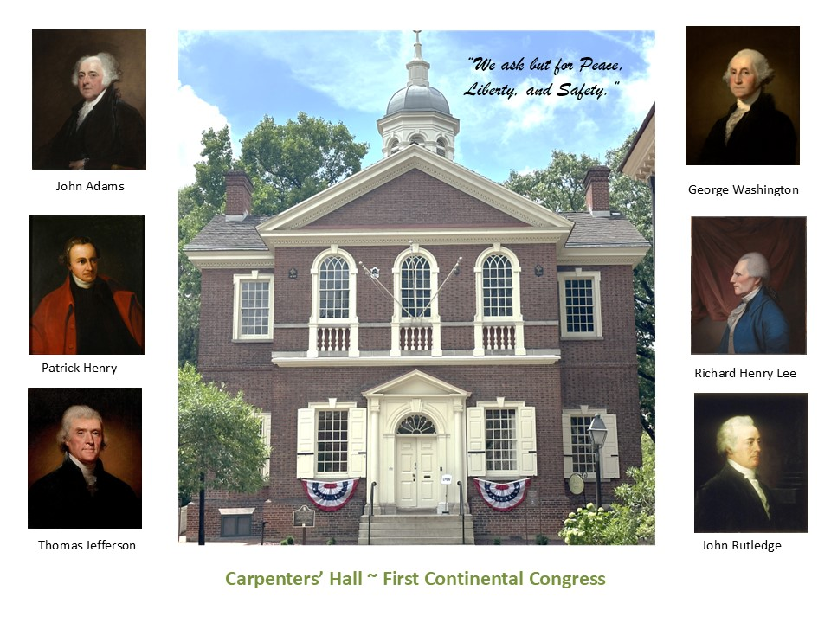

Slide 9
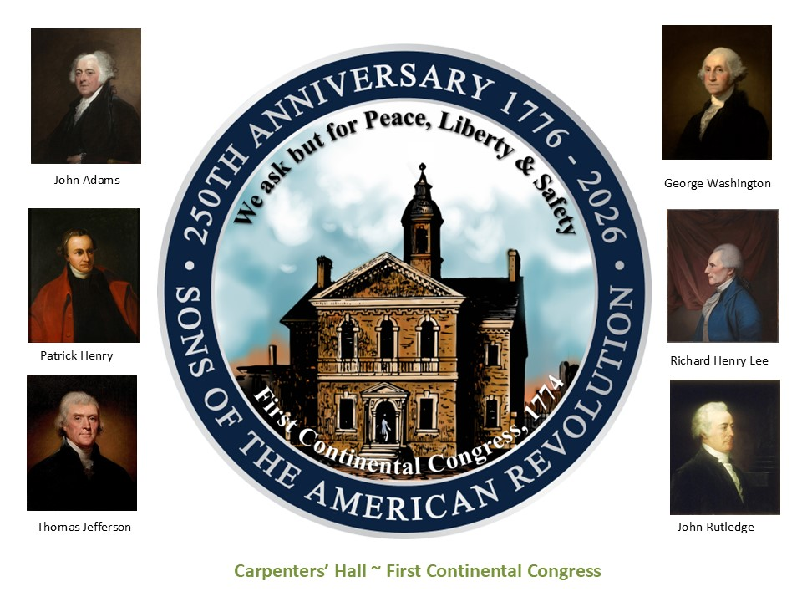

Slide 10


Slide 11
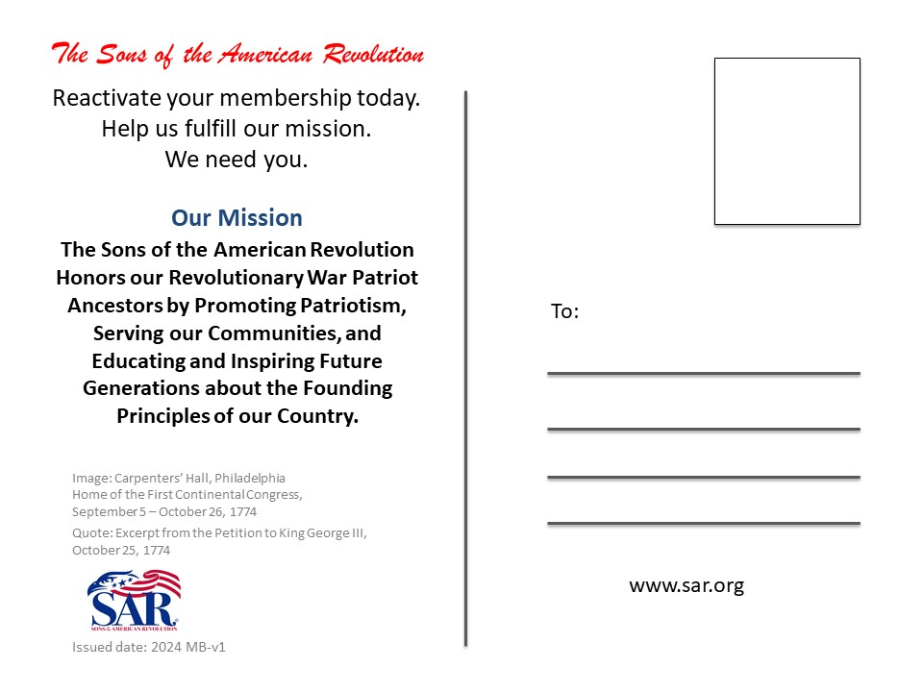

Slide 12
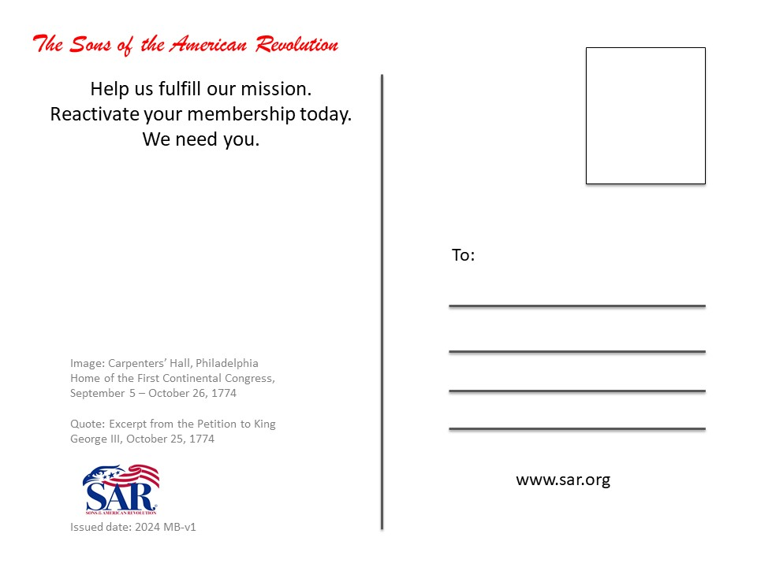

Slide 13
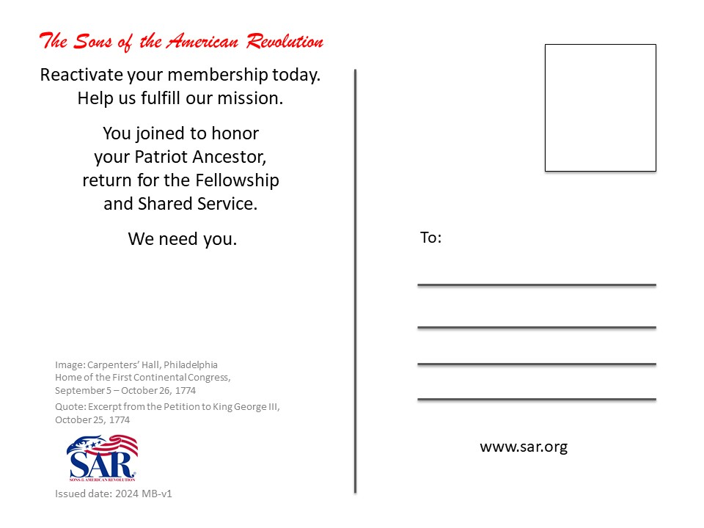

Slide 14
Postcard Project – Section 3
Boston Tea Party

Slide 15


Slide 16


Slide 17
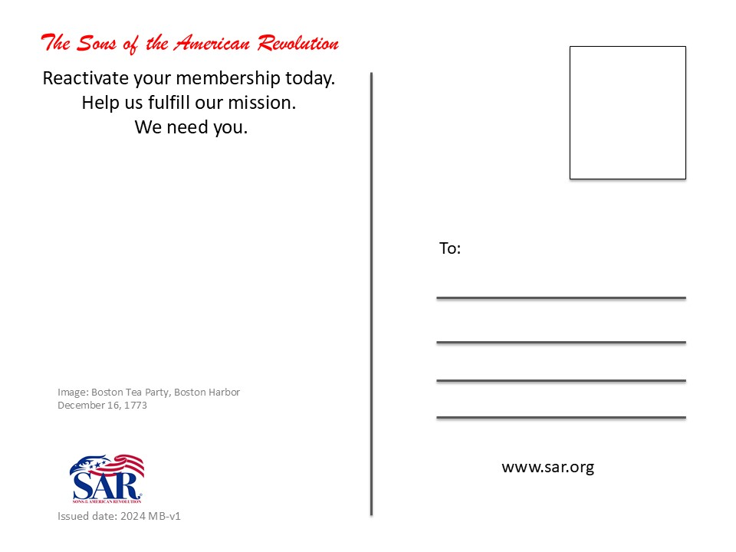

Slide 18
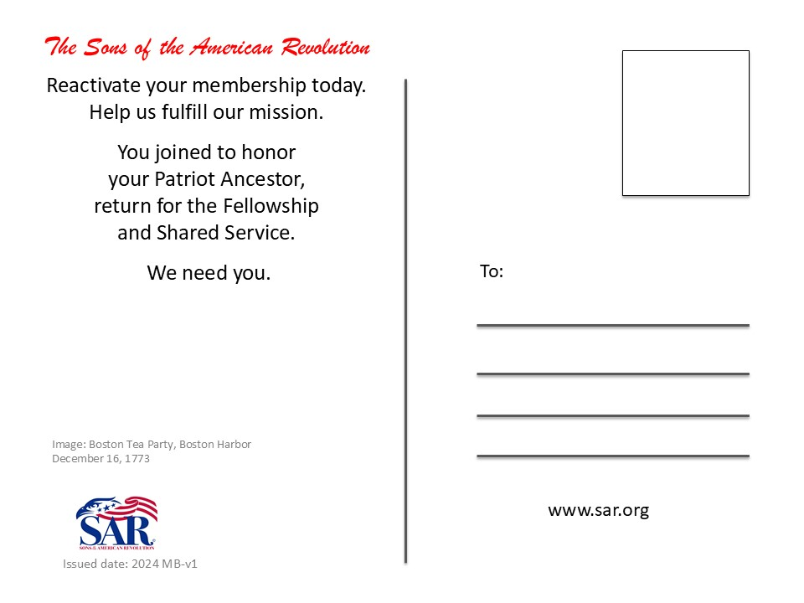

Slide 19
Postcard Project – Section 3
The SAR Commissioned Art has not been developed as of this time.
Battles of Lexington and Concord
Note: You have three fronts to choose from.
Only one has a quote on the front. If you choose the front with the quote, you must choose the back which references the quote.

Slide 20
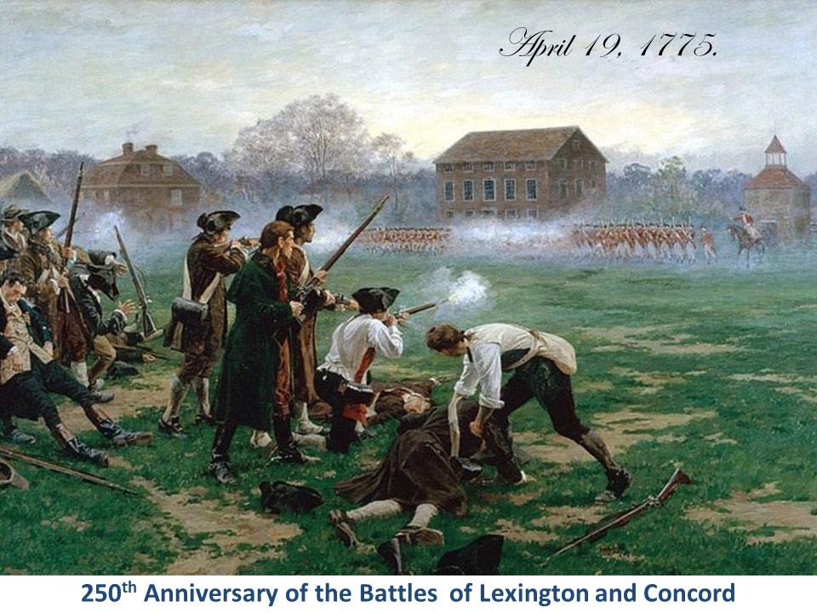

Slide 21


Slide 22
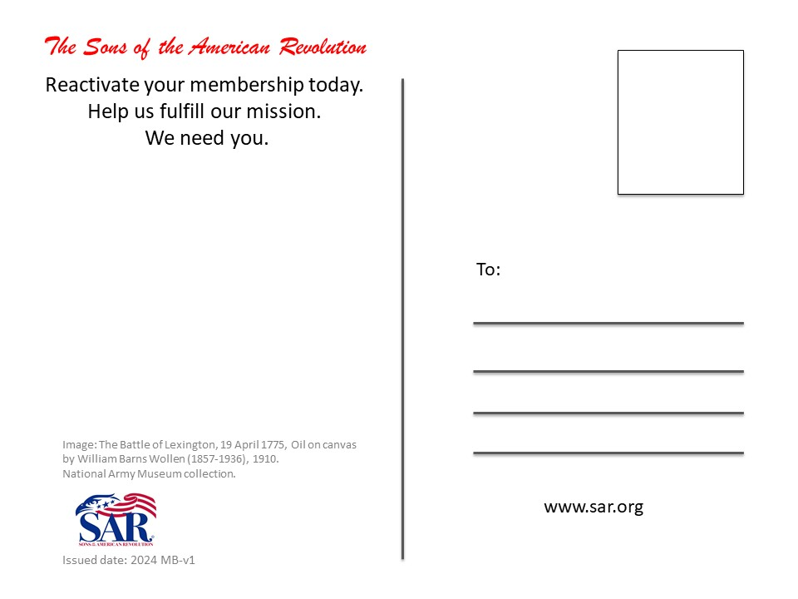

Slide 23
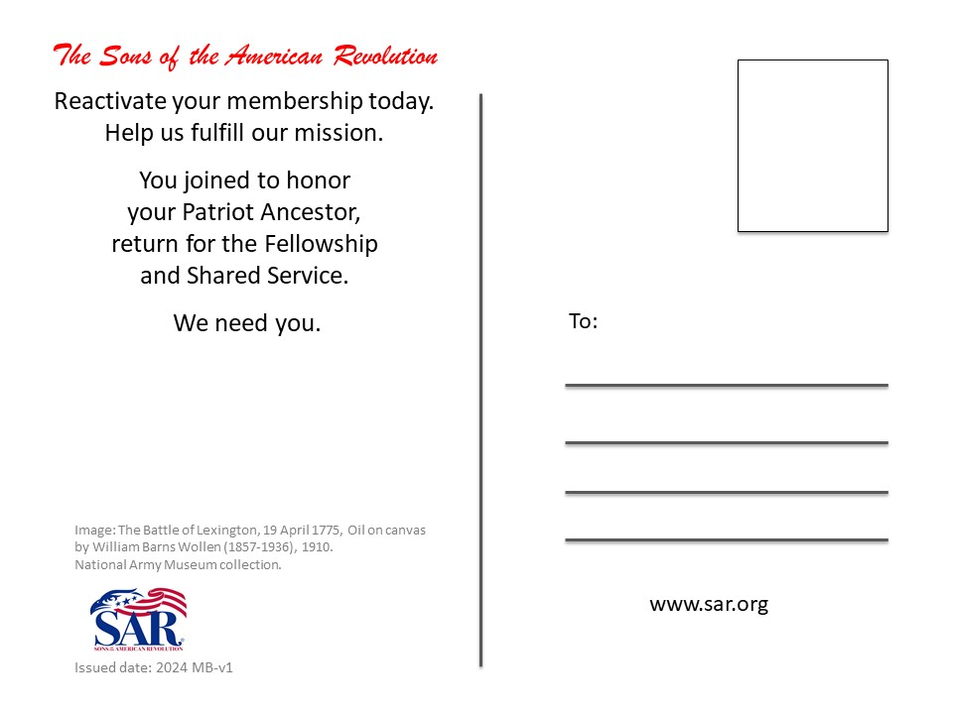

Slide 24


Slide 28
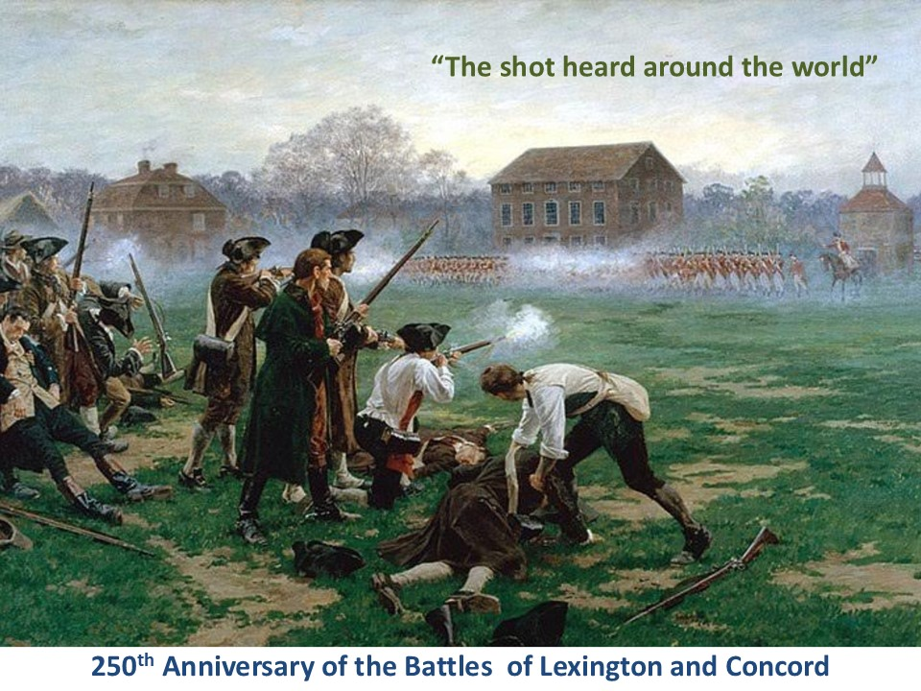

Slide 29


Slide 30
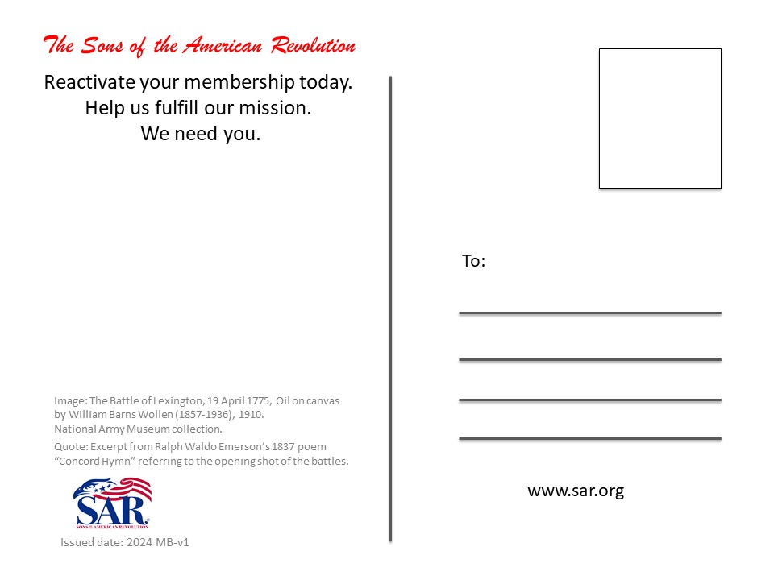

Slide 31
