Slide 1


Slide 2
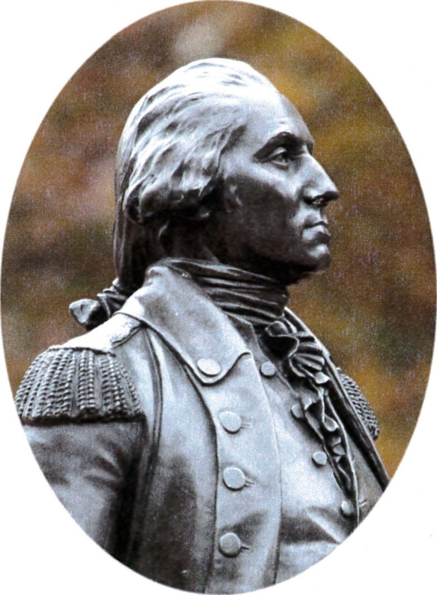
Become a George Washington Fellow today!!
Pay a lump sum of $1000 or pay yearly installments to become a GWEF Fellow!
Your donations help fund many projects and programs across the entire Society – chapters, state societies, and national committees!!

Slide 3
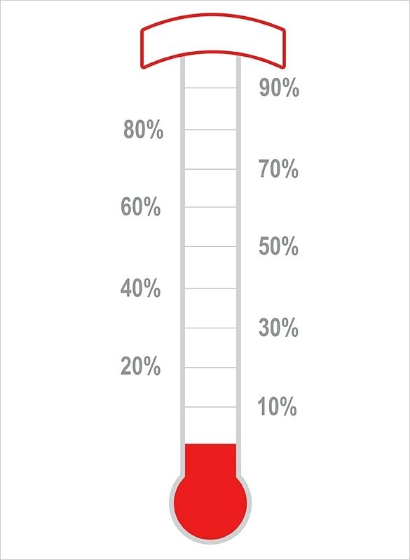
2024-25 GWEF Goal & Status
CHALLENGE: 100 New GWEF Fellows
100 Fellows
2023-24 was a record year!
  119 new GWEF Fellows!!
Where do your GWEF dollars go?
  Monuments/Plaques
  250th Anniversary Benches
  Historical/Educational Programs
  New Chapter Starter Kits
  Committee Support
39% (39)
As of 6 October 2024

Slide 4
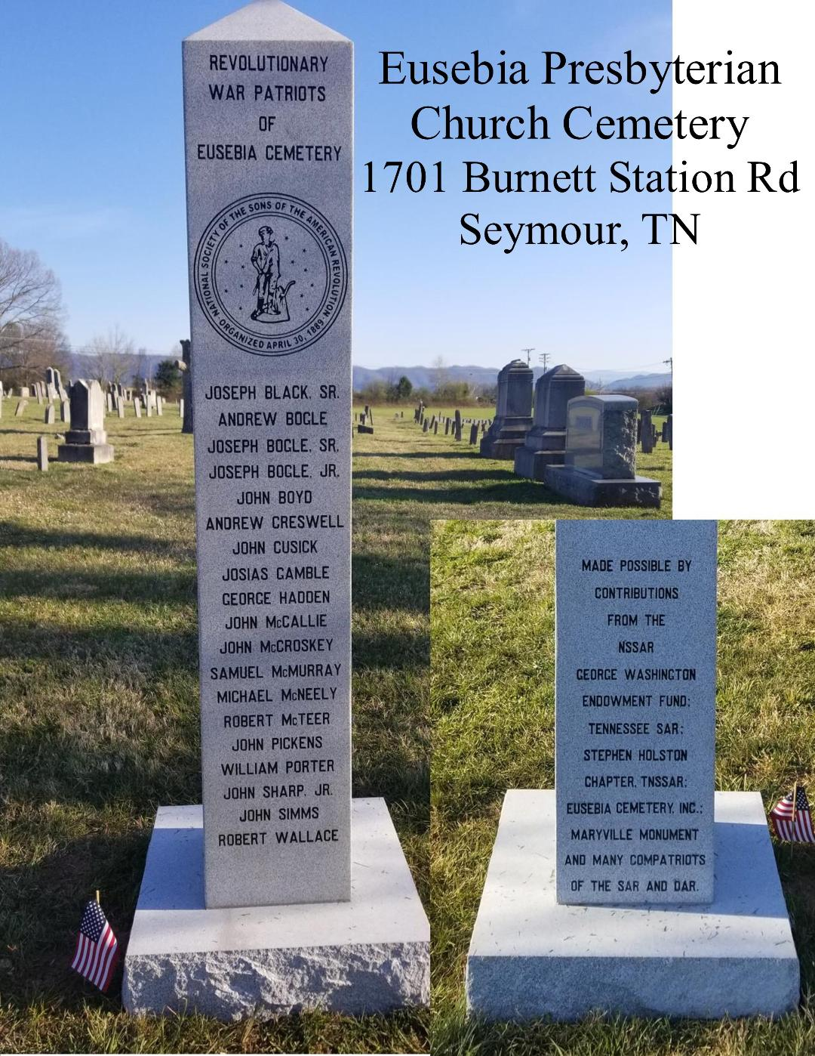
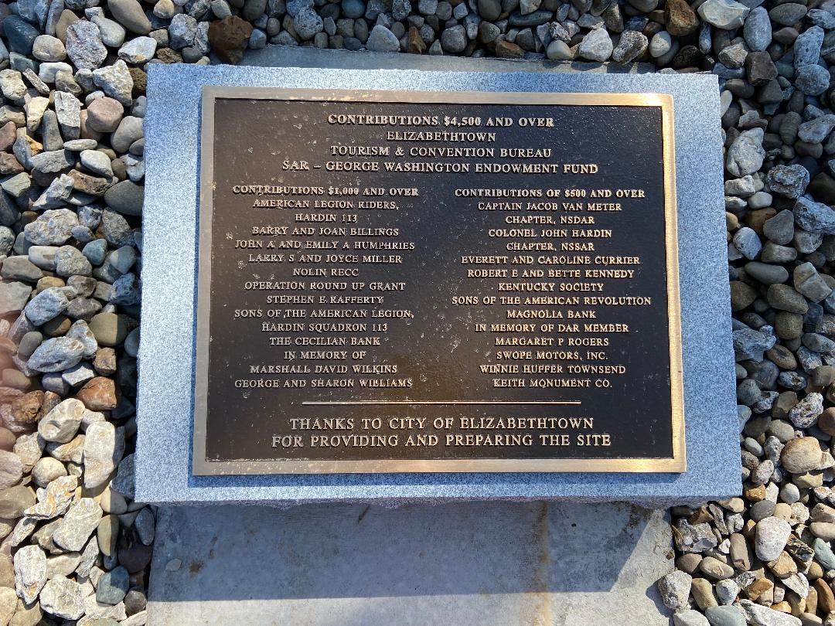
Key Projects Funded by GWEF
Monuments/Plaques
  Vermont – Brittle Azar Stow Cemetery [$5,000 ~22%]
  North Carolina – Greenlee Ford Monument for 33 Rev War Patriots [$4,000 ~ 32.78%]
  Tennessee – Sullivan County Veteran’s Memorial Park Marker [$7,500 ~ 49.2%]
  Michigan – Patriot Cemetery Plaque Marking Project (5 cemeteries) [$4,500 ~ 32.7%]
  West Virginia – Restoration & Relocation of McColloch’s Leap Monument [$10,000 ~ 33%]
  Texas – Texas SAR Monument Project, Texas State Cemetery in Austin [$15,000.00 ~25%]

Slide 5
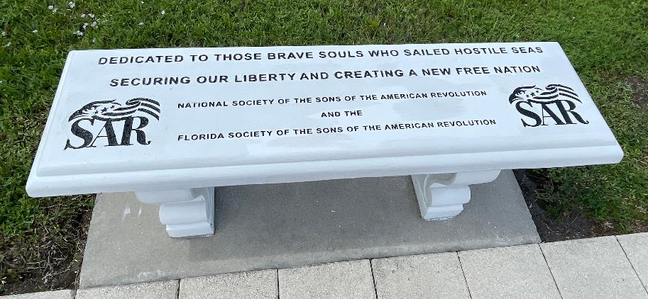
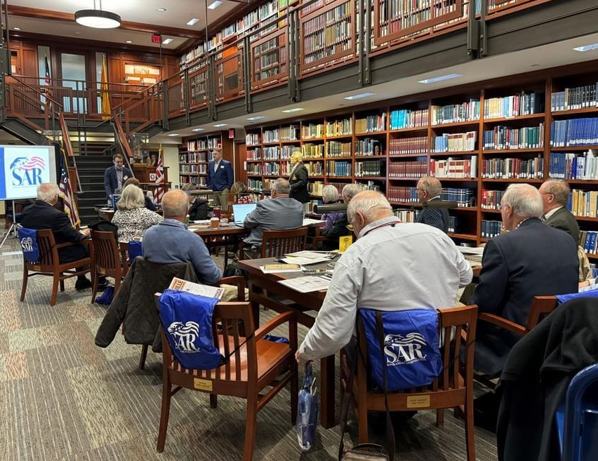
Key Projects Funded by GWEF
250th Anniversary Benches
  Florida – Last Naval Battle [$1,715 ~50%]
  West Virginia - North House Museum, Greenbrier Historical Society [$ 1,250 ~36.17%]
Historical/Educational Programs
  2020 SAR Annual Conference on the American Revolution [$12,000 ~25.6%]
  Historian General – Congress History Roundtable [$1,500 ~100%]
  Education Committee – Revolutionary War Education Forum [$ 1,731 ~50%]

Slide 6
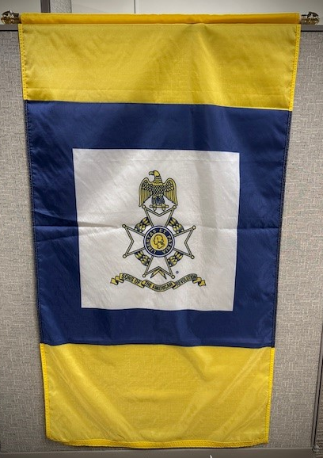
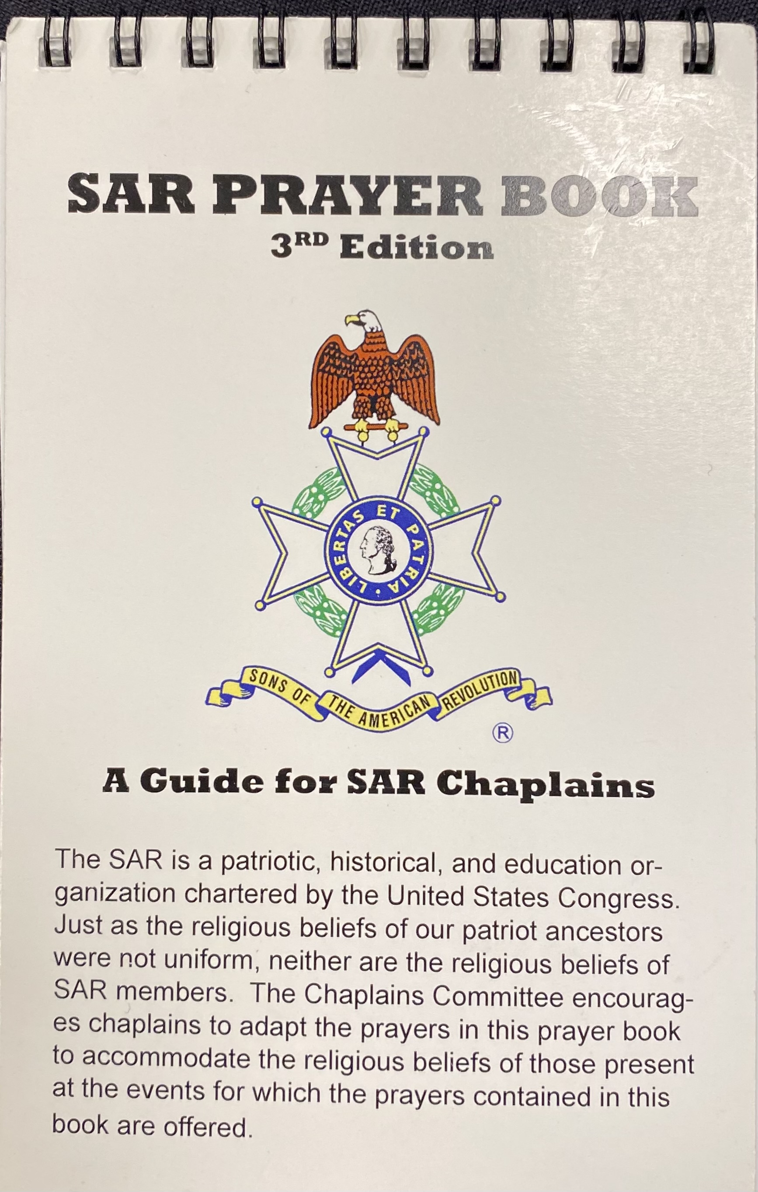
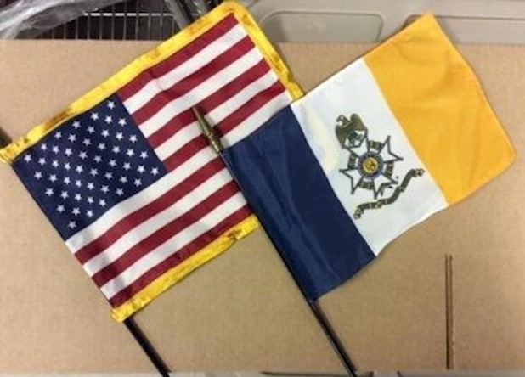
Key Projects Funded by GWEF
New Chapter Starter Kits
  Starter Kit: SAR Podium Banner, US & SAR Flags Desk Set, SAR Prayer Book
  New chapters in Virginia, North Carolina, Massachusetts, Texas, Mississippi, Missouri
Committee Support
  Rumbaugh Orations Committee - Congress Contestants Breakfast [$600.00 ~ 100%]
  Veterans Recognition Committee – Certificates, Brochures, Mailing & Postage [$1,000.00 ~100%]
  Museum Board – Display Case for Custom Built Model of the Turtle Submarine [$5,000.00~26%]

Slide 7

Be a George Washington Fellow
Send contributions or pledges to GWEF at 809 W. Main Street, Louisville, KY 40202 for the following options:
  $1000 initial one-time payment by check
  $250 initial payment completed over 4 years
  $200 initial payment complete over 5 years
  $100 initial payment completed monthly over 10 months
Or pay by credit card for same amounts - same time periods for payments. Go to either:
  http://bit.ly/2seARG5 or
  http://weblink.donorperfect.com/GWEF

Slide 8
GWEF Fundraising Team
Jim Maples (AL) – GWEF Board Chairman
  jhmaples@gmail.com
Jay DeLoach (NC) – GWEF Fundraising Committee, Chairman
  jaydeloach@aol.com
John Fulwider (MS) – GWEF Fundraising Committee, Eastern Vice Chairman
  driff@aol.com
Derek Brown (CA) – GWEF Fundraising Committee, Western Vice Chairman
  dptydeke@yahoo.com

