Slide 1
NATIONAL SOCIETY OF THE SONS OF THE AMERICAN REVOLUTION
OVERVIEW

Slide 2
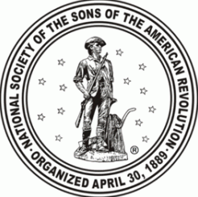
NATIONAL SOCIETY OF THE SONS OF THE AMERICAN REVOLUTION
HISTORY
Sons of Revolutionary Sires formed in 1876
Sons of the American Revolution organizes on April 30, 1889
Chartered by an Act of Congress on June 9, 1906

Slide 3
NATIONAL SOCIETY OF THE SONS OF THE AMERICAN REVOLUTION
MISSION
The Sons of the American Revolution honors our Revolutionary War patriot ancestors by promoting patriotism, serving our communities, educating and inspiring future generations about the founding principles of our Country. This is best achieved by:
REMEMBERING OUR PAST – by honoring those who served or assisted the colonies during the Revolutionary war.
PROMOTING CORE VALUES - by protecting our Constitution and perpetuating American ideals and traditions.
SHAPING YOUNG MINDS – by educating our youth about the Constitution and those who developed the American ideals and traditions.

Slide 4
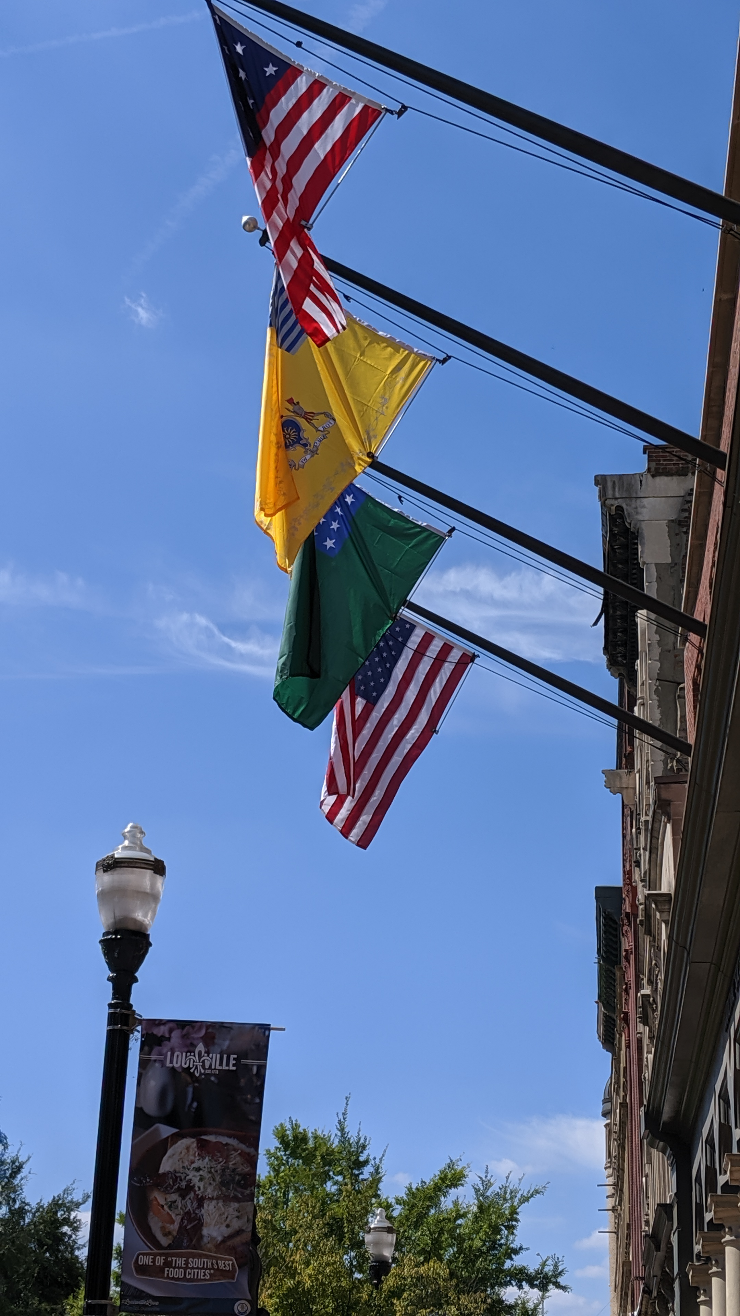
NATIONAL SOCIETY OF THE SONS OF THE AMERICAN REVOLUTION
OVERVIEW
SAR is the largest male lineage organization in the United States
Over 33,000 members in total
Consists of 50 state societies and over 590 local chapters
Several international societies including Canada, France, Spain and Germany
National headquarters in Louisville, KY

Slide 5
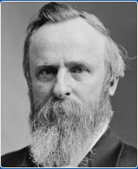
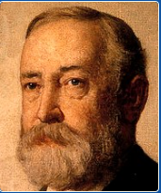
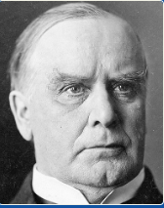
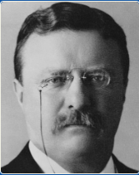
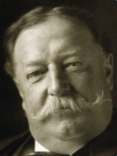
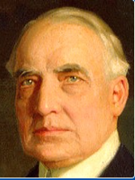
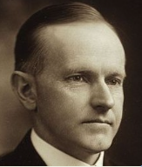
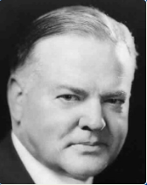
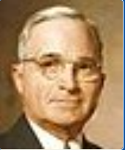
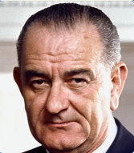
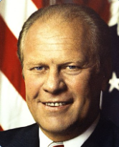
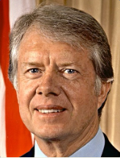
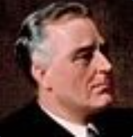
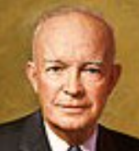
NATIONAL SOCIETY OF THE SONS OF THE AMERICAN REVOLUTION
Compatriot US Presidents
Rutherford Hayes
Benjamin Harrison
William McKinley, Jr.
Theodore Roosevelt
William Taft
Warren Harding
John Calvin Coolidge, Jr.
Herbert Hoover
Franklin
Delano Roosevelt
Dwight Eisenhower
Lyndon B. Johnson
Gerald Ford
George W. Bush
Harry Truman
James E. Carter, Jr.
George H. W. Bush

Slide 6
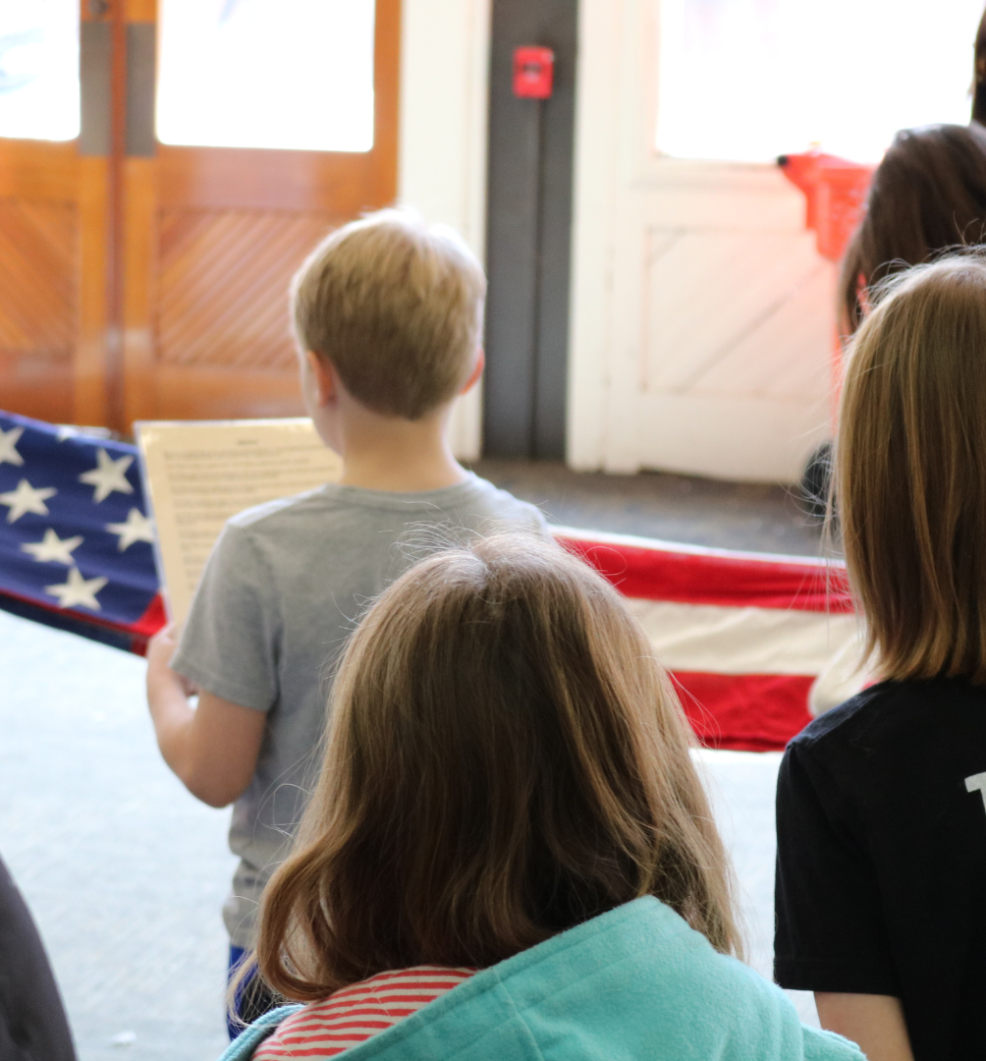
NATIONAL SOCIETY OF THE SONS OF THE AMERICAN REVOLUTION
OUTREACH AND EDUCATION
Our vision is to use our outreach programs to perpetuate knowledge of our founding documents and stories of patriotism, courage, sacrifice, tragedy, and triumph of the patriots who achieved the independence of the American people.
YOUTH AWARD PROGRAMS
The SAR Youth Award Programs operate under four main objectives:
Promote character
Increase confidence
Foster civic responsibility
Develop critical thinking skills

Slide 7
NATIONAL SOCIETY OF THE SONS OF THE AMERICAN REVOLUTION
SAR GENEALOGICAL LIBRARY
Located within National headquarters at 809 W. Main Street
Its mission is to maintain and enlarge the collection of genealogical and historical materials available for research by SAR members and the general public
Serves to reinforce the SAR Center’s educational, patriotic, and historical objectives.

Slide 8
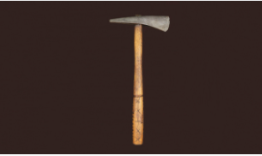
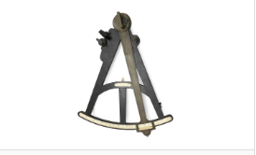
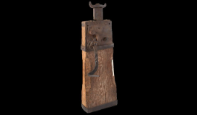
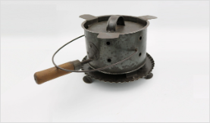
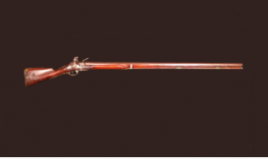
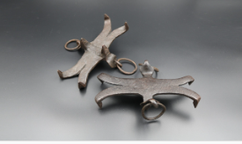
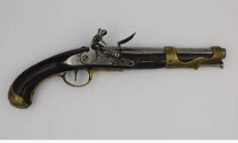
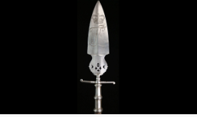
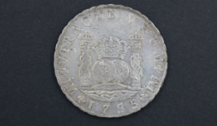
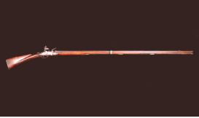
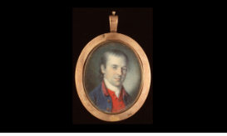
NATIONAL SOCIETY OF THE SONS OF THE AMERICAN REVOLUTION
COLLECTIONS
In 2019, the Museum Board established an Artifact Donor Program to increase the scope and quality of the SAR Museum Collection. Through donor’s generosity the program has resulted in the accession of over 350 historical artifacts.
Spiked Tomahawk
Quadrant
Wagon-Jack
Tinned-Iron Brazier
Pattern 1742 “Brown Bess” Infantry Musket
Pair of Ice Creepers
French Model 1766 Calvary Pistol
Spontoon Bearing the Cypher of Landgrave Fredrick ll of Hesse-Cassel
Spanish 8 Reales “Piece of Eight”
American Flintlock Fowler
Miniature Portrait of Dr. James Craik
Lantern

Slide 9
NATIONAL SOCIETY OF THE SONS OF THE AMERICAN REVOLUTION
EDUCATION CENTER AND MUSEUM
Will house galleries and exhibits will highlight the ideals of our patriot ancestors and tell the story of the American Revolution
Gifts of all levels will have an impact
Naming rights available

Slide 10
NATIONAL SOCIETY OF THE SONS OF THE AMERICAN REVOLUTION
JOIN TODAY!
DETERMINE ELIGIBILITY
FIND A LOCAL CONTACT
COLLECT YOUR DATA
The SAR does not restrict membership on basis of race, age, color, religion, national origin, nation of citizenship or residency.

Slide 11
NATIONAL SOCIETY OF THE SONS OF THE AMERICAN REVOLUTION

Slide 12
NATIONAL SOCIETY OF THE SONS OF THE AMERICAN REVOLUTION
Follow us on Twitter!
@SarHeadquarters
Like us on Facebook!

Slide 13
NATIONAL SOCIETY OF THE SONS OF THE AMERICAN REVOLUTION
“While I have enjoyed learning about my Patriot ancestors and honoring their service, I have also enjoyed the many new friendships I have made and I have a much keener interest in history in general and the Revolution in particular.”
– Alan Douglass Fitch, Jr.

Slide 14
NATIONAL SOCIETY OF THE SONS OF THE AMERICAN REVOLUTION
“The American Revolution was about both the pen and the sword. The SAR provides a place where I can explore the ideas that motivated my New England Yankee ancestors and think about how those ideas continue to shape a country that has made a home for my German and Norwegian emigrant ancestors and all the other people who make up our nation.”
– David Schrader (MA)

Slide 15
NATIONAL SOCIETY OF THE SONS OF THE AMERICAN REVOLUTION
QUESTIONS?

