Slide 1
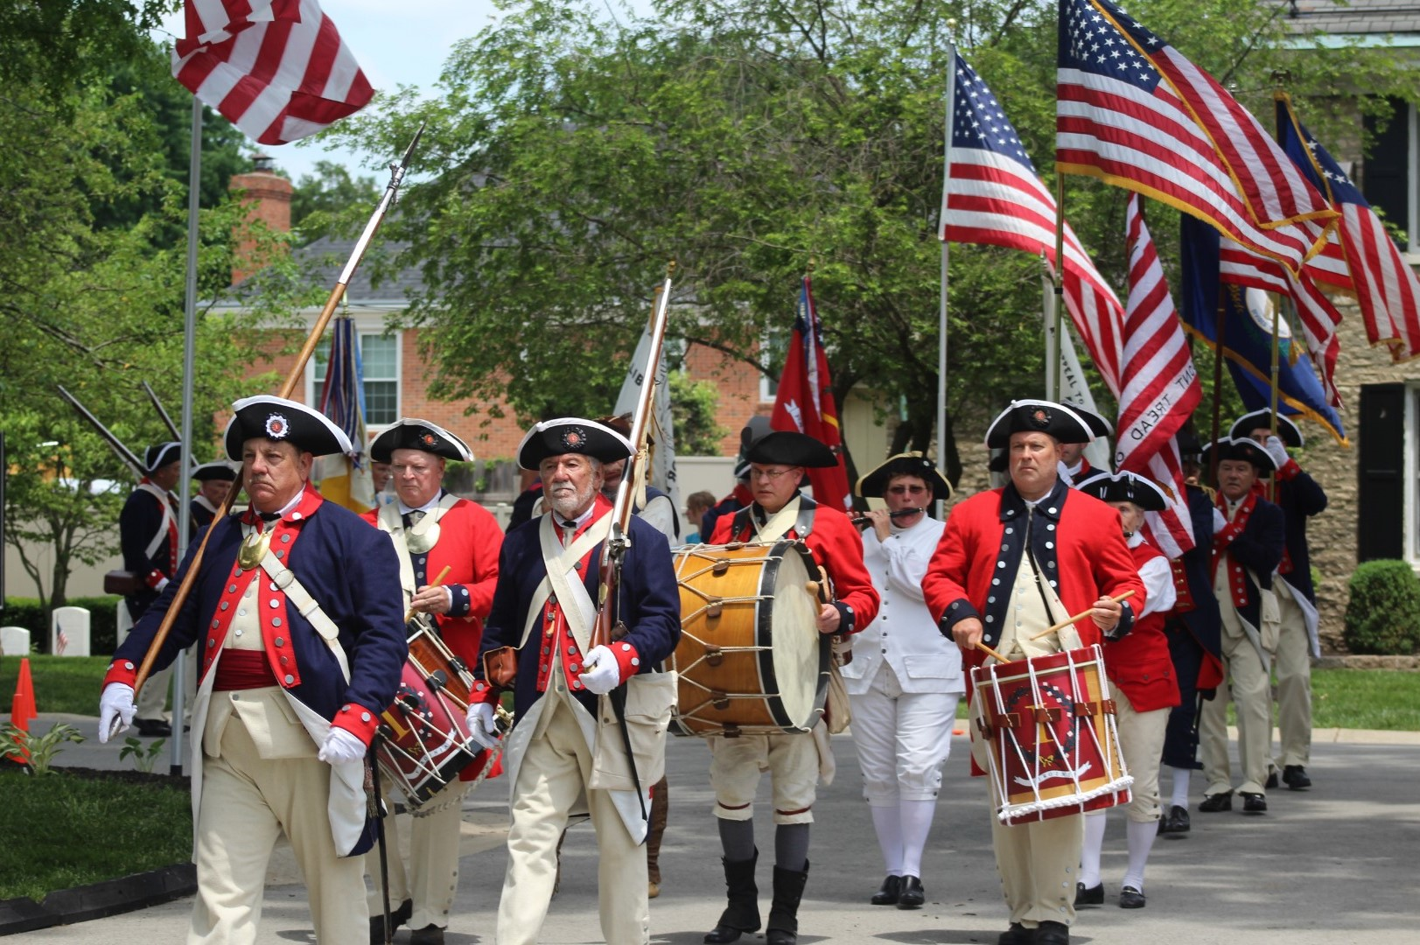
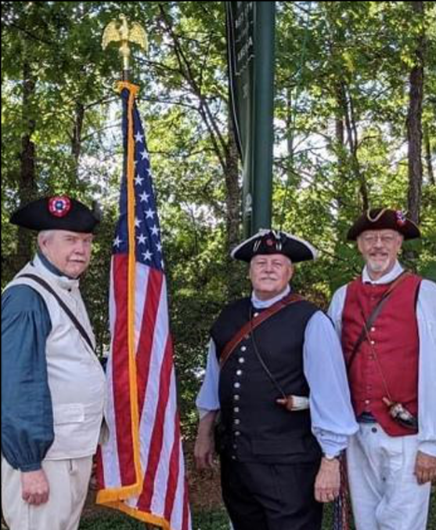
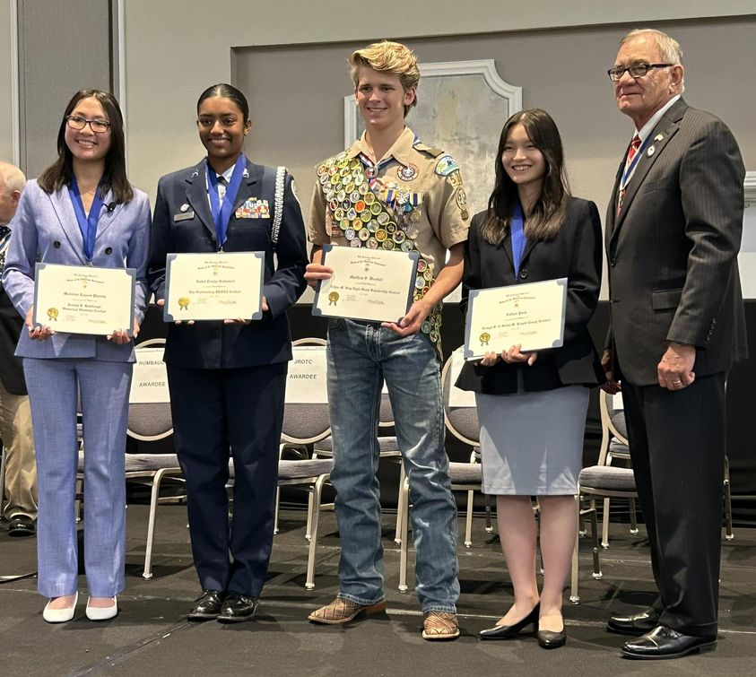
SAR Recognition Programs
The Mission of the SAR
We believe our American Story continues to be written today. We see it in and work to recognize:
Those who serve and have served in our country’s military;
First responders, who risk their lives for our safety;
Our youth leaders, including JROTC and Eagle Scouts;
Historical research, both academic and the work of students in grade and high school.
The Sons of the American Revolution honors our Revolutionary War patriot ancestors by promoting patriotism,
serving our communities,
and educating and inspiring
future generations about the
founding principles of our country.
Where does YOUR American Story Begin?
For More Information Contact
www.sar.org
:
America is about it’s people – about those who arrived from centuries past, to those arriving today, and for those yet to be born. These stories belong to all of us and need to be told.
Local Chapter Name
Website/Contact information
State Society Name
www.xxsar.org
Please visit our associated organizations:
Daughters of the American Revolution
www.dar.org
National Society of Children of the American Revolution
www.nscar.org
America 250
Notes:
Trifold Brochure Directions
Double Click on “Title of Project” to replace with your text.
You can change font, color and outline of this by using the menu bar
The numbers/descriptions of the pages are marked on the template, delete them when your brochure is complete.
Anywhere there is text, you can replace it with your text.
Text boxes that ask you to insert images can be covered with images or deleted.

Slide 2
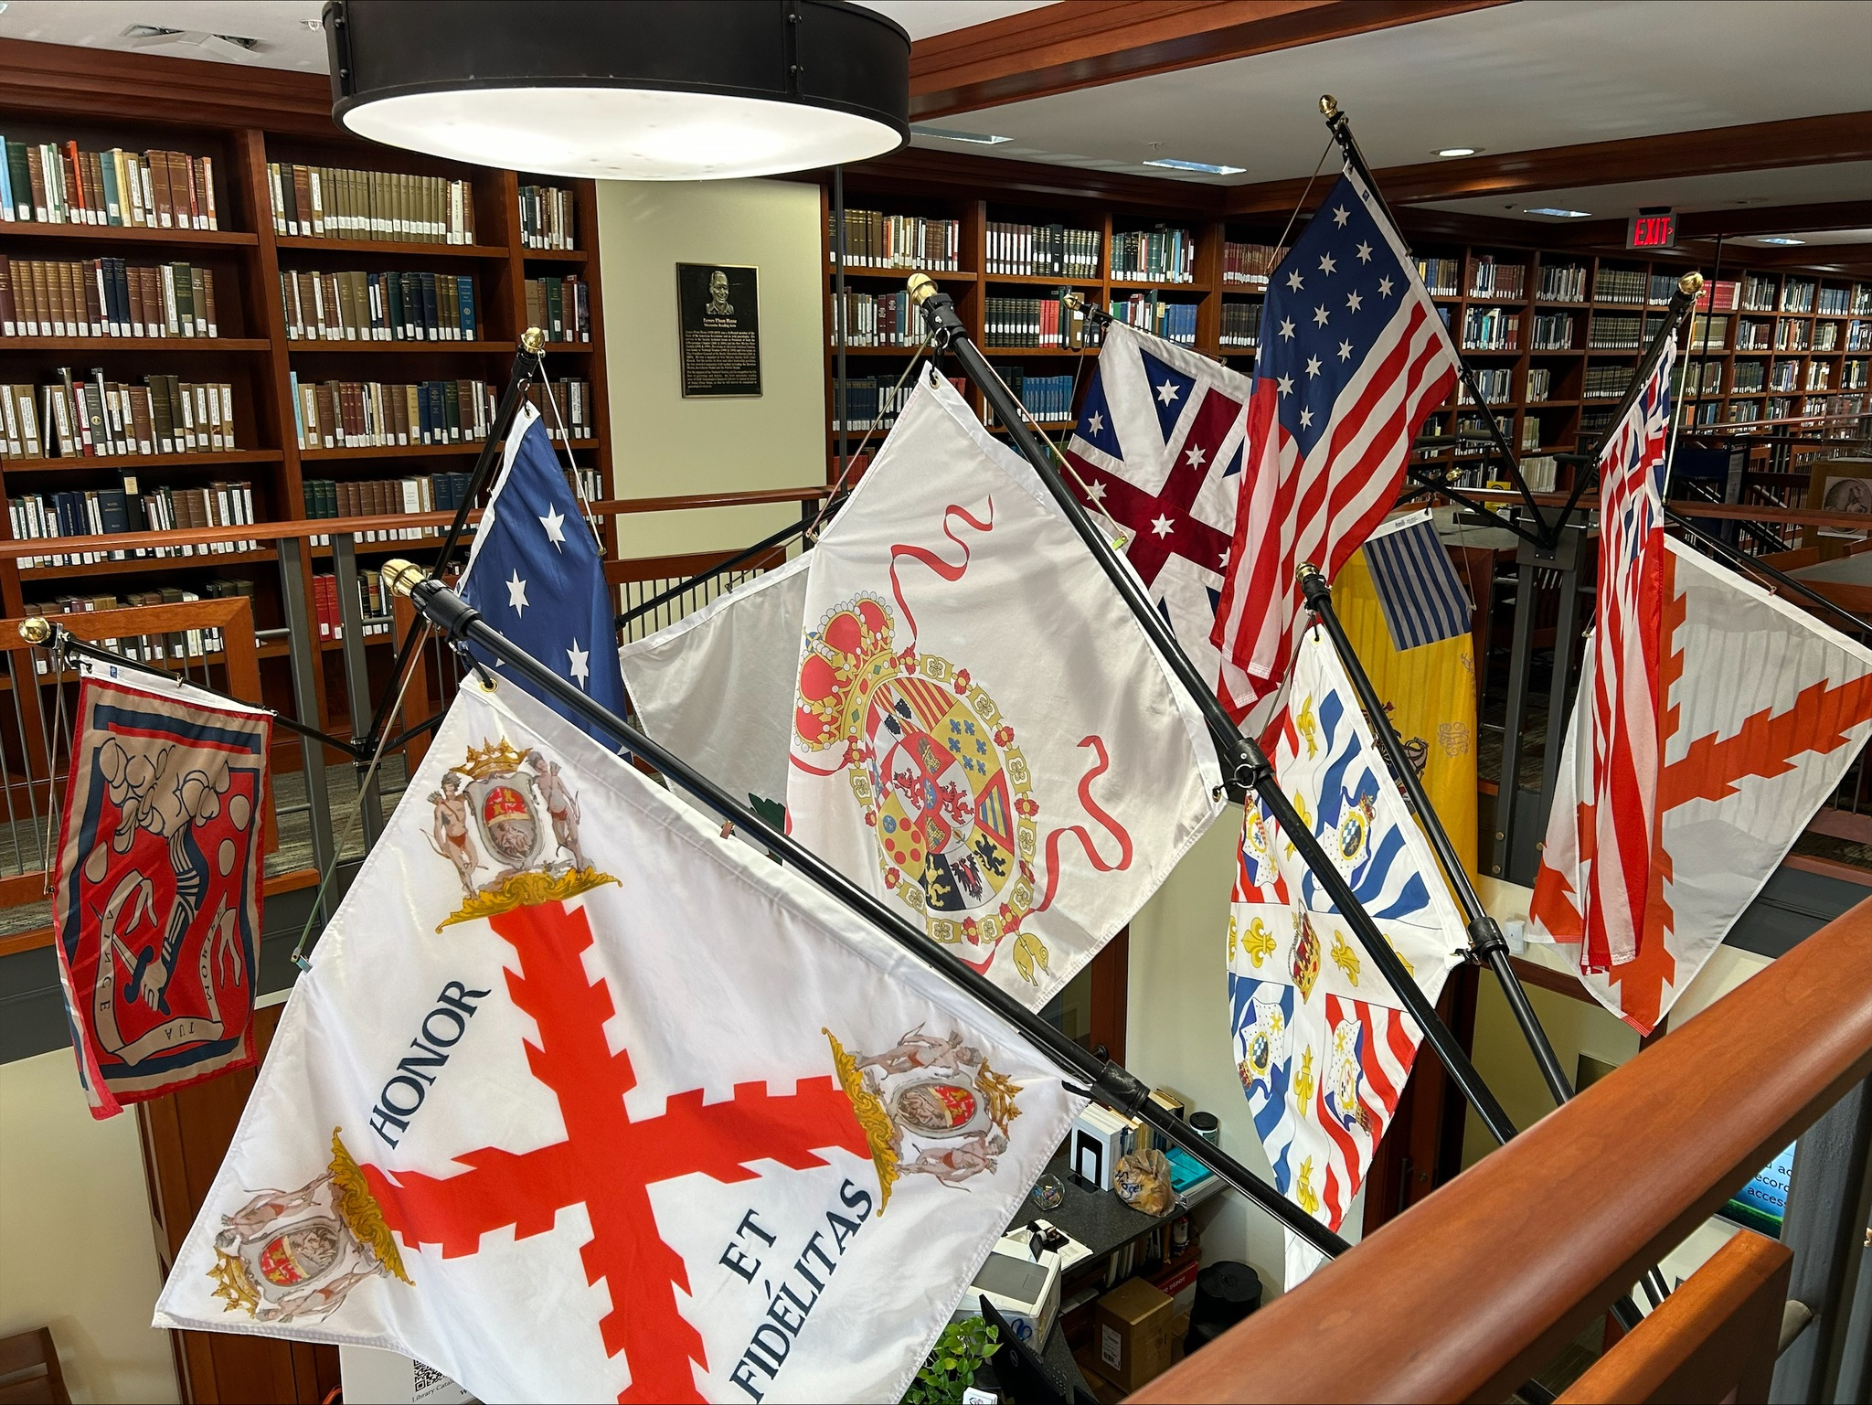
Who can join?
What does it mean to be a member?
The SAR is a "lineage" society. Mem-bers have traced their lineage back to an ancestor who supported the cause of American Independence during the years 1774-1783 through military service, financial support, or civil service. All ages are welcome to apply.
“The American Revolution was about both the pen and the sword. The SAR provides a place where I can explore the ideas that motivated my …ancestors and think about how those ideas continue to shape a country that has made a home for my .. emigrant ancestors and all the other people who make up our nation.” –
David Schrader
“While I have enjoyed learning about my Patriot ancestors and honoring their service, I have also enjoyed the many new friendships I have made and I have a much keener interest in history in general and the Revolution in particular.” – Alan Douglass Fitch, Jr.
Being a SAR member involves you in your community with the telling of the story of the making of the United States of America. It connects you directly to the history and stories of the American Revolution and to others tthat share that connection.
America is celebrating it’s 250th birthday in 2026, but the movement towards independence had started years earlier.
The events and stories of this journey – to a free Untied States- hold special significance for all Americans. We invite you to participate and share in this historic happening to join us in our celebration of America 250.
https://america250sar.org/
I’m interested - what do I do next?
Your local SAR Chapter is the best place to start. Whether you know you have a patriot ancestor – perhaps a grandparent or uncle joined the SAR – or you are curious about your ancestry, they can help you on your journey.
Many supported the colonists’ strug-gle, even if they were not from here. Many French, German, and Spanish people supported American independence and their descendants are eligible for membership.
What are some memorable events?
250 Years Ago…
2023 Boston Tea Party
2024 The First Continental Congress
2025 Battles of Lexington and Concord.
2026 Declaration of Independence
2027 Battle of Saratoga
2028 French Alliance
2029 Siege of Vincennes/Kettle Creek
2030 Battle of Kings Mountain
2031 Siege of Yorktown
2032 Battle of Blue Licks
2033 Treaty of Paris
Where are SAR chapters?
https://www.sar.org/find-your-contact/
Notes:
To Print this properly, you may need to spin everything upside down:
Click on some blank space to the right or left of the slide
press CTRL+A on the keyboard (selects everything)
Hover over the dot at the top of the whole selection (cursor will turn into a + sign when placed correctly)
Click and drag straight down and adjust (before releasing click) until you find 180 degrees.
In the Print dialogue box, UNcheck the “Fit to Page” option

