Slide 1
Postcard Project
Purpose, Target Audience (External)
Postcards are being created that help commemorate the 250th anniversary of significant events during the Decade of the Revolution. These postcards might become keepsakes.
These postcards are to be given to members of the public.
Organization
This PowerPoint is divided into three sections.
Section 1 – talks about the Why and the What.
Section 2 – discusses How a postcard is made.
Section 3 – has .jpeg images of both the front side of the postcard, as well as the back side of the postcard.
Section 3 also has images for: The Boston Tea Party, Carpenter’s Hall, and Lexington & Concord. More images will be added in the future.

Slide 2
Postcard Project – Section 1
Purpose, Target Audience (External)
Postcards are being created that help commemorate the 250th anniversary of significant events during the Decade of the Revolution. These postcards might become keepsakes.
The post cards are to be given to members of the public.
At color guard events these could be given to those who inquire or want to have their picture taken. They could also be provided when speaking to the public such as DAR, Rotary, etc.
Design Concept
Obverse Side
The message content is generally SAR contact information, the mission statement, and a brief image comment. The back side may explain a quote on the front and should be used.
Design Concept
Front Side
The design of this project is to develop postcards of each of the ten primary signature events of the Decade of the Revolution as developed by the SAR America 250th Committee.
There are multiple images offered. They either utilize SAR commissioned artwork or an image believed to be in the public domain. The images are meant to be evocative of the American Revolution. It is your choice to use the image that best fits your needs.
Occasionally there may be different options with each image.

Slide 3
Postcard Project – Section 2
How to make a Postcard
There are two basic steps to creating your postcard.
The first is you pick the reproduction medium.
The second is you select the front page and also the back side.
Reproduction Medium
You could use a vendor you can find online such as Vista Print. The other way is to print them yourself using a product such as Avery matte white postcards, 4” by 6”. Cost varies by quantity ordered and vendor selected. Time of delivery is also a consideration.
Selection of the Front and Back sides
Obviously, you select the image and the message for your target audience.
The images on this power point are jpegs. You must capture these and then upload to the vendor or copy and paste into the template space if you choose a product such as Avery.

Slide 4
Postcard Project – Section 2
Sample Front Side
Right click on the image to save as a .jpeg to your computer. Using a filename that usefully matches the image.
This applies to any of the .jpeg images in Section 3.

Slide 5
Postcard Project – Section 2
Sample Back Side
Right click on the image to save as a .jpeg to your computer. Using a filename that usefully matches the image.
This applies to any of the .jpeg images in Section 3.

Slide 6
Postcard Project – Section 3
Carpenters’ Hall
First Continental Congress

Slide 14
Postcard Project – Section 3
Boston Tea Party

Slide 17
Postcard Project – Section 3
The SAR Commissioned Art has not been developed as of this time.
Battles of Lexington and Concord

Slide 18
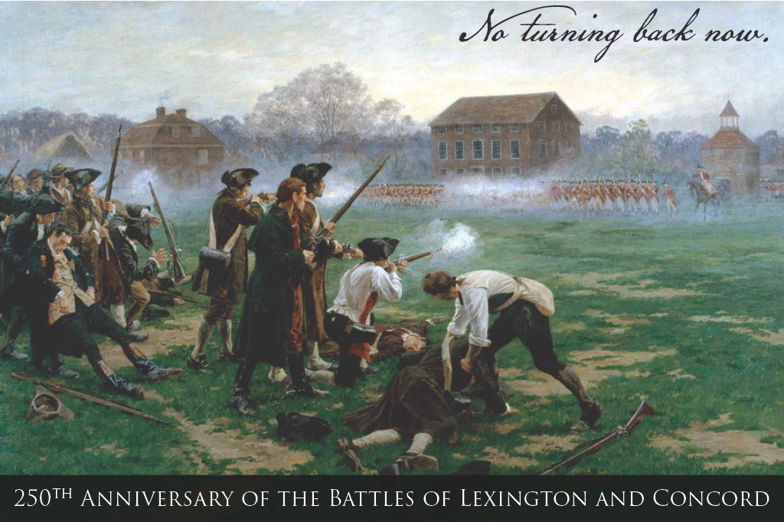

Slide 24
